Slide 1
WHO strategies to fight AMR
APEC conference
Tapei, Sept 2018
Professor Didier Pittet, MD, MS, CBE
Infection Control Programme
WHO Collaborating Centre on Patient Safety
Infection Control and Improving Practices
University of Geneva Hospitals and Faculty of Medicine, Switzerland
Lead Adviser, Save Lives: Clean Your Hands
World Health Organization (WHO) Service Delivery & Safety

Slide 2
GLOBAL ANTIMICROBIAL RESISTANCE SURVEILLANCE SYSTEM
Manual for Early Implementation
Notes:
The slides are based on the manual for early implementation and give an introduction to the methodology of the global antimicrobial resistance surveillance system (GLASS).

Slide 3
Guidance for national AMR surveillance systems
Outlines the steps in establishing a national AMR
surveillance system including the core components
Describes how to participate in global AMR surveillance, including:
enrolling in GLASS
collecting and sharing data
Suggests a set of indicators for monitoring and
evaluating a national surveillance system
3
Notes:
The GLASS manual for early implementation provides guidance for countries on the following:
It outlines 10 proposed steps for the development of a comprehensive national antimicrobial resistance surveillance system including the 3 core components, i. e. a national coordinating centre, a national reference laboratory and surveillance sites.
It describes the stepwise approach for participation in the Global Antimicrobial Resistance Surveillance System (GLASS), the requirements for GLASS enrollment and the methodology for data collection and data sharing.
It proposes a set of indicators for monitoring and evaluation of the implementation status of a national antimicrobial resistance surveillance system.

Slide 4
Manual contents
Introduction
Background
Global Antimicrobial Resistance Surveillance System (GLASS)
Objectives of GLASS
Road map
4
Notes:
The following slides summarise the content and the annexes of the GLASS manual for early implementation.

Slide 5
Manual contents
Surveillance methods
Routine surveillance and case-finding based on routine clinical samples of priority specimen types
The priority pathogen-antibacterial combinations on which GLASS will gather data
The priority specimen types to be analysed
5

Slide 6
Manual contents
Participation in GLASS
How to enroll
Requirements for participation
Proposed steps in setting up a national
AMR surveillance system
Collecting, managing, analysing and reporting data
How WHO is supporting GLASS activities and capacity-building
6

Slide 7
Manual annexes
Annex 1
Surveillance approaches
Annex 2
Information to be collected routinely at points of care on all clinical samples sent for bacteriological culture and testing for susceptibility to antimicrobial agents
Annex 3
Structure for reporting aggregated data by a national coordinating centre
Annex 4
Sample indicators for monitoring and evaluating implementation of GLASS
Annex 5
Document review group
7
Notes:
The annexes describe different surveillance approaches in more detail, give samples for data structure and collection on the local and national level, and provide a set of sample indicators for monitoring and evaluating implementation of GLASS.

Slide 8
Introduction
Background
WHO Global Action Plan on Antimicrobial Resistance
Adopted at the Sixty-eighth World Health Assembly, May 2015
Goal is to ensure continuity
of successful prevention and
treatment of infectious diseases
Five strategic objectives
8
Notes:
The WHO Global Action Plan was adopted at the Sixty-eighth World Health Assembly in May 2015. The goal of the global action plan is to ensure, for as long as possible, continuity of successful treatment and prevention of infectious diseases with effective and safe medicines that are quality-assured, used in a responsible way, and accessible to all who need them. The following slide shows the 5 strategic objectives of the global action plan on antimicrobial resistance.

Slide 9
Introduction
Background
WHO Global Action Plan on Antimicrobial Resistance
Five strategic objectives
Improve awareness and understanding
Strengthen the knowledge and evidence base through surveillance and research
Reduce the incidence of infection
Optimize the use of antimicrobial medicines
Develop the economic case for sustainable investment
9

Slide 10
Introduction
Background
Member States request to WHO
(WHA Resolution WHA68.7)
“…develop and implement an integrated global program for surveillance of antimicrobial resistance across all sectors…”
10
Notes:
In addition to the adaptation of the global action plan Member States requested WHO to develop and implement an integrated global program for surveillance of antimicrobial resistance across all sectors reinforcing the “One Health” approach of the global action plan.

Slide 11
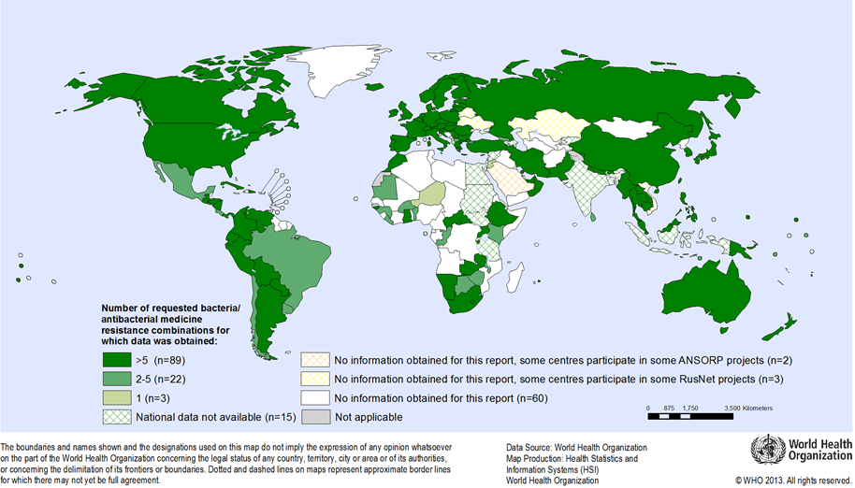
Introduction
Background
Available National Data* on Resistance for 9 AMR indicators, 2013
*National data means data obtained from official sources, however data may not necessarily be representative for the entire population or country
11
Notes:
WHO published 2014 a global report on surveillance. This map shows an overview of the responses regarding resistance data
from the Member States:
129 countries responded and 114 returned at least some data on at least one of the 9 requested bacteria–antibacterial drug indicator combinations.

Slide 12
Introduction
Background
Key points
High proportions of resistance
% of resistance among tested isolates
Significant gaps
No global system on surveillance of
antibacterial resistance (ABR)
Lack of harmonized standards,
data sharing, and coordination
12
Notes:
Key findings were high proportions of resistance reported from all WHO regions. Most data compiled for the report present proportions of resistant bacteria among tested isolates. This allows to measure trends over time but does not provide the necessary information on the impact of antimicrobial resistance on the population.

Slide 13
Introduction
Background
Process of GLASS development
Collaboration
WHO collaborating centres
International and regional networks
Partners
Consultation with 30 Member States hosted by Sweden, Stockholm, 2-3 Dec 2014
International collaboration to build
global AMR surveillance capacity
13
Notes:
The development of a global antimicrobial surveillance system builds on previous consultations and meetings such as 1st Technical Meeting on Strategies for global surveillance of antimicrobial resistance in December 2012 and 2nd Technical Consultation on Global Surveillance of Antibacterial Resistance in Humans in March 2014 as well as strong collaboration with WHO collaborating centres, regional and international networks and other partners.
In December 2014, Sweden hosted a meeting on AMR surveillance for local and global action with representatives from 30 Member states from all WHO regions committed to build global surveillance capacity and a global AMR surveillance system.

Slide 14
Introduction
GLASS
Guiding principles
Strengthen national AMR surveillance systems
Coordinated within the national action plan on AMR
Built upon existing surveillance structures and networks
Collect epidemiological, clinical and microbiological data
Stepwise approach to meet local and global priorities
GLASS early implementation focus on bacterial pathogens
Routine surveillance in humans
Progressive link to other types of AMR-related surveillance
(e.g. food chain, veterinary, antimicrobial use, environment)
14
Notes:
The key to implement global AMR surveillance is to support and strengthen national AMR surveillance systems and to build upon existing surveillance structures and networks. National AMR surveillance should be coordinated within the national action plan or strategy on AMR. GLASS collects and links epidemiological, clinical and microbiological data on AMR markers.
It is recognized that national surveillance systems will vary in levels of development and scale. Flexibility has therefore been built into the system. This will enable each country to participate from the outset while implementing and strengthening the core components of a national AMR surveillance system with the aim of generating high-quality data to meet both national needs and GLASS requirements. As an example, once enrolled, countries may start reporting to GLASS on the status of implementation of the surveillance system prior to sending actual AMR data. Countries that produce data on any one of the AMR markers described in the GLASS manual, can also submit these data even if they lack data on other AMR markers. Countries can then progressively build capacity to share data on other markers.
The early implementation focus on priority bacterial pathogens isolated from humans and in which antimicrobial resistance is perceived as major threat globally and explores the progressive link to other types of AMR-related surveillance.

Slide 15
Introduction
Objectives of GLASS
Primary objectives
Support national AMR surveillance systems
Harmonize global standards
Estimate burden of AMR globally
Analyse and report global data
Detect emerging resistance and its spread
Inform targeted prevention and control programmes
Assess impact of interventions
15
Notes:
The primary objectives outlined in the manual are the following:
Support national AMR surveillance systems and harmonize global standards
Estimate the extent and burden of AMR globally by selected indicators
Analyse and report global data on a regular basis
Detect emerging resistance and its international spread
Inform implementation of targeted prevention and control programmes and
Assess the impact of interventions.

Slide 16
Introduction
Objectives of GLASS
Secondary objectives
Improve patient safety by
Optimizing diagnostic practices (diagnostic stewardship)
Promoting responsible use of antimicrobial agents
Ensuring quality-assured, standardized identification of bacteria and antimicrobial susceptibility testing (AST)
Promoting use of local data as basis for treatment guidelines
16
Notes:
The surveillance standards and methodology proposed in GLASS may also improve patient management and safety by optimizing diagnostic practices and by ensuring bacterial identification and antimicrobial susceptibility testing according to internationally recognized standards. Therefore the approach promotes responsible use of antimicrobial agents. Locally generated data may be used as basis for treatment guidelines.

Slide 17
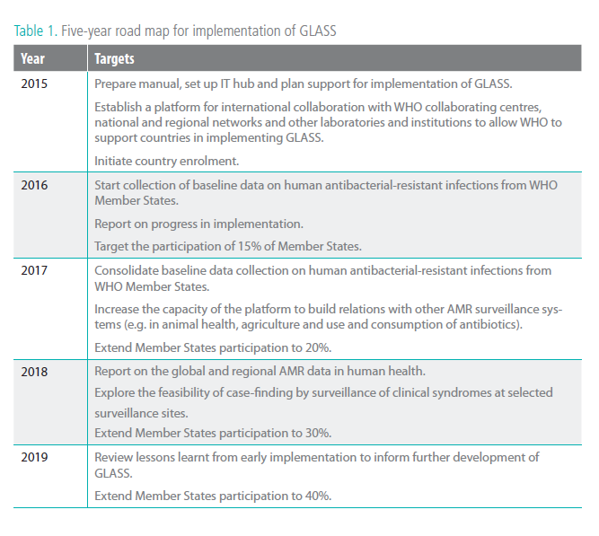
Introduction
Road map
17
Notes:
Early implementation will cover the period 2015-2019 with enrollment of Member States starting by 2016.

Slide 18
Surveillance methods
Surveillance and case-finding through
routine clinical sampling of priority specimen types
Priority pathogen-antibacterial combinations on which GLASS will gather data
Priority specimen types to be assessed
18
Notes:
The following slides describe the GLASS approach and methodology in detail including the proposed priority specimens, pathogens and pathogen-antibacterial combinations under surveillance in GLASS.

Slide 19
Surveillance methods
Routine surveillance and case-finding based on routine clinical samples of priority specimen types
Case-finding
Through routine clinical sampling
Clinical, microbiological and epidemiological data
Surveillance targets
All patients sampled for prioritized specimens
with growth of priority species
All patients sampled for prioritized specimens
19
Notes:
Case-finding during the early implementation phase is based on routine surveillance in clinical samples sent to the laboratory for antimicrobial susceptibility testing. Clinical, microbiological and epidemiological data will be collected and linked.
Data collection will include all patients for which any of the prioritized specimens were sent to the laboratory and in which any of the priority species were identified. In addition data collection aims to include data from all patients for which any of the priority specimens were sent to the laboratory with the request for pathogen identification, including both negative and positive results.
The priority specimens are blood, urine, stool and urethral and cervical swabs as these specimens represent infections in the bloodstream, urinary tract, gastrointestinal tract and gonorrhoea.

Slide 20
Surveillance methods
Routine surveillance and case-finding based on routine clinical samples of priority specimen types
Core patient data collected at surveillance site
Age
Gender
Type of health-care facility where specimen was collected
Hospital/in-patient
patient admitted for >2 calendar days
Community/out-patient
patient at outpatient clinics or patient in hospital ≤ 2 calendar days
20
Notes:
Stratification of antimicrobial resistance data will be by the listed variables. Age is categorized according to age groups in the Global Health Observatory.
The definition of hospital/other type of in-patient care facility: patient admitted for >2 calendar days when the specimen was taken or admitted to the health care facility for < 2 calendar days but transferred from another health care facility where he or she was admitted for ≥ 2 calendar days.
The definition for community/out-patient is patients cared for at outpatient clinics or patients in hospital for ≤ 2 calendar days when the specimen was taken.

Slide 21
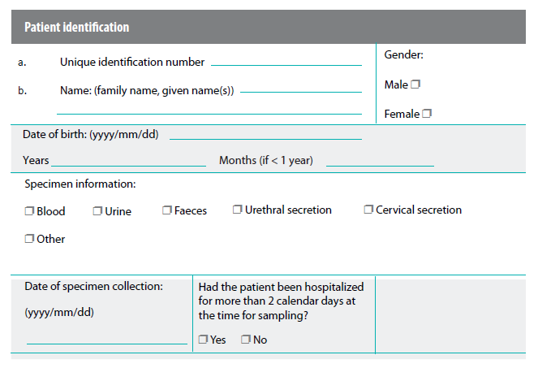
Surveillance methods
Routine surveillance and case-finding based on routine clinical samples of priority specimen types
Sample of data collection form for patient data
at surveillance site (see manual annex 2)
Same information could be collected in digital format
21
Notes:
This is a sample form that should accompany a sample sent to the laboratory with the request for pathogen identification and antimicrobial susceptibility testing including essential information. Depending on hospital information system the information could be entered and collected in digital format.

Slide 22
Surveillance methods
Routine surveillance and case-finding based on routine clinical samples of priority specimen types
Population and denominator data
At national level
Total national population
At surveillance site level
Number of patients seeking care at surveillance site over surveillance period
Number of all patients with specimens sent for bacterial identification and antimicrobial susceptibility testing
22
Notes:
In order to estimate the population affected and the extent of antimicrobial resistance in the population some basic demographic and epidemiological information will be requested by GLASS. This information includes the total national population figures collected from official statistics. Basic denominator data such as number of patients seeking care at surveillance site (e.g. bed occupancy rate, patient days, number of consultations) over the surveillance period (e. g. 12 months) should be collected.
In addition the number of all patients with positive and negative cultures per specimen type and with susceptible and non-susceptible pathogens for each priority pathogen-antibiotic combination per specimen type according to core patient data (age, gender, type of healthcare facility where specimen was collected) should be collected and reported.

Slide 23
Surveillance methods
Routine surveillance and case-finding based on routine clinical samples of priority specimen types
Removal of duplicate results (de-duplication)
Removal of duplicate findings (de-duplication) at surveillance site or national level
Period for national surveillance
Continuous surveillance
Aggregate data at national level for each surveillance period
23
Notes:
Duplicate findings for the same patient should be excluded. De-duplication of repeated results within a surveillance period, e. g. 12 months, can be performed at surveillance site or at national level (requirement line-level data with unique identifier for each patient).
The surveillance should be continuous and aggregated at national level every 12 months and according to national surveillance schedule respectively.

Slide 24
Surveillance methods
Routine surveillance and case-finding based on routine clinical samples of priority specimen types
Reporting to WHO
Implementation status of national AMR surveillance system
Aggregated national data
New resistance mechanisms after confirmation and reporting to national authorities
Feedback
Regular update on IT platform
Regular publication of global report on AMR
24
Notes:
Countries will share data on the progress of implementation status of national antimicrobial resistance surveillance systems and upload annual aggregated national data to the GLASS IT platform. WHO should be informed also on newly detected resistance mechanisms after confirmation and reporting to the respective national authorities.
Individual data reports for countries are being implemented in the GLASS IT platform and WHO will publish regular reports on the global antimicrobial resistance situation.

Slide 25
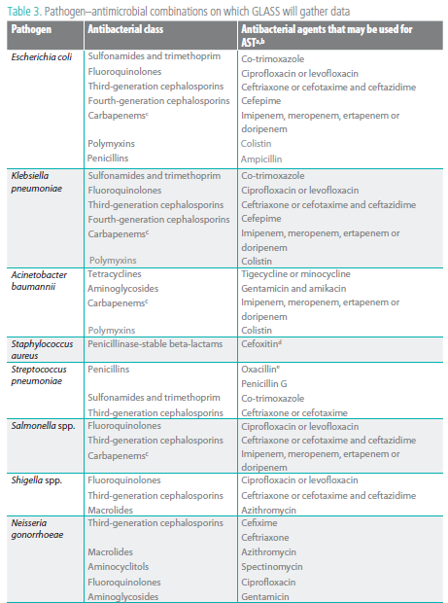
Surveillance methods
Priority pathogen-antibacterial combinations on which GLASS will gather data
25
Notes:
GLASS collects data on the following pathogen-antibacterial combinations.

Slide 26
Surveillance methods
Priority pathogen-antibacterial combinations on which GLASS will gather data
26
Notes:
GLASS collects data on the following pathogen-antibacterial combinations.

Slide 27
Surveillance methods
Priority pathogen-antibacterial combinations on which GLASS will gather data
27
Notes:
GLASS collects data on the following pathogen-antibacterial combinations.

Slide 28
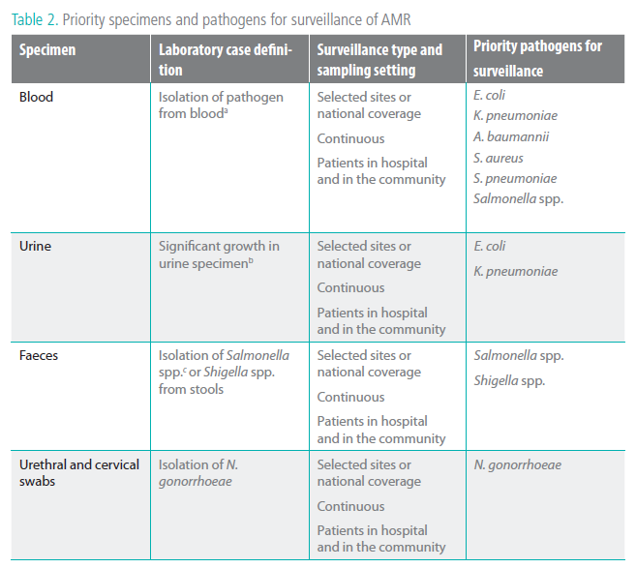
Surveillance methods
Priority specimen types to be assessed
28
Notes:
The table lists all priority specimens and priority pathogens under surveillance in GLASS. The rationale for the priority specimens and pathogens is to cover community and hospital infections caused by pathogens in which antimicrobial resistance is considered of greatest threat globally and to include also common indicators used in foodborne antimicrobial resistance surveillance.

Slide 29
Surveillance methods
Priority specimen types to be assessed
29
Notes:
The table lists all priority specimens and priority pathogens under surveillance in GLASS. The rationale for the priority specimens and pathogens is to cover community and hospital infections caused by pathogens in which antimicrobial resistance is considered of greatest threat globally and to include also common indicators used in foodborne antimicrobial resistance surveillance.

Slide 30
Surveillance methods
Priority specimen types to be assessed
Rationale
Focus in the early implementation phase on defined priorities
Specimen type as proxy for infection (e.g. blood for bloodstream infections)
Countries can participate in GLASS providing information on some of the combinations
National surveillance should cover specimens and combinations according to their priorities
30
Notes:
At the early implementation phase GLASS focus on defined priorities. Priority specimens serve as proxy for infections and represent common infections in the hospital and the community. In addition to GLASS priorities national antimicrobial resistance surveillance system may choose a more comprehensive approach according to national needs and priorities.

Slide 31
Participation in GLASS
Enrolment
Requirements for participation
Proposed steps in setting up a national AMR surveillance system
Collection, management, analysis and reporting of data
WHO support for GLASS activities and capacity-building
31
Notes:
The next section covers the requirements and procedures for participation as well as the support for GLASS activities and capacity building provided by WHO.

Slide 32
Participation in GLASS
Enrolment
Key points
Open call for enrolment for countries on WHO website
http://www.who.int/drugresistance/surveillance
Enrolment in stepwise manner
Build on existing surveillance systems and networks
System is flexible to account for differences in surveillance systems (e.g. methodology, stage of development)
Capacity-building tools are provided (e.g. IT tools)
For enrolment and any related questions please contact the GLASS Secretariat glass@who.int
32
Notes:
An open call for enrolment is published on the WHO website. The GLASS system accounts for different stages of national antimicrobial resistance surveillance systems. The system is flexible and implementation should build on already existing surveillance systems and structures. WHO provides tools and materials to support GLASS implementation. These will be avilable on the GLASS website and through the GLASS secretariat. Please contact the secretariat for enrollment and any related questions.

Slide 33
Participation in GLASS
Requirements for participation
Member States participating in GLASS are requested to have/establish
A national coordinating centre (NCC)
A national reference laboratory
Surveillance site(s)
33
Notes:
The 3 proposed core components for GLASS participation of national antimicrobial resistance surveillance systems are a national coordinating centre, a national reference laboratory and at least one surveillance site. Their roles and responsibilties are outlined in the following slides.

Slide 34
Participation in GLASS
Requirements for participation – NCC I
Roles and responsibilities of national coordinating centre (NCC)
Defines AMR surveillance objectives within national strategy
Defines implementation strategy for standards proposed by GLASS
Identifies a focal point for communication with WHO
Monitors and evaluates national surveillance system
Selects and enrolls surveillance site(s) within country
Prepares and coordinates dissemination of national protocols
Coordinates data collection, analysis and reporting
Reports national aggregated data to WHO
Supports NRL and AMR surveillance sites with guidance for data collection and reporting
Links to or coordinates AMR surveillance across human health, animal health and environmental sectors
34
Notes:
The national coordinating centre defines the objectives of the national antimicrobial resistance surveillance system as part of the national strategy on antimicrobial resistance and develops and implements a strategy for implementation of surveillance standards proposed by GLASS.

Slide 35
Participation in GLASS
Requirements for participation – NRL
Roles and responsibilities of national reference laboratory (NRL)
Liaises with the NCC
Develops, maintains and shares relevant reference material
Provides guidance and technical support to quality management including participation in external quality assurance schemes
Defines isolates to be sent to NRL for further testing (including identification of resistance mechanisms)
Collaborates with regional NRLs for capacity building and exchange of best practice examples
35
Notes:
The national reference laboratory liaise with the national coordinating centre in standardizing and verifying microbiological results and agrees on reporting routines. It serves as a resource and coordination point for laboratory expertise and shares information and advice with relevant stakeholders.

Slide 36
Participation in GLASS
Requirements for participation –
AMR surveillance sites
Roles and responsibilities of AMR surveillance sites
Collect and report data for local, national and global AMR surveillance
Report data to NCC on antimicrobial susceptibility testing results and minimal core patient data from tested clinical specimens and basic demographic population data
36
Notes:
The participating surveillance sites are responsible for data collection and reporting to the national coordinating centre acording to surveillance standards and protocols. The data combines laboratory, clinical and epidemiological information.

Slide 37
Participation in GLASS
Requirements for participation –
AMR surveillance sites
Epidemiological capacity at AMR surveillance sites
Personnel trained to collect, analyse and report epidemiological, clinical and laboratory data
Basic demographic data from population
Data management capacity (manual or IT based)
Produce timely reports on a regular basis according to standards
37
Notes:
The required capacities of the participating surveillance sites include epidemiological, laboratory and clinical capacity. Adequate training and education are essential to collect, analyse and report the data. Data management capacity facilitates the process and ensures timely reporting on a regular basis according to surveillance standards and protocols.

Slide 38
Participation in GLASS
Requirements for participation –
AMR surveillance sites
Laboratory capacity at AMR surveillance sites
Personnel trained to recognize and raise alert to unusual findings
Quality management recognized by the NRL to ensure accuracy, reliability and timeliness of reported laboratory results
Quality control according to WHO manuals and CLSI or EUCAST guidelines
Participation in proficiency testing scheme recognized by the NRL
Testing of susceptibility to newly introduced drugs, to ensure emerging resistance is identified
38
Notes:
Continuous education and training of laboratory personnel is important and should include training on recognizing and raising alerts in the case of unusual finding. Quality control for all aspects of laboratory testing to identify pathogens and detect resistance according to WHO manuals and CLSI or EUCAST guidelines may be supported by the national reference laboratory. It is recommended that laboratories perform susceptibility testing for newly introduced drugs in order to identify emerging resistance timely.

Slide 39
Participation in GLASS
Requirements for participation –
AMR surveillance sites
Laboratory capacity at AMR surveillance sites
Surveillance sites linked to laboratory
Sampling processing, species identification and antimicrobial susceptibility testing according to good laboratory practice and internationally recognized standards
Minimum inhibitory concentration and inhibition zone diametres collected at national level
Personnel trained to recognize and raise alert to unusual findings
Quality management recognized by the NRL to ensure accuracy, reliability and timeliness of reported laboratory results
Quality control according to WHO manuals and CLSI or EUCAST Participation in proficiency testing scheme recognized by the NRL
Testing of susceptibility to newly introduced drugs, to ensure emerging resistance is identified
39
Notes:
The surveillance site may have a laboratory on site or is linked to a laboratory with the capacity to identify pathogens and perform antimicrobial susceptibility testing. The sampling processing and species identification follows good laboratory practice and antimicrobial susceptibility testing is according to internationally recognized standards. Although WHO collects susceptibility data categorized as “susceptible”, “intermediate” and “resistant” only, it is recommended to collect the minimum inhibitory concentration and inhibition zone diametres at national level for quality control.

Slide 40
Participation in GLASS
Requirements for participation –
AMR surveillance sites
Diagnostic stewardship
Integral part of clinical management and standardized surveillance
Can improve the quality of surveillance
Leads to coordinated guidance to improve appropriate use of microbiological diagnostics
Is dependent upon effective communication between clinicians and laboratories
Promote appropriate, timely diagnostic testing, collection and identification of specimens
Promote accurate, timely reporting of results to guide patient treatment
40
Notes:
The early implementation of GLASS focus on case-finding based on clinical samples from patients sent routinely from participating surveillance sites to laboratories according to local guidelines and practices. The quality of surveillance based on routine data can be improved by diagnostic stewardship, which is an integral part of both clinical management and standardized surveillance. Diagnostic stewardship is defined as coordinated guidance and interventions to improve appropriate use of microbiological diagnostics and guide clinical management.
Clinicians should be given timely, systematic guidance/training in conducting diagnostic activities to minimize sampling bias due to variations in samples sent for antimicrobial susceptibility testing (AST). They should complete a standard form containing patient data accompanying every sample sent for AST.
Laboratories should support clinicians in diagnosing infectious disease syndromes, in choosing the best therapeutic option and provide assistance in detecting new types of antimicrobial resistance and outbreaks.

Slide 41
Participation in GLASS
Proposed steps in setting up a national AMR surveillance system
Establish a national AMR surveillance coordinating body with
a focal point and a data management structure
Define the surveillance objectives to
assist the planning and monitoring of the national strategies to control AMR
inform global efforts to control AMR
Define a strategy for gradual implementation of the national surveillance system and participation in GLASS
Establish at least one national reference laboratory that participates in an external quality assurance scheme
Develop or adapt national protocols for
data collection (see manual annexes 2 and 3)
laboratory protocols
diagnostic stewardship
data flow
41

Slide 42
Participation in GLASS
Proposed steps in setting up a national AMR surveillance system
Disseminate protocols and tools, and train staff in their use
Identify AMR surveillance sites, that have access to
epidemiological support and a microbiology laboratory, and promote diagnostic stewardship
Start collecting data on progress or status of implementation and on AMR
Report information on the AMR situation to inform the
national strategy, and report aggregated data to GLASS to inform global strategies
Ensure that monitoring and evaluation include pilot-testing of any new surveillance approach, a review of steps, and adjustment of processes as necessary
42

Slide 43
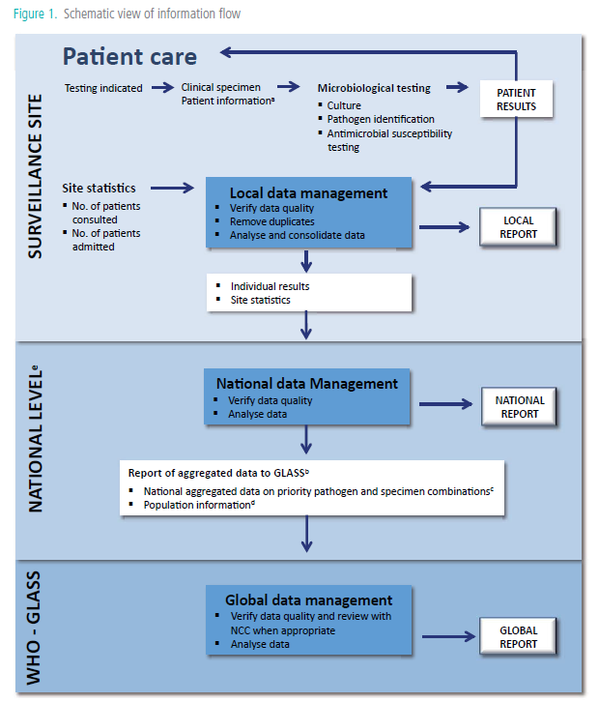
Participation in GLASS
Collection, management, analysis and
reporting of data
Core patient information
age
gender
Specimen
date of specimen collection
hospital or community origin
Structure for reporting aggregated data at country level given in Annex 3.
Priority pathogen-specimen combinations are listed in Tables 2 and 3.
Population information as described in 2.1.1.
National level includes the national surveillance coordinating centre and the national reference laboratories.
Notes:
The schematic data flow gives an overview of data collection at local and national level, including data structure and reporting.

Slide 44
Participation in GLASS
Collection, management, analysis and
reporting of data
Collection and management of data at local AMR surveillance sites
Clinicians collect and send samples for culture and antimicrobial susceptibility testing to laboratory
Core patient data accompanying laboratory request
Age, gender, specimen type, date of sampling, hospital or community origin
Enter and manage data in data management software, e.g. WHONET
Surveillance sites without data management software use paper form
Remove duplicates (locally or NCC)
Check data quality before submission to NCC
44
Notes:
Core patient information will be collected at surveillance sites. Data quality check and removal of duplicates may take place locally and/or at the national coordinating centre.

Slide 45
Participation in GLASS
Collection, management, analysis and
reporting of data
Collection and management of data at national level
Check data quality
Remove duplicates (NCC or locally)
Aggregate data before submission to GLASS
Submit aggregated AMR data and data on implementation status of national surveillance system to GLASS electronically
In addition to data set for GLASS submission a more comprehensive approach is recommended at country level according to national priorities/objectives
45
Notes:
Data aggregated at national level is uploaded to the GLASS IT platform for data management and data sharing. In addition countries report data on the implementation status of the national antimicrobial resistance surveillance system. The GLASS early implementation phase focus on priority specimens, pathogens and combinations, however a more comprehensive approach for the national antimicrobial resistance surveillance system is recommended according to national priorities.
The potential benefits of a comprehensive approach may include the characterization of frequency of resistance, organisms and, when available, antimicrobial agents used in different facilities and regions. Information is collected on emerging public health threats and on the geographical spread of priority pathogens and phenotypes in the country and identification of community and healthcare-associated outbreaks. The assessment of the performance of participating facilities and mentoring for optimal analysis and presentation of results is supported. With a comprehensive approach national standard treatment guidelines can be evaluated and optimized. This approach also facilitates the detection of first appearance and spread of newly emerging resistance patterns, which should be reported to GLASS, particularly if any of the priority pathogens shows resistance to all antimicrobial agents.

Slide 46
Participation in GLASS
Collection, management, analysis and
reporting of data
Which data to be reported to WHO
Progress in implementing the national AMR surveillance system
Aggregated AMR data of priority pathogens as defined by GLASS
Unusual types of AMR after confirmation and reporting to relevant national authority
46
Notes:
Countries may start reporting to GLASS on the status of implementation of the surveillance system prior to sending actual antimicrobial resistance data. Furthermore, countries that produce data on any one of the antimicrobial resistance markers described in the GLASS manual, can also submit these data even if they lack data on other antimicrobial resistance markers. Countries can then progressively build capacity to share data on other markers.
Unusual types of antimicrobial resistance should be reported to WHO only after confirmation and report to the relevant national authority.

Slide 47
Participation in GLASS
Collection, management, analysis and
reporting of data
Examples of data to be reported to WHO
Progress in implementing the national surveillance system
Presence of a national coordinating centre (NCC)
Presence of a national focal point (NFP)
Presence of a national reference laboratory (NRL)
Number of AMR surveillance sites
47

Slide 48
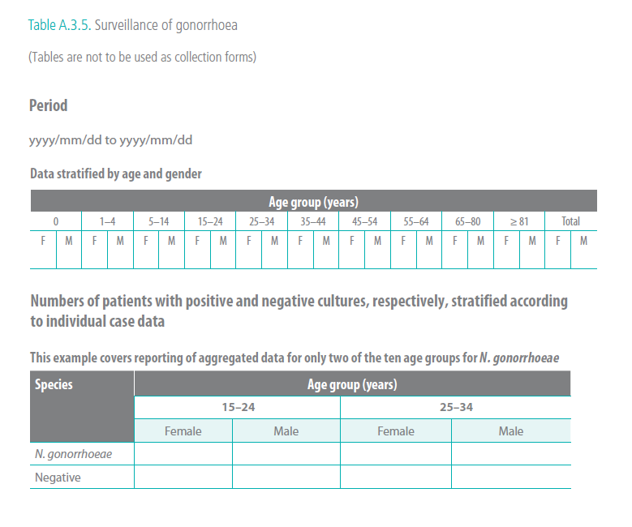
Participation in GLASS
Collection, management, analysis and
reporting of data
Examples of data to be reported to WHO
Note: Table illustrate the structure of aggregated data to be collected and is not to be used as collection form; other tools (e. g. WHONET application, specification of export files) are provided for this purpose.
48
Notes:
The tables on the following 2 slides illustrate the structure of aggregated data and are not intended to be used for data collection. WHO will provide other tools for this purpose. This table shows the data stratified by age group and gender for patients with positive and negative cultures.

Slide 49
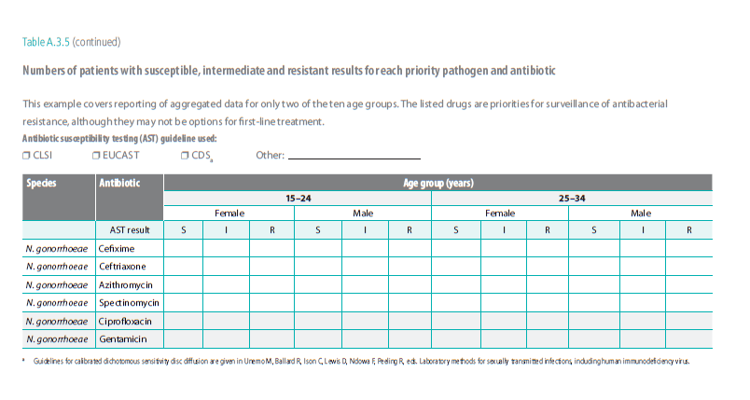
Participation in GLASS
Collection, management, analysis and
reporting of data
Examples of data to be reported to WHO
Note: Table illustrate the structure of aggregated data to be collected and is not to be used as collection form; other tools (e. g. WHONET application, specification of export files) are provided for this purpose.
49
Notes:
This table shows the results stratified by age group and gender with susceptible, intermediate and resistant results for each antibiotic tested.

Slide 50
Participation in GLASS
Collection, management, analysis and
reporting of data
Data analysis, reporting and feedback
Data quality check and feedback report to NCC for verification
Data analysis by WHO
Publication of global report on AMR surveillance
including
Data on implementation status of national AMR surveillance systems and progress of countries
Data on AMR trends
Report to WHO Member States at the World Health Assembly on implementation of GLASS
50
Notes:
After data sharing with the GLASS IT platform the nominated focal point responsible for data submission/national coordinating centre receives a feedback report for verification.
WHO will analyse the data and publish a global surveillance report on antimicrobial resistance on a regular basis, including data on implementation status of national antimicrobial resistance surveillance systems and progress of countries and data on antimicrobial resistance trends.

Slide 51
Participation in GLASS
WHO support for GLASS activities and
capacity building
GLASS internet platform
Data sharing, management and reporting
Support package including
Implementation tools
Surveillance software
Capacity-building activities
Assistance in monitoring and evaluation for low-income countries
GLASS collaborating platform
WHO collaborating centres, national and regional networks and partner institutions to
Assist WHO in providing technical support for implementation
Promote exchange and peer support between countries
51
Notes:
WHO has developed materials and tools to support the implementation of GLASS and national antimicrobial resistance surveillance systems. Those materials and tools will be available at the WHO website and through the GLASS secretariat. A collaborating platform including WHO collaborating centres, national and regional networks and partner institutions assists WHO in providing technical support for implementation.

Slide 52
GLASS – Global Antimicrobial Resistance Surveillance System starts now
Surveillance is a cornerstone to control antimicrobial resistance
Surveillance part of national action plans on AMR
Policy support and commitment
Resources and funding
Clinical, epidemiological and laboratory capacity building
Strengthen collaboration through GLASS platforms
52
Notes:
In summary, surveillance is a cornerstone to control antimicrobial resistance and should be part of the national action plan on antimicrobial resistance. Policy support and commitment as well as adequate resources and funding are key factors for a successful implementation. Clinical, epidemiological and laboratory capacity need to be strenghthen. The GLASS IT platform facilitates data sharing and collaboration and the GLASS collaborative platform promotes exchange and peer support between countries.

Slide 53
GLASS – Global Antimicrobial Resistance Surveillance System starts now
For enrolment and any related questions please contact the GLASS Secretariat glass@who.int
53

