Slide 1
Aedes-Transmitted Diseases: A Global Public Health and Economic Threat
Duane J Gubler, ScD, FAAAS, FIDSA, FASTMH
Emeritus Professor
Program in Emerging Infectious Diseases,
Duke-NUS Medical School, Singapore,
Chairman, Global Dengue & Aedes-Transmitted Diseases Consortium
APEC DEN Conf, 3-4 May, 2018, Tainan, Taiwan

Slide 2
Disclosure
Provided consultation and advice on dengue to:
Sanofi Pasteur
Takeda
Inviragen
NIH
Merck
GSK
Janssen
Globavir
Novartis
Hawaii Biotech
Bayer
Patent holder of Takeda dengue vaccine

Slide 3
Emergence and Geographic Spread of Aedes-transmitted Viruses
Talk Outline
  Viruses involved
  Basic epidemiology
  Changing epidemiology
  Drivers of emergence
  Other viruses/ yellow fever
  Preparedness and conclusions

Slide 4
Emergent Arboviruses Currently Causing Urban Epidemics Transmitted by Aedes (Stegomyia) Species Mosquitoes
Flaviviruses
  Dengue
  Zika
  Yellow fever
Alphaviruses
  Chikungunya

Slide 5

Basic epidemiology, Sub-Saharan Africa/Asia/Tropical America
No known barriers to initial host range changes
Ae. aegypti aegypti
Ae. albopictus
Aedes spp.
TSETSARKIN, K. A., CHEN, R., SHERMAN, M. B. &
WEAVER, S. C. 2011. Curr Opin Virol, 1, 310-317.

Slide 6
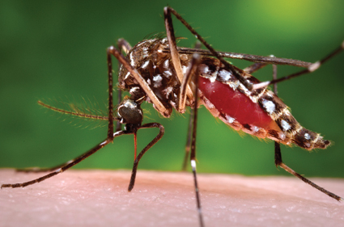
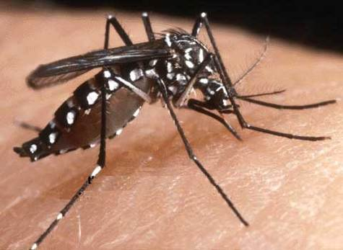
Urban Aedes Virus Vectors
Ae.aegypti
Ae.albopictus
Originated in sub-Saharan Africa, spread throughout the tropics centuries ago
Originated in Asia, spread to the Americas, Africa and Europe beginning in 1985
Kraemer, M.U., et al., 2015. The global distribution of the arbovirus vectors Aedes aegypti and Ae. albopictus. Elife 4.

Slide 7
Other Potential Urban/Peridomestic Mosquito Vectors
  Pacific and Asia
  Aedes polynesiensis
  Aedes hensilii
  Aedes malayensis
  Other Aedes scutellaris species
  Other potential mosquito vectors

Slide 8
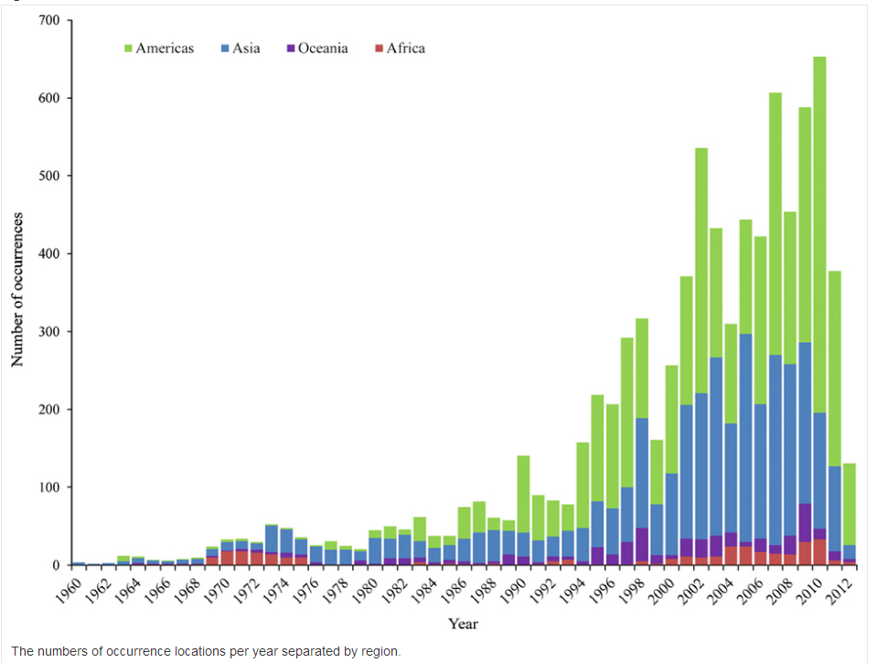
Pandemic dengue spread to 128 countries in 40 years
Expanding geographic distribution
Increased epidemic activity
Hyperendemicity
Emergence of severe disease
Messina, et al, 2014
Messina, et al, 2014

Slide 9
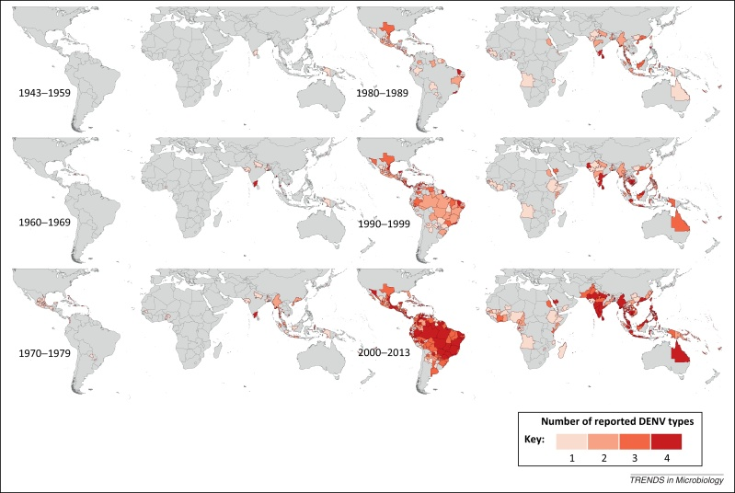
Global Spread of Dengue Viruses
Courtesy, Simon Hay
Messina, et al, 2014

Slide 10

Global distribution of dengue virus serotypes, 1970
DEN 1
DEN 2
DEN 1
DEN 2
DEN 3
DEN 4
DEN 1
DEN 2

Slide 11
Global distribution of dengue virus serotypes, 2018
DEN 1
DEN 2
DEN 3
DEN 4
DEN 1
DEN 2
DEN 3
DEN 4
DEN 1
DEN 2
DEN 3
DEN 4
DEN 1
DEN 2
DEN 3
DEN 4
DEN 1
DEN 2
DEN 3
DEN 4
DEN 1
DEN 2
DEN 3
DEN 4
DEN 1
DEN 2
DEN 3
DEN 4
DEN 1
DEN 2
DEN 3
DEN 4
DEN 1
DEN 2
DEN 3
DEN 4

Slide 12
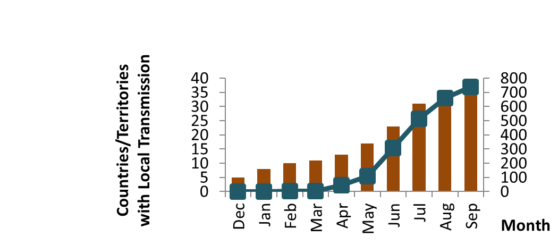
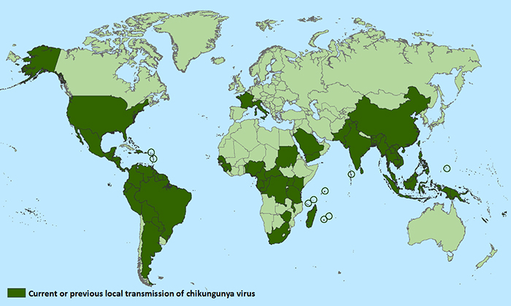
Pandemic chikungunya spread to 37 countries in 10 years

Slide 13
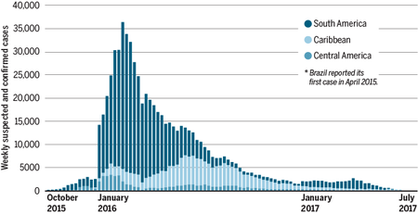
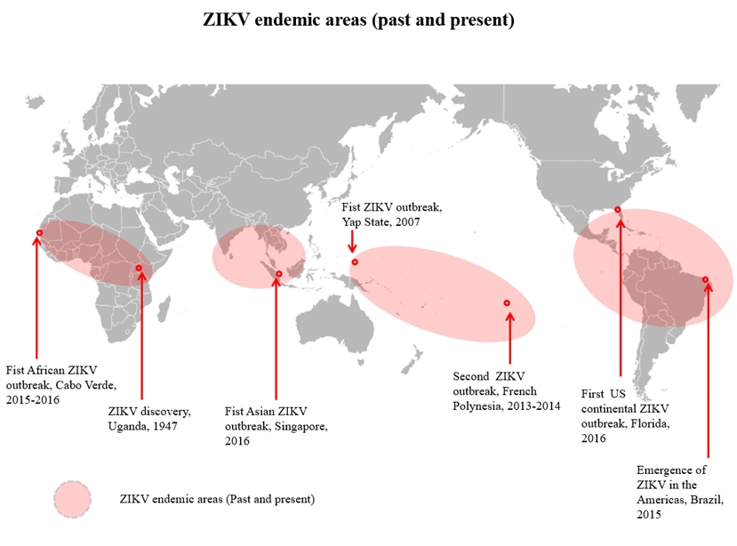
Pandemic Zika spread to 79 countries in 7 years
PAHO/WHO

Slide 14
Why have we seen such a dramatic increase in epidemic arboviral diseases?
Complacency, Lack of Political Will
Policy Changes
Changes in Public Health
Changing Life Styles/Behavior
Microbial Adaptation
Technology
Intent to Harm
Climate Change?

Slide 15
Why Have we Seen Such a Dramatic Geographic Expansion in Epidemic Aedes-Transmitted Diseases?
Major Drivers
Demographic changes (Pop Growth)
  Environmental change
    Unprecedented urban growth
    Changing lifestyles
Increased transmission and emergence of viruses with greater epidemic potential
Modern transportation (Globalization)
  Increased movement of people, animals, commodities & pathogens
Lack of effective vector control

Slide 16
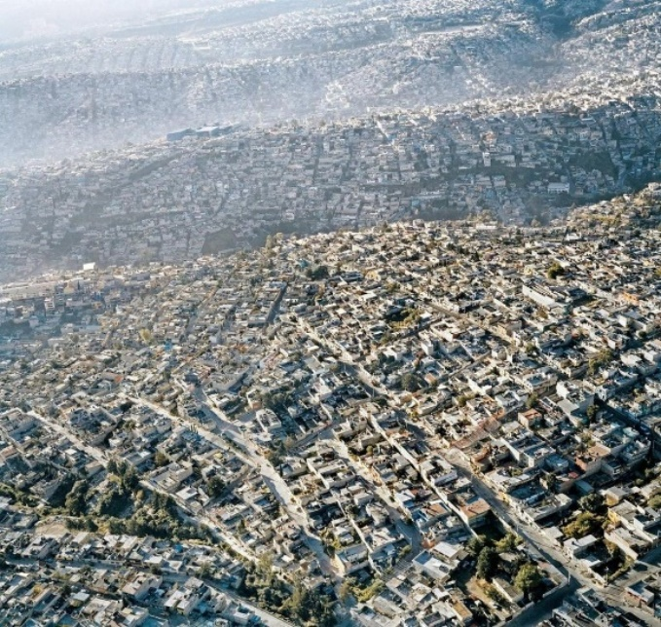
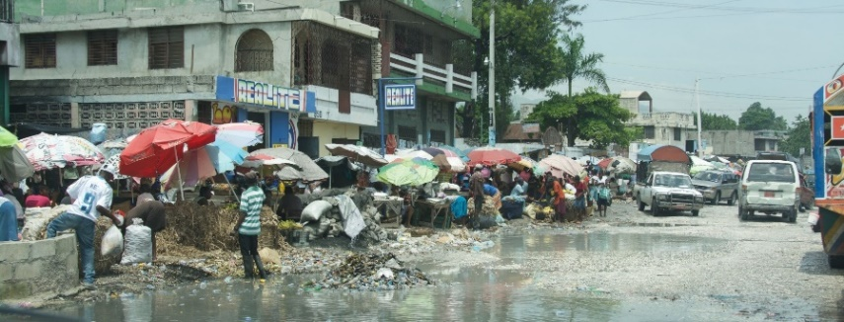
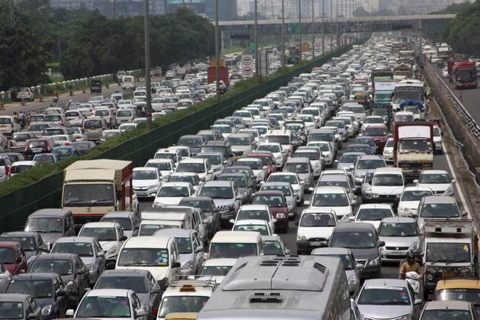
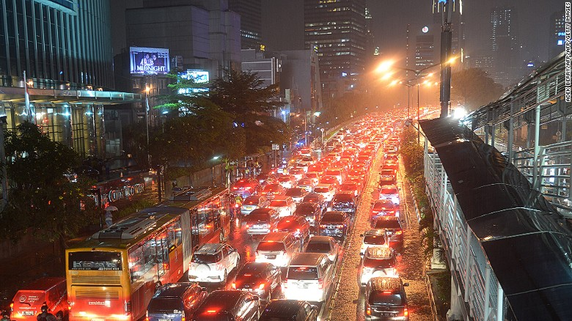
The Global Threat of Urban Epidemics of Arboviral Diseases
Unplanned urban growth unprecedented
Crowded tropical urban centers provide ideal ecological conditions to maintain viruses and mosquito vectors
Used auto tires provide ideal mosquito breeding grounds
At risk human population exceeds 3.6 billion people

Slide 17
Urban Agglomerations, 1950, 2000, 2015
5 million & over in 1950
5 million & over in 2000
5 million & over in 2015
Source: UN, World Urbanization Prospects, The 1999 Revision

Slide 18
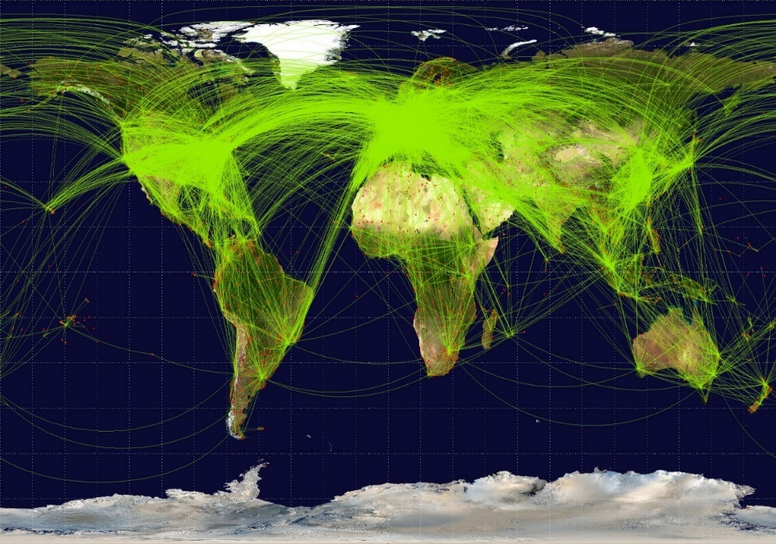

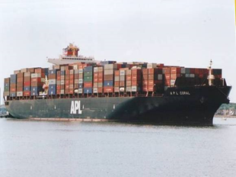
The Global Threat of Urban Epidemics of Arboviral Diseases
Globalization and modern transportation provides ideal mechanism to move viruses and vectors among population centers
In 2018, estimated 3+ billion passengers will travel by air
Global Air Network
Mean passengers per year
Millions of Passengers

Slide 19
Global Threat of Epidemic Arboviral Diseases
Disease and Trade-interwoven History
  14th century, Europe discovers exotic goods from Asia
Global Trade Flourishes
  18th, 19, 20th centuries
New Millennium
  Integrated global economic system with a transnational flow of capital, products, people, animals, knowledge, and pathogens
  Rapid spread of epidemic infectious disease from point of origin

Slide 20
Other Arboviruses with Potential for Urban Emergence
Yellow fever
Spondweni
Rift Valley
VEE
Kedougou
Ross River
O’nyong nyong
Japanese encephalitis
Severity
Wesselsbron
Usutu
Barmah Forest
Bwamba
Sindbis
Mayaro
Sepik
Flavivirus
Edge Hill
Alphavirus
Tembusu
Me Tri
Bunyaviridae
Probability of occurring

Slide 21
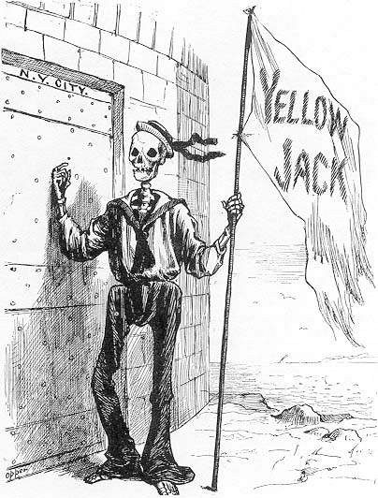
Pandemic yellow fever: the next global threat?
ASIA

Slide 22
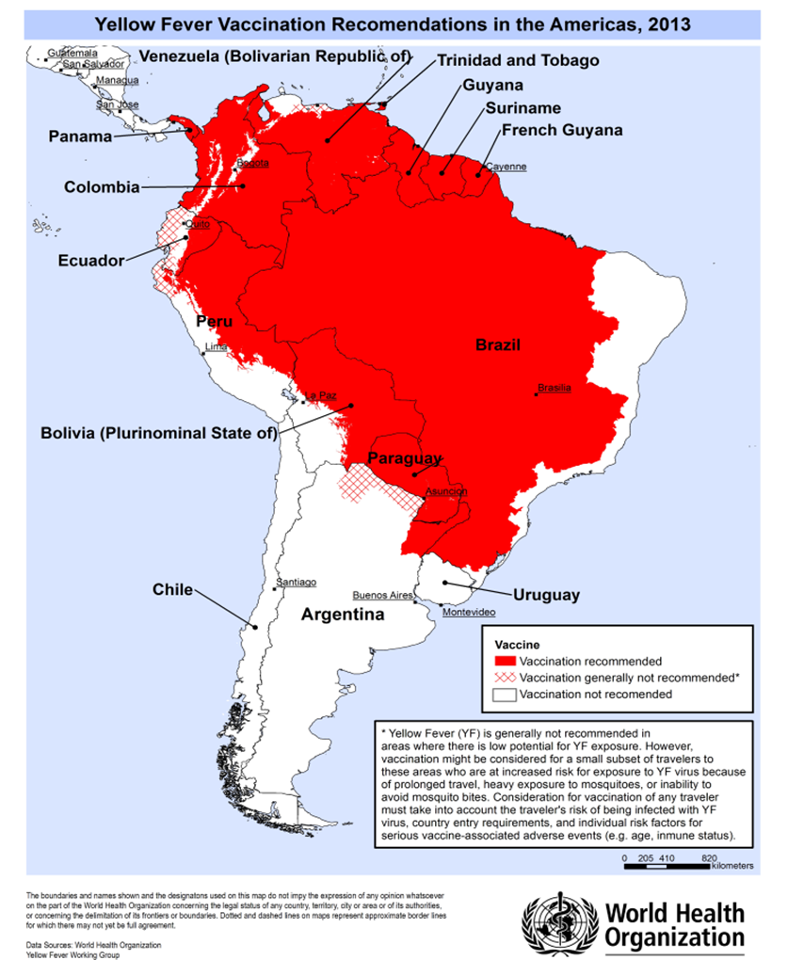
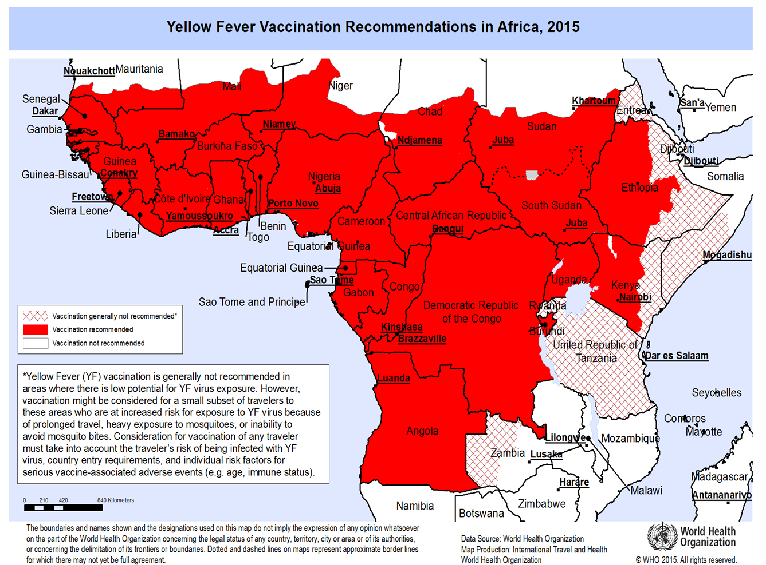
YF Endemic zones
SOUTH AMERICA
AFRICA

Slide 23
Aedes aegypti Distribution in the Americas
1930's
1970
2017
Adapted from Gubler, 1998

Slide 24
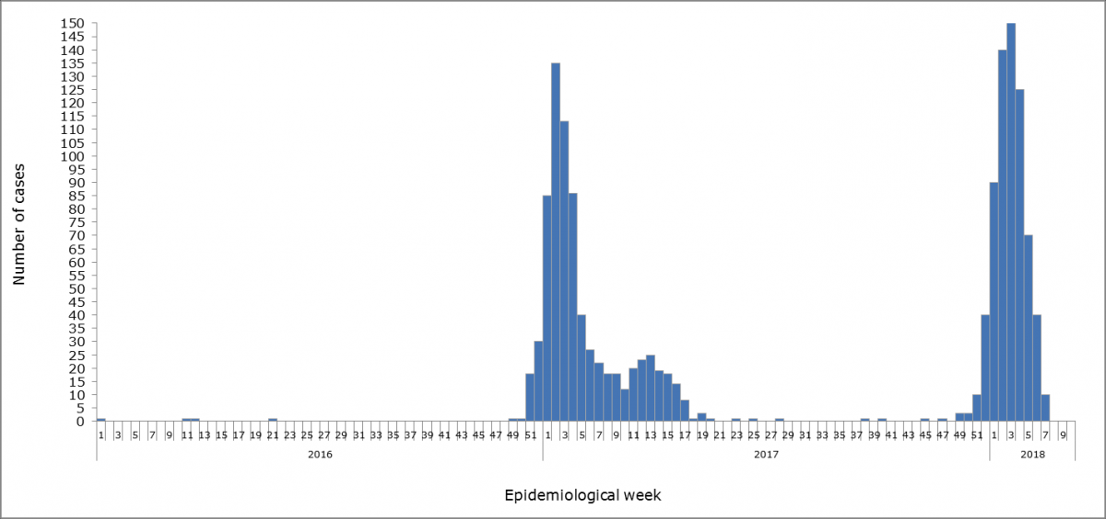
Number of confirmed yellow fever cases by epidemiological week based on date of symptom onset. Brazil, EW 1 of 2016 to EW 8 of 2018.

Slide 25
Imported Yellow Fever, 2016-2018
Highest in decades

Slide 26
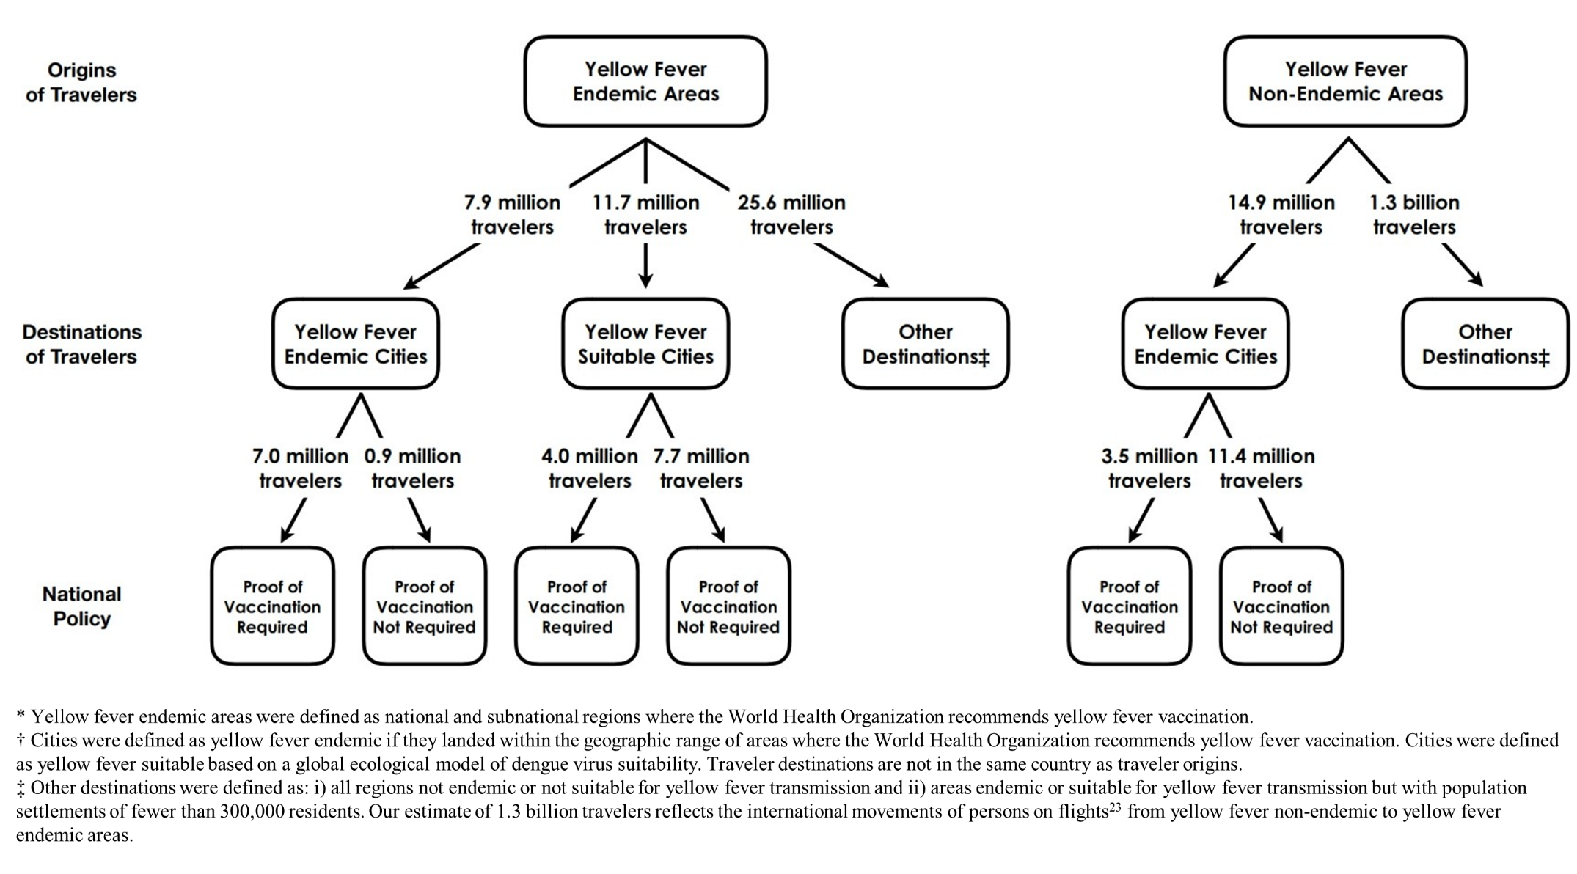
Movements of international air travelers between yellow fever endemic* and non-endemic† areas of the world, 2016.
Brent, et al, 2018

Slide 27
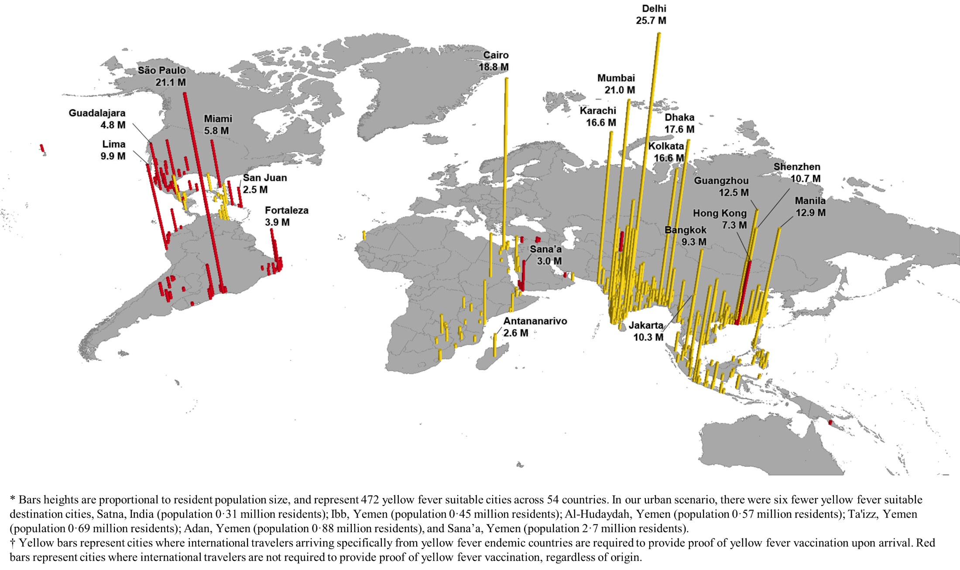
Global populations* living in yellow fever suitable cities and corresponding national yellow fever travel vaccination policy†
Brent, et al, 2018

Slide 28
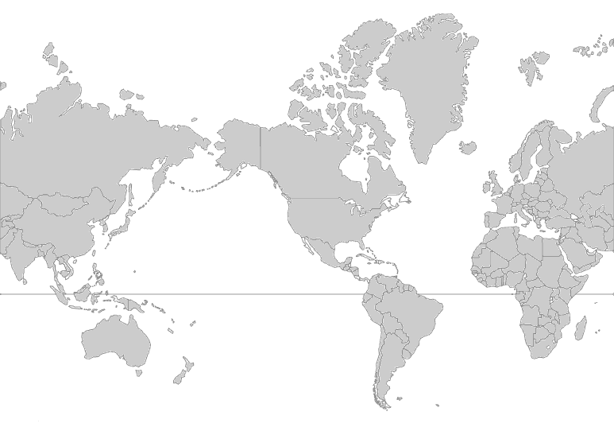
POTENTIAL GLOBAL SPREAD OF URBAN YELLOW FEVER

Slide 29
Table 10. Comparative susceptibility of Asian, Caribbean and African strains of Aedes aegypti to oral infection with yellow fever virus.*
Mosquito Strain | Number† | % Infected | Transmission Rates
Gambia, West Africa | 9/17 | 52.9 | 0
Koro, West Africa | 21/30 | 70.0 | 18.2
Shimba Hills, East Africa | 8/19 | 42.1 | 0
Colombo, Sri Lanka | 26/30 | 86.7 | 50.0
Jakarta, Indonesia | 16/27 | 59.3 | 0
San Juan, Puerto Rico | 27/28 | 96.4 | 33.3
Port au Prince, Haiti | 15/20 | 75.0 | 28.6
* Dakar strain – 5 mouse brain passages. Virus titer in monkey at time of feeding was 10^{8.3} MID₅₀/ml.
† Number Infected/number tested
§ Percentage of infected female mosquitoes transmitting after 20 days extrinsic incubation.
Source:
DJ Gubler, R Novak and CJ Mitchell. Arthropod Vector Competence – Epidemiological, Genetic ,and Biological Considerations. Recent Development in the Genetics of Insect Disease Vectors, Stipes Publishing Company, Champaign, IL, 1982 pp 343-78

Slide 30
What is the Risk of Urban Epidemics of Yellow Fever Today?
Risk Factors
Unplanned urban growth unprecedented
Crowded tropical urban centers provide ideal ecological conditions to maintain viruses and mosquito vectors
Modern transportation provides ideal mechanism to move viruses and vectors among permissive population centers
At risk susceptible population exceeds 3.6 billion people
Low herd immunity in humans
Increased encroachment of humans on sylvatic cycles
Aedes aegypti and Ae. albopictus have global distribution
Vector control has been unable to prevent epidemic dengue, chikungunya and Zika
Egg-based production makes it difficult to scale up YF vaccine supply quickly for emergency response

Slide 31
The Risk for Pandemic Yellow Fever
is the Highest in 70 Years
Are we Prepared?
NO!
A

Slide 32
Vaccine situation
Existing world stocks are insufficient to counter major epidemics
Surge production of vaccine supply cannot be ramped up fast enough to provide protection to all at risk areas
YF vaccine requires a cold chain -- these exist in many at risk countries but are inadequate to handle emergency response supply
Emergency training for and mobilization of mass vaccination program takes months and is beyond the capacity of many low resource countries

Slide 33
Vaccine situation
Adverse effects of 1 or 2 deaths due to the vaccine (inevitable during mass campaigns) are sufficient to shut down a vaccination program
Cultural resistance: some at risk countries may resist vaccination (as happened recently with polio vaccination in Nigeria, measles in USA & Europe)
Fractional dilution of vaccine can expand supply in an emergency
WHO/GAVI eliminate YF epidemics (EYE) program
  Increase vaccine supply
  Expand preventive vaccination
  Improve surveillance
  Build capacity

Slide 34
Vector control situation
Existing vector control programs in at risk countries are failing to control dengue, chikungunya and Zika
Emergency training & deployment of vector control staff and programs would take months
Many people find insecticide spray obnoxious
  close up their houses when sprayers pass
  protecting the mosquitoes inside!
New vector control tools are desperately needed

Slide 35
Hospital situation
If major epidemics occurred:
Inadequate numbers of beds
Stocks of intravenous fluids would soon be exhausted
Stocks of syringes, needles, etc., would run out and be re-used, risking other infections
A potential infection rate of 20% & CFR of 20-50% would create chaos

Slide 36
Containment
Epidemic yellow fever difficult to contain
  Lag time
  Silent transmission
  Misdiagnosis
1994 Indian plague example
  Populace may flee
  When plague was announced in Surat, 500 000 people (one-fourth of population) fled the city
  Including doctors, nurses and other health workers

Slide 37
Potential spread of pnuemonic plague out of India, 1994
India
Delhi
Calcutta
Madras
Bombay
Global public health emergency

Slide 38
Conclusions
Aedes-Transmitted Urban Epidemics
Risk is highest in history due to global trends of urbanization and globalization
Vaccines are unavailable or in short supply
Egg-based production makes it difficult to scale up YF vaccine supply quickly for emergency response
Vector control has been unable to prevent epidemic dengue, chikungunya and Zika
We should expect more emergent epidemic viruses transmitted by Aedes Stegomyia mosquitoes

Slide 39
Conclusions
Urban Yellow Fever Epidemics
The most cost effective strategy to prevent a global yellow fever public health emergency will be to include yellow fever vaccine in the EPI in every at risk country in Africa, Central and South America
Vaccine alone will not be enough

Slide 40
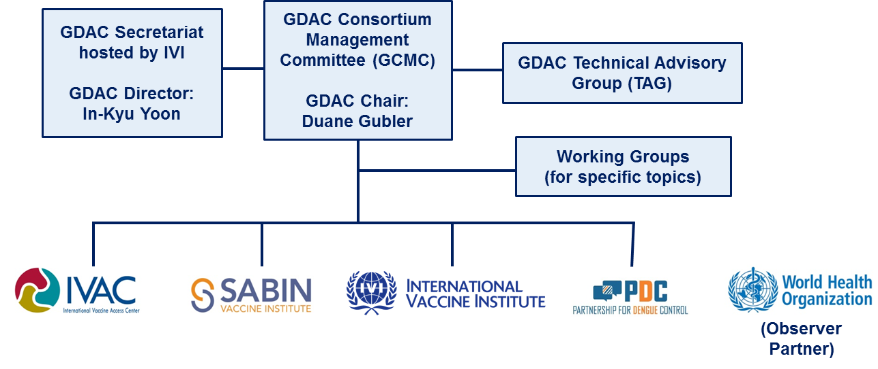
Global Dengue and Aedes-transmitted Diseases Consortium (GDAC)

Slide 41
GDAC Paradigm to Rollback Dengue and Other Aedes-Transmitted Diseases Using New Tools in the Control Pipeline
Integration and Synergy
Clinical management/
therapeutics
Community
engagement
Vector
Control
Targeted Control program
Vaccination
Improved
Surveillance
International mobilization of resources
Build public health capacity
Fund program implementation
Fund research

