Slide 1

EPIDEMIOLOGY AND STRATEGIES FOR EARLY DETECTION OF DENGUE CASE IN CHINESE TAIPEI
Chin-Hui Yang, MD, PhD
Division of Acute Infectious Disease
Centers for Disease Control, Chinese Taipei
2018-5-3

Slide 2
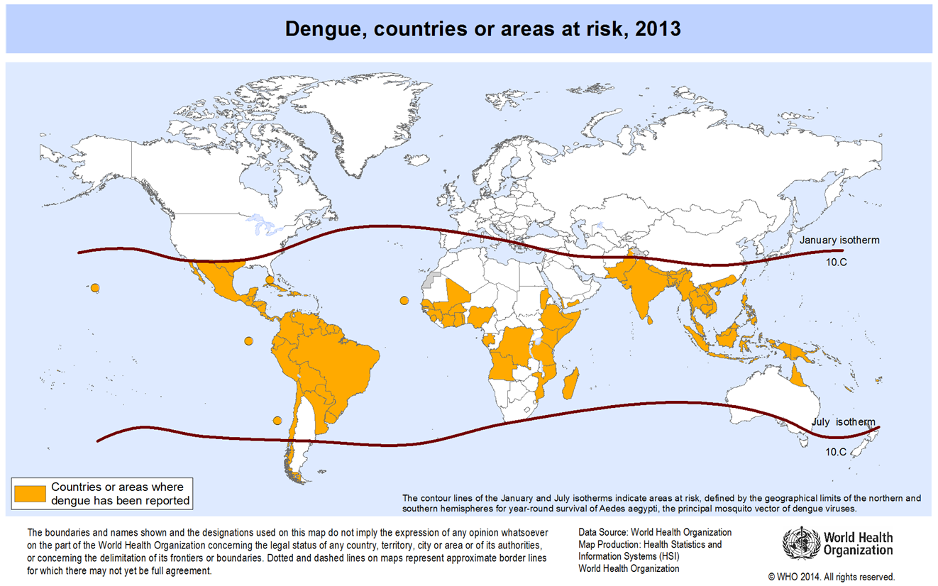
Dengue
In tropical and sub-tropical climates worldwide

Slide 3
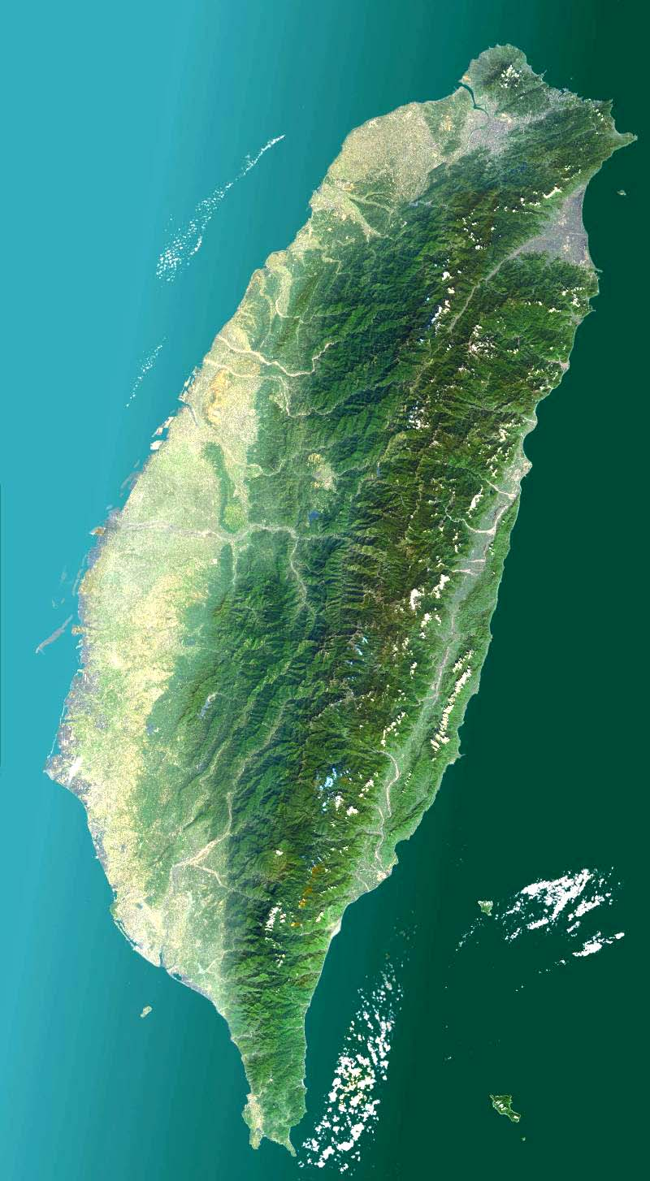
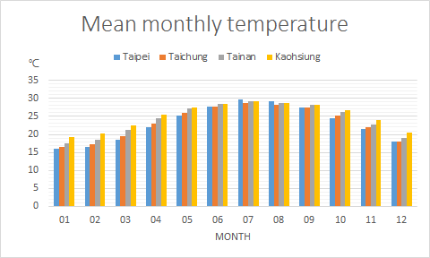
Chinese Taipei
Located in the Pacific Ocean and overlying the tropical and subtropical zones
Landmass : 35,882.6 km²
Population/Density: 23 million/649.7 per km²
Humid throughout the year and receives abundant rainfall
Mean monthly temp. in summer: 28~29 ℃
Tropic of Cancer
Source: Central Weather Bureau, Chinese Taipei

Slide 4
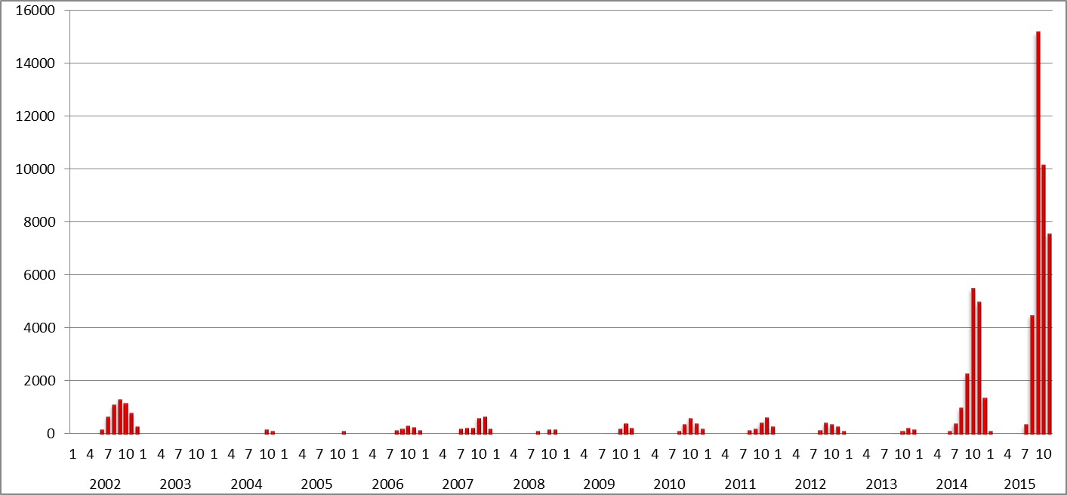
Annual Reported Indigenous Dengue cases (1987‒2017)
DEN-2
43,419
Epidemic starts in July annually, usually peaks in October, and resolves in December.
DEN-1
15,492
DEN-1
DEN-2
4,389
5,336
381
10

Slide 5
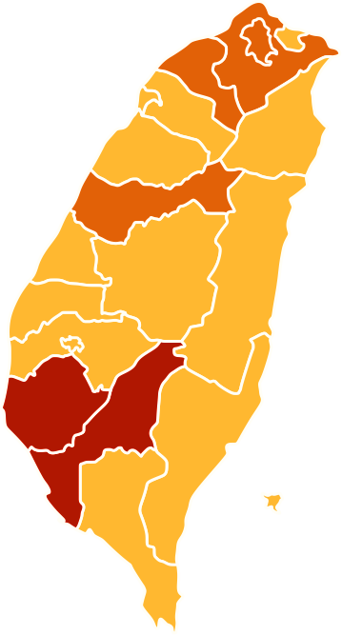
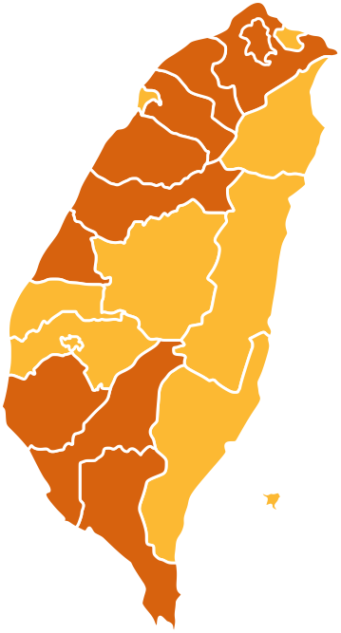
Geographic Distributions of Dengue Cases
1998–2017
Tropic of Cancer
6-50 cases
51-500 cases
>500 cases
Indigenous cases
Imported cases
Notes:
This is the geographic distribution of Dengue cases in Taiwan.

Slide 6
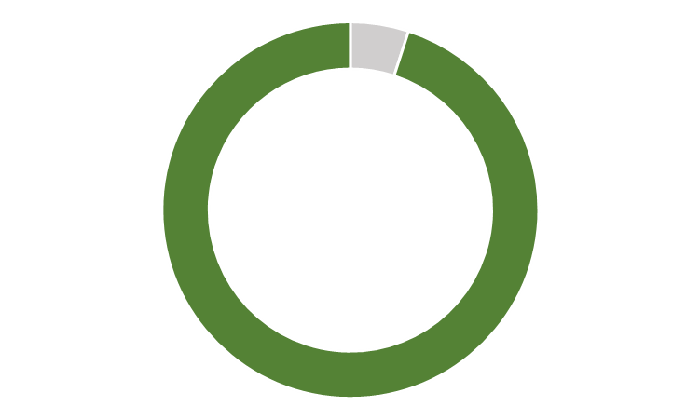
Imported Dengue Cases 2000-2017,
Chinese Taipei
95%
Source country: Southeast Asia
Year
According to the molecular analysis of the virus, most indigenous acquired dengue cases were connected to the imported cases preceding the local transmission.
Notes:
Imported dengue cases were increasing in recent years
Therefore, early detection of imported cases would be helpful to reduce the risk of local transmission

Slide 7
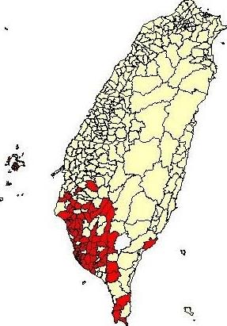

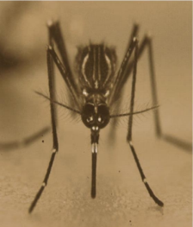

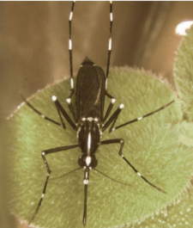
Aedes aegypti (red area)
Geographically limited to southern part of the island
Most common indoor habitat
A “nervous feeder” leading to higher transmission rates
Aedes albopictus (yellow area)
Distributed throughout the island
Below the sea level of 1500 m
Most common outdoor habitat
Lin C, et al. The Study of Dengue Vector Distribution in Taiwan from 2009 to 2011.
Taiwan Epidemiology Bulletin 2014;30.
http://www.cdc.gov.tw/english/downloadfile.aspx?fid=412EEBD7DA1C783B
Notes:
Aedes aegypti, the most important vector for Dengue virus was limited to southern Taiwan, as shown in red.
More than 90% of the Ae. aegypti population rests on dark, humid and secluded places inside houses or buildings.
It is a nervous feeder (i.e. it bites more than one host to complete one blood meal) and is a discordant species (i.e. it needs more
than one feed for the completion of the gonotropic cycle). These habits epidemiologically result in
the generation of multiple cases and the clustering of dengue cases in cities.
The other vector, Ae. Albopictus, was distributed throughout the island, below the sea level 150 meters.
Basically Ae. albopictus is a feral species most commonly found in fringe areas of forests. Hence, Ae. albopictus carries poor vectorial
capacity in an urban epidemic cycle.

Slide 8
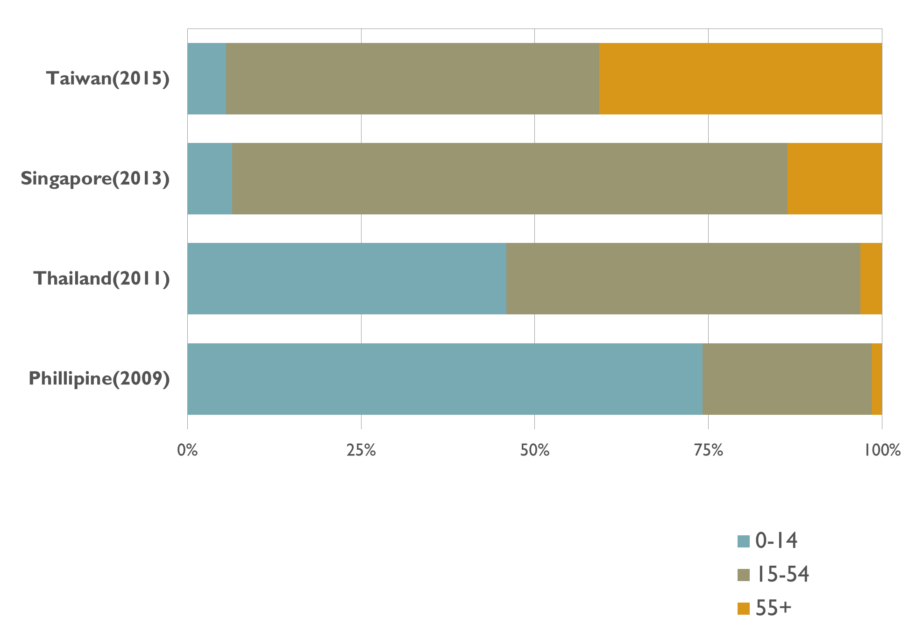
Age Distribution of
Reported Dengue cases
Chinese Taipei(2015)
https://goo.gl/8e270F
Epidemiology of Dengue Disease in the Philippines (2000–2011): A Systematic Literature Review. PLoS Negl Trop Dis. 2014 Nov; 8(11): e3027.
Epidemiology of Dengue Disease in the Philippines (2000–2011): A Systematic Literature Review. PLoS Negl Trop Dis. 2014 Nov; 8(11): e3241
8
Notes:
Around half of the reported dengue cases were aged over 50 years old.

Slide 9
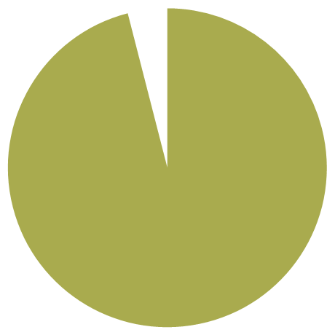


2015 Dengue Mortality Cases Analysis
228 death
due to dengue
Mortality
5.3‰
M : F
1.1:1
Median Age
74 y/o
(range 26-96)
90%
older than 60 years-old
96%
at least one
co-morbidity
52%
No warning signs at presentation
Onset to Death: Median 5 days

Slide 10
Dengue epidemic dropped significantly in 2016-2017
1. Early detection and diagnosis for the suspected cases
  (1) Fever screening at international airports and seaports
  (2) Primary care clinics to use NS1 rapid test
  (3) Surveillance system optimization to be more user friendly
2. Early intervention
  Urge local public health authorities to start multi-pronged control earlier
3. Early and appropriate case management
  (1) Remind doctors to be aware and notify suspected cases
  (2) Training courses of clinical case management for doctors

Slide 11
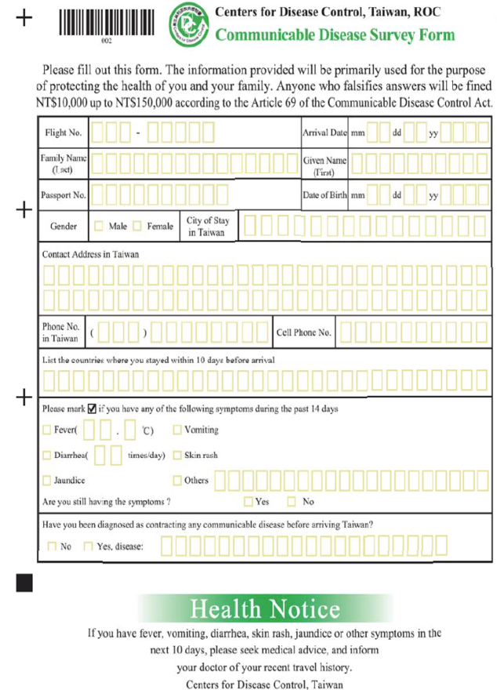
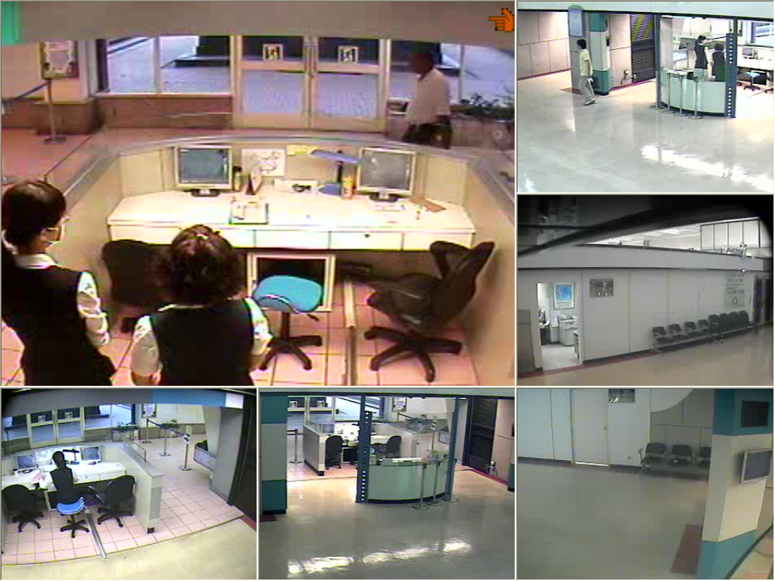
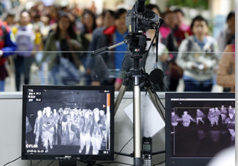
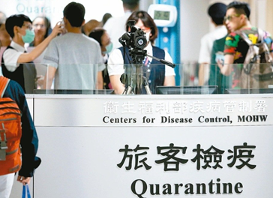
Border Fever Screening
Notes:
The Symptom Surveillance System monitors inbound passengers at airports and seaports and enables Taiwan CDC to effectively and quickly implement control measures. Symptom categories under surveillance include persons under investigation for H5N1 influenza, fevers of unknown etiology, diarrhea, and respiratory or other disease clusters.
11

Slide 12
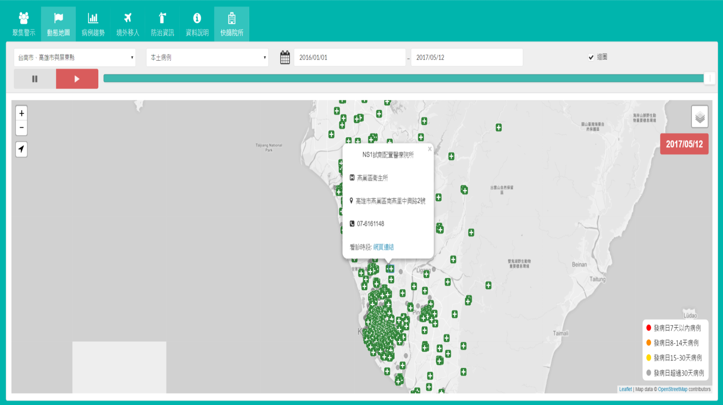
Hospital and clinics offering public-funded dengue NS1 rapid tests
Taipei City | 42
New Taipei City | 118
Tainan City | 258
Kaohsiung City | 538
Pingtung County | 81
Total | 1037
http://cdcdengue.azurewebsites.net/

Slide 13
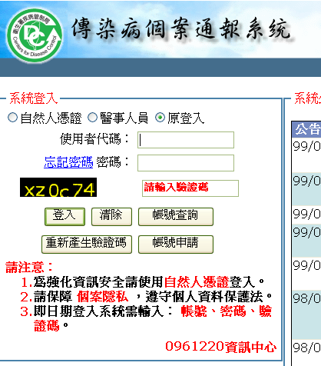
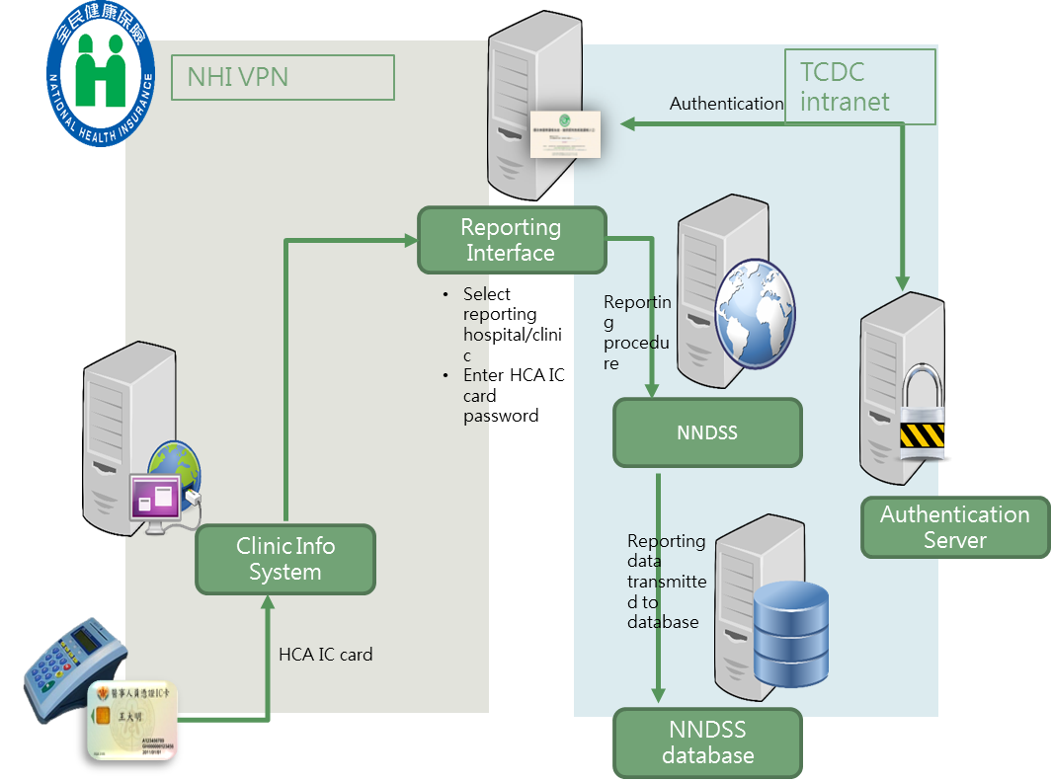
Disease Surveillance
Notifiable disease surveillance system
Reporting a suspected case to health authority within 24 hours (by internet)
Awarding NTD 2,500 to doctor for reporting a confirmed imported case
Account-less reporting system
Notes:
Fever screening for all arriving passengers at airports and seaports
febrile or symptomatic passengers:
Filled out “Communicable Disease Survey Form”
Medical evaluation : on-site specimen collection or refer to designated hospital
Local public health department will follow-up the health status for passengers through the incubation period
Travelers returning from the affected areas should monitored their health for 21 days upon arrival. If any symptoms such as fever, vomiting, diarrhea or rash develop, they should call the toll-free hotline 1922 (or 0800-001922) to seek medical attention and inform the doctor of any recent travel and exposure. 24/7 access

Slide 14
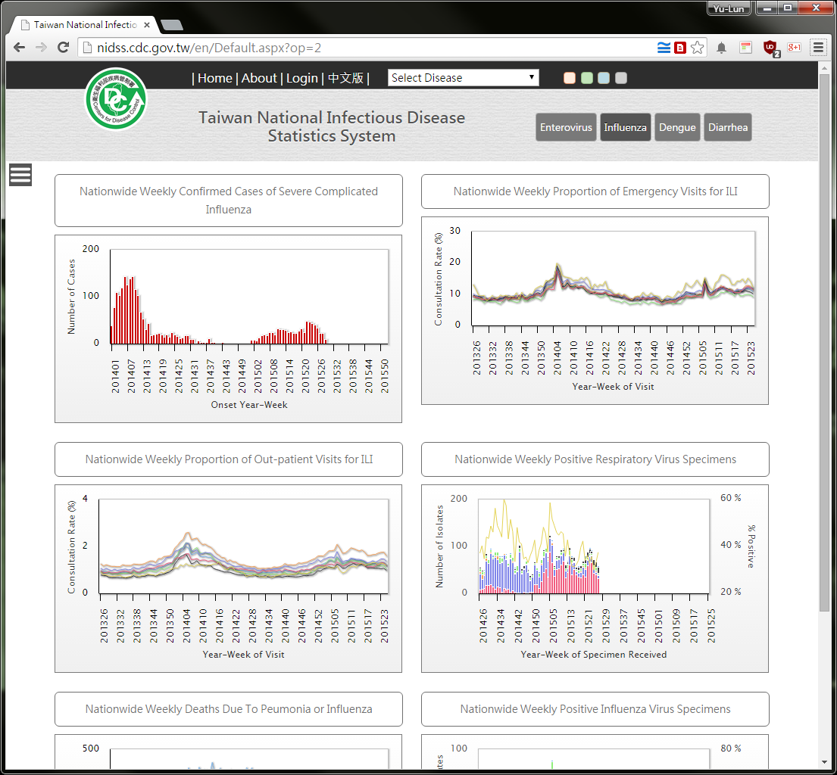
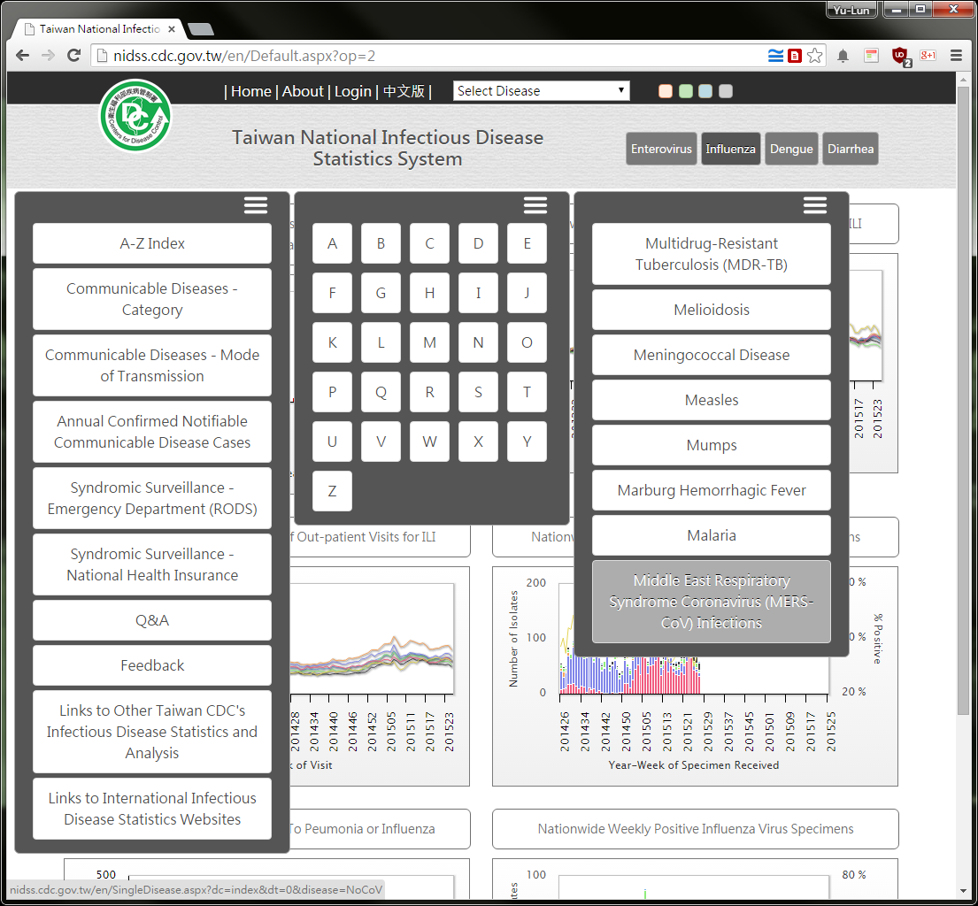
Public Accessible National Infectious Diseases Statistics Website
http://nidss.cdc.gov.tw/
Notes:
Notifiable diseases surveillance data are updated daily and aggregate data are available to the public on the CDC website. This graph shows the epidemic curve and geographic distribution of confirmed dengue fever since 20111. The number of patients peaks during weeks 40 to 50 and clusters mainly in Tainan and Kaohsiung counties in southern Taiwan.

Slide 15
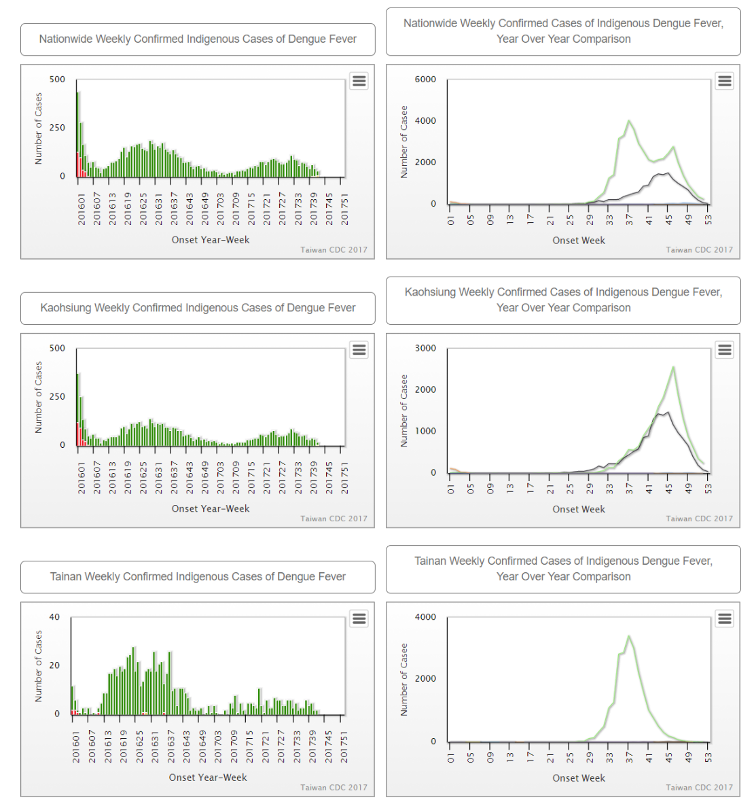
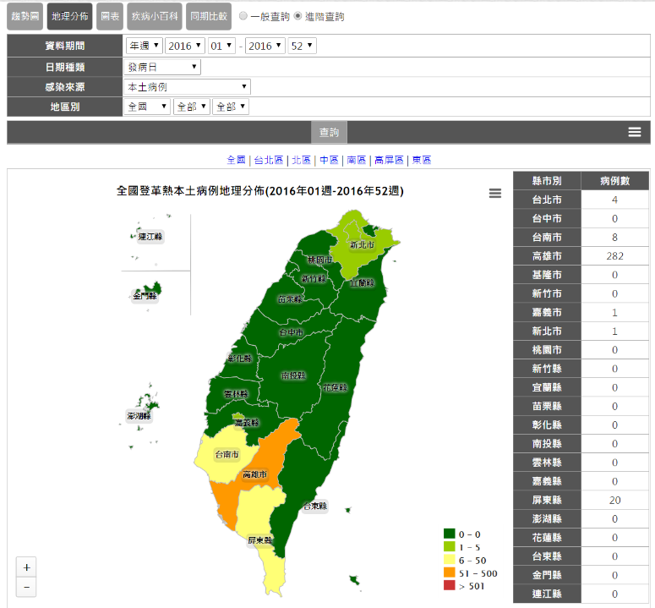
Dengue fever dashboard

Slide 16
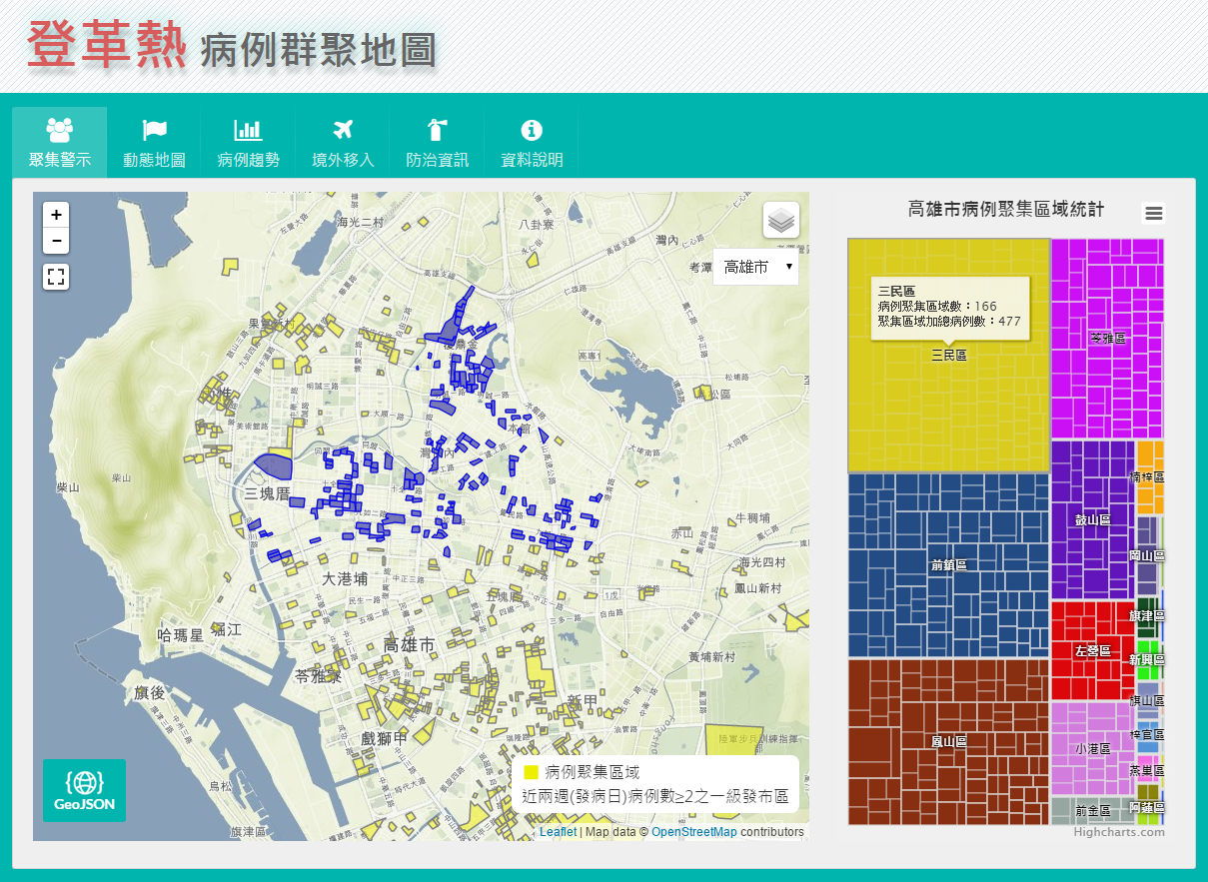
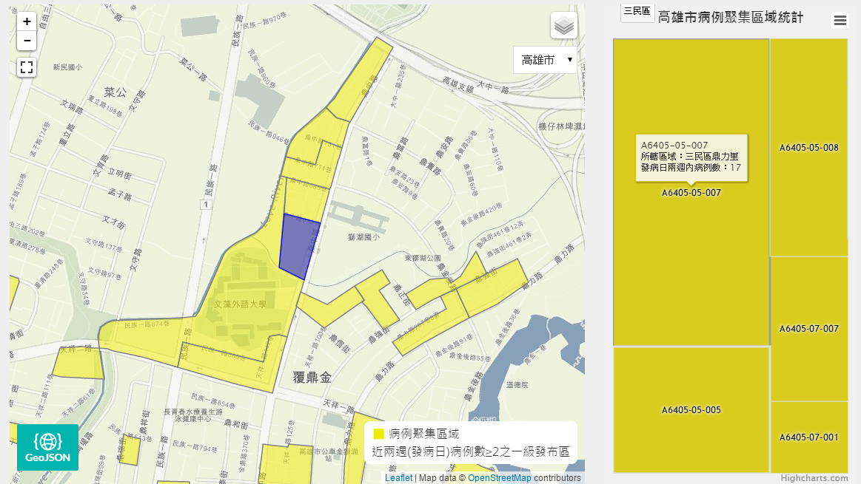
Dengue Case Clusters Map
http://cdcdengue.azurewebsites.net/

Slide 17
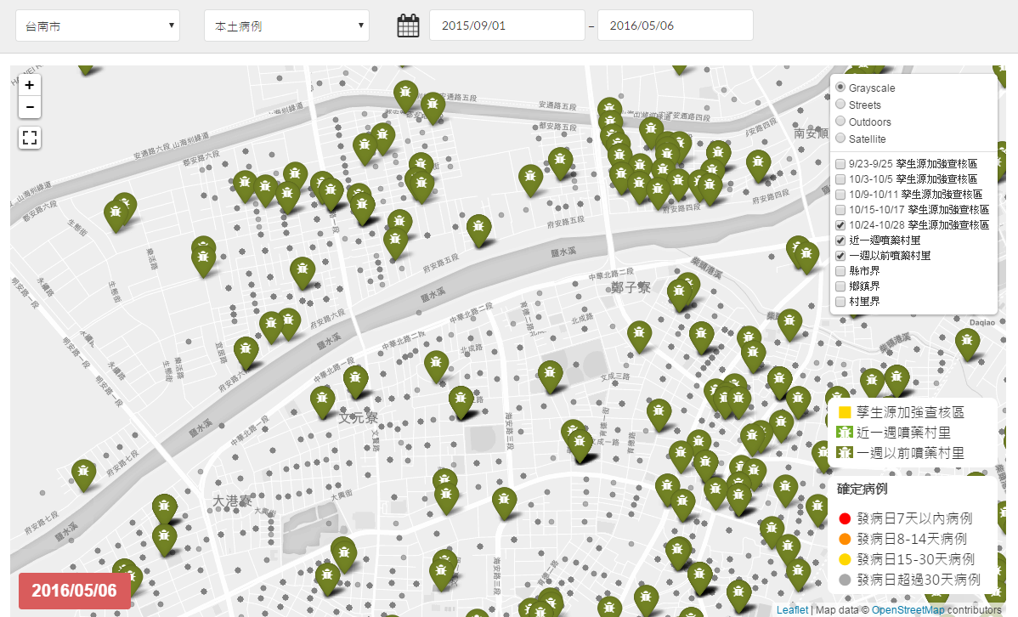
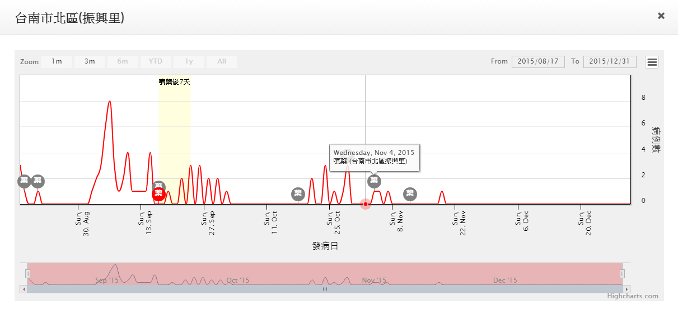
Relationship between interventions and dengue cases
http://cdcdengue.azurewebsites.net/

Slide 18
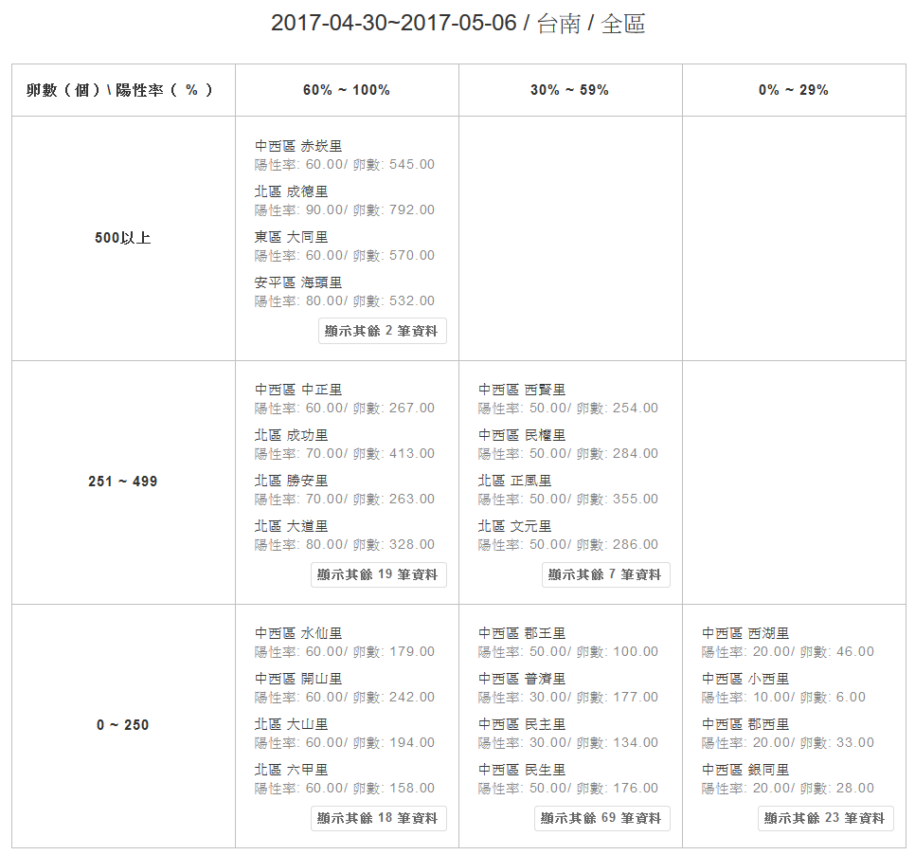
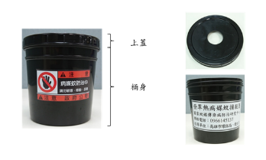
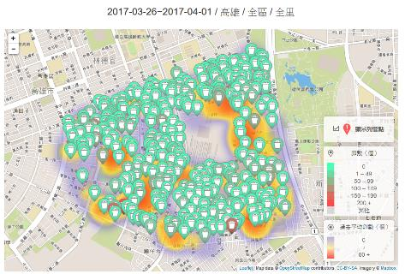
New approach of Vector mosquito surveillance in 2016~2017
To remind local public health authorities to eliminate the breeding sites as soon as possible
Ovitraps
Ovitrap (+) 60%~100%
Ovitrap (+) 30%~59%
Ovitrap (+) 0%~29%
eggs≥500
Alert
Watch
Eggs
251~499
Watch
Eggs 0~250
Watch
Source: National Mosquito-Borne Diseases Control Research Center

Slide 19
Dengue surveillance framework
Media surveillance
Cell-based broadcasting
International surveillance
Death certificates
MS Azure Cloud
Dotted line: in development
Dengue dynamic map
Airport fever screening
RODS
ER visits
Microsoft PowerBI
Epidemiologic surveillance
 Paper/Fax based
Symptom surveillance
 Web-based
Dengue GIS
 Reporting via hospital EMR
Lab
Data warehouse
 Accountless reporting via NHI VPN
Case-based surveillance
Public statistic website
 Reporting via clinic info sys. (pilot)
Case investigation
Open Data
Vector Surveillance
Vector indices
Data linkage with NHI
SAS Visual Analytics
Raw data
 Breeding site registration
Epidemic info mngt system
Onsite case crosschecking
Vector-borne disease data center
Intervention evaluation model
Control measure data
Misc.
Forecasting
 Chemical / non-chemical intervention
 Seroepid.
Local vector / breeding site surveillance
Ovitrap / Gravitrap
Local case investigation
Local GIS layers
 Environmental
 Vacant / unoccupied house or land registration
 Socioeconomic
 Weather
Notes:
圖示簡單說明通報流程
An ill person seeks medical attention in a hospital or clinic.
The clinicians judge whether the symptom is conformed with the reporting definition of notifiable foodborne disease.
A clinicians decided to report the information of patient to NNDSS or not.
If yes, the local health investigators further investigate and gain more information

Slide 20





Health Education
Environment Management
  Container management
  Elimination of breeding sites
Personal Protection
  Apply repellents (DEET) to exposed skin
  Wear long-sleeved tops and pants
Doctor Encouragement
  Remind doctors to aware and notify suspected cases
Emptying and cleaning containers
DEET
Insect repellent (DEET)
Long-sleeved clothes and pants

Slide 21
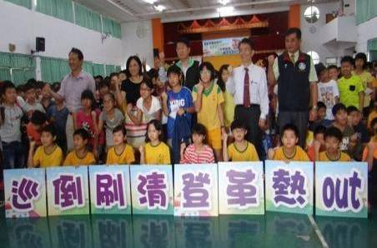
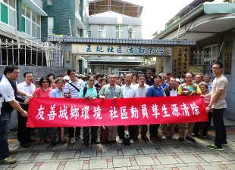
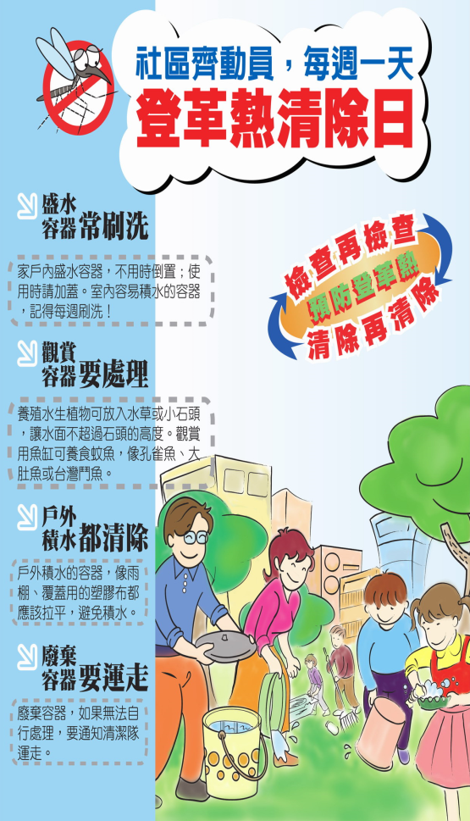
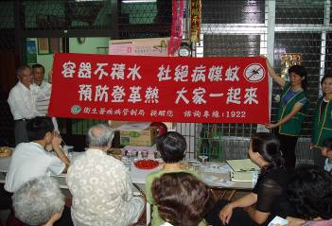
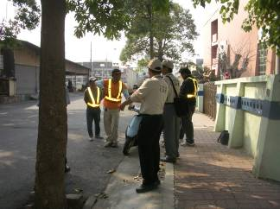
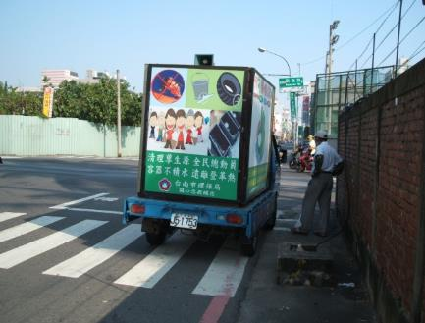
Community Mobilization
Encourage communities to organize volunteers to eliminate mosquito-breeding containers

Slide 22

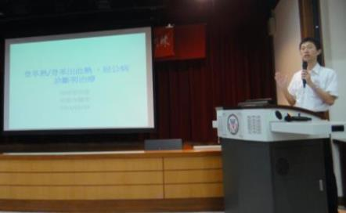
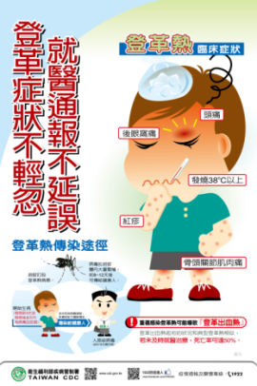
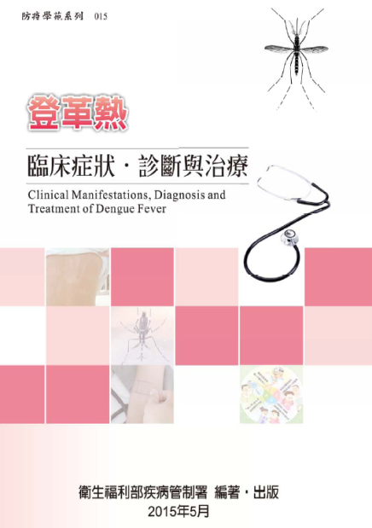
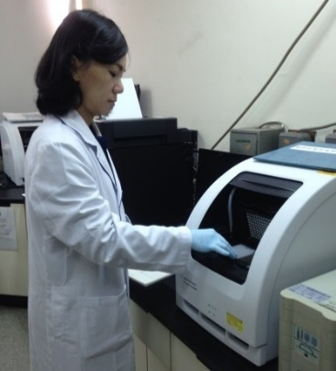
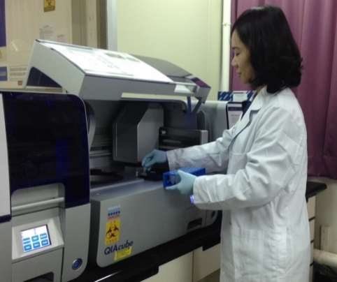
Laboratory Diagnosis
Clinical case management
Laboratory
    2 central reference labs
    3 authorized laboratory testing institutions for dengue
Method
  Virus Culture
  Real-Time RT-PCR
  DENV NS1 Ag Test
  Capture IgM and IgG ELISA
Education and training for clinical diagnosis, treatment and case management.
Multiple materials to remind doctors to aware and notify suspected cases.

Slide 23
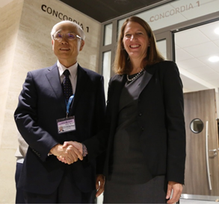
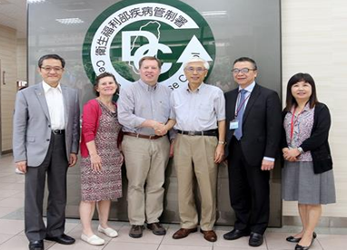
  Dengue vaccine development for the elderly in collaboration with US NIH
Developing the world’s first dengue vaccine for people older than 50 years
Phase II clinical study of the vaccine will begin this year
Plans on having locally produced vaccines for possible Phase III trial

Slide 24
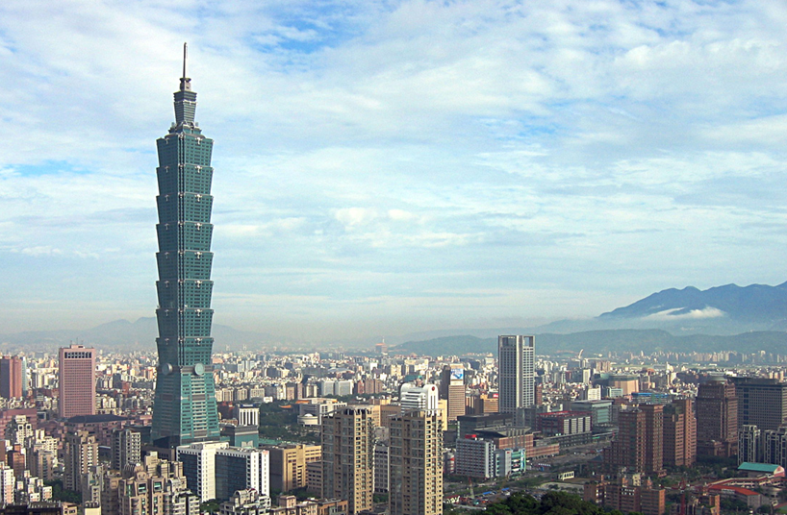
Thank you for your attention
By peellden - Own work, CC BY-SA 3.0, https://commons.wikimedia.org/w/index.php?curid=1658991

