Slide 1
Dengue – Drivers, Restrainers, and the Role of Biomedical Interventions Michael D. Malison, M.D. MPA

Slide 2
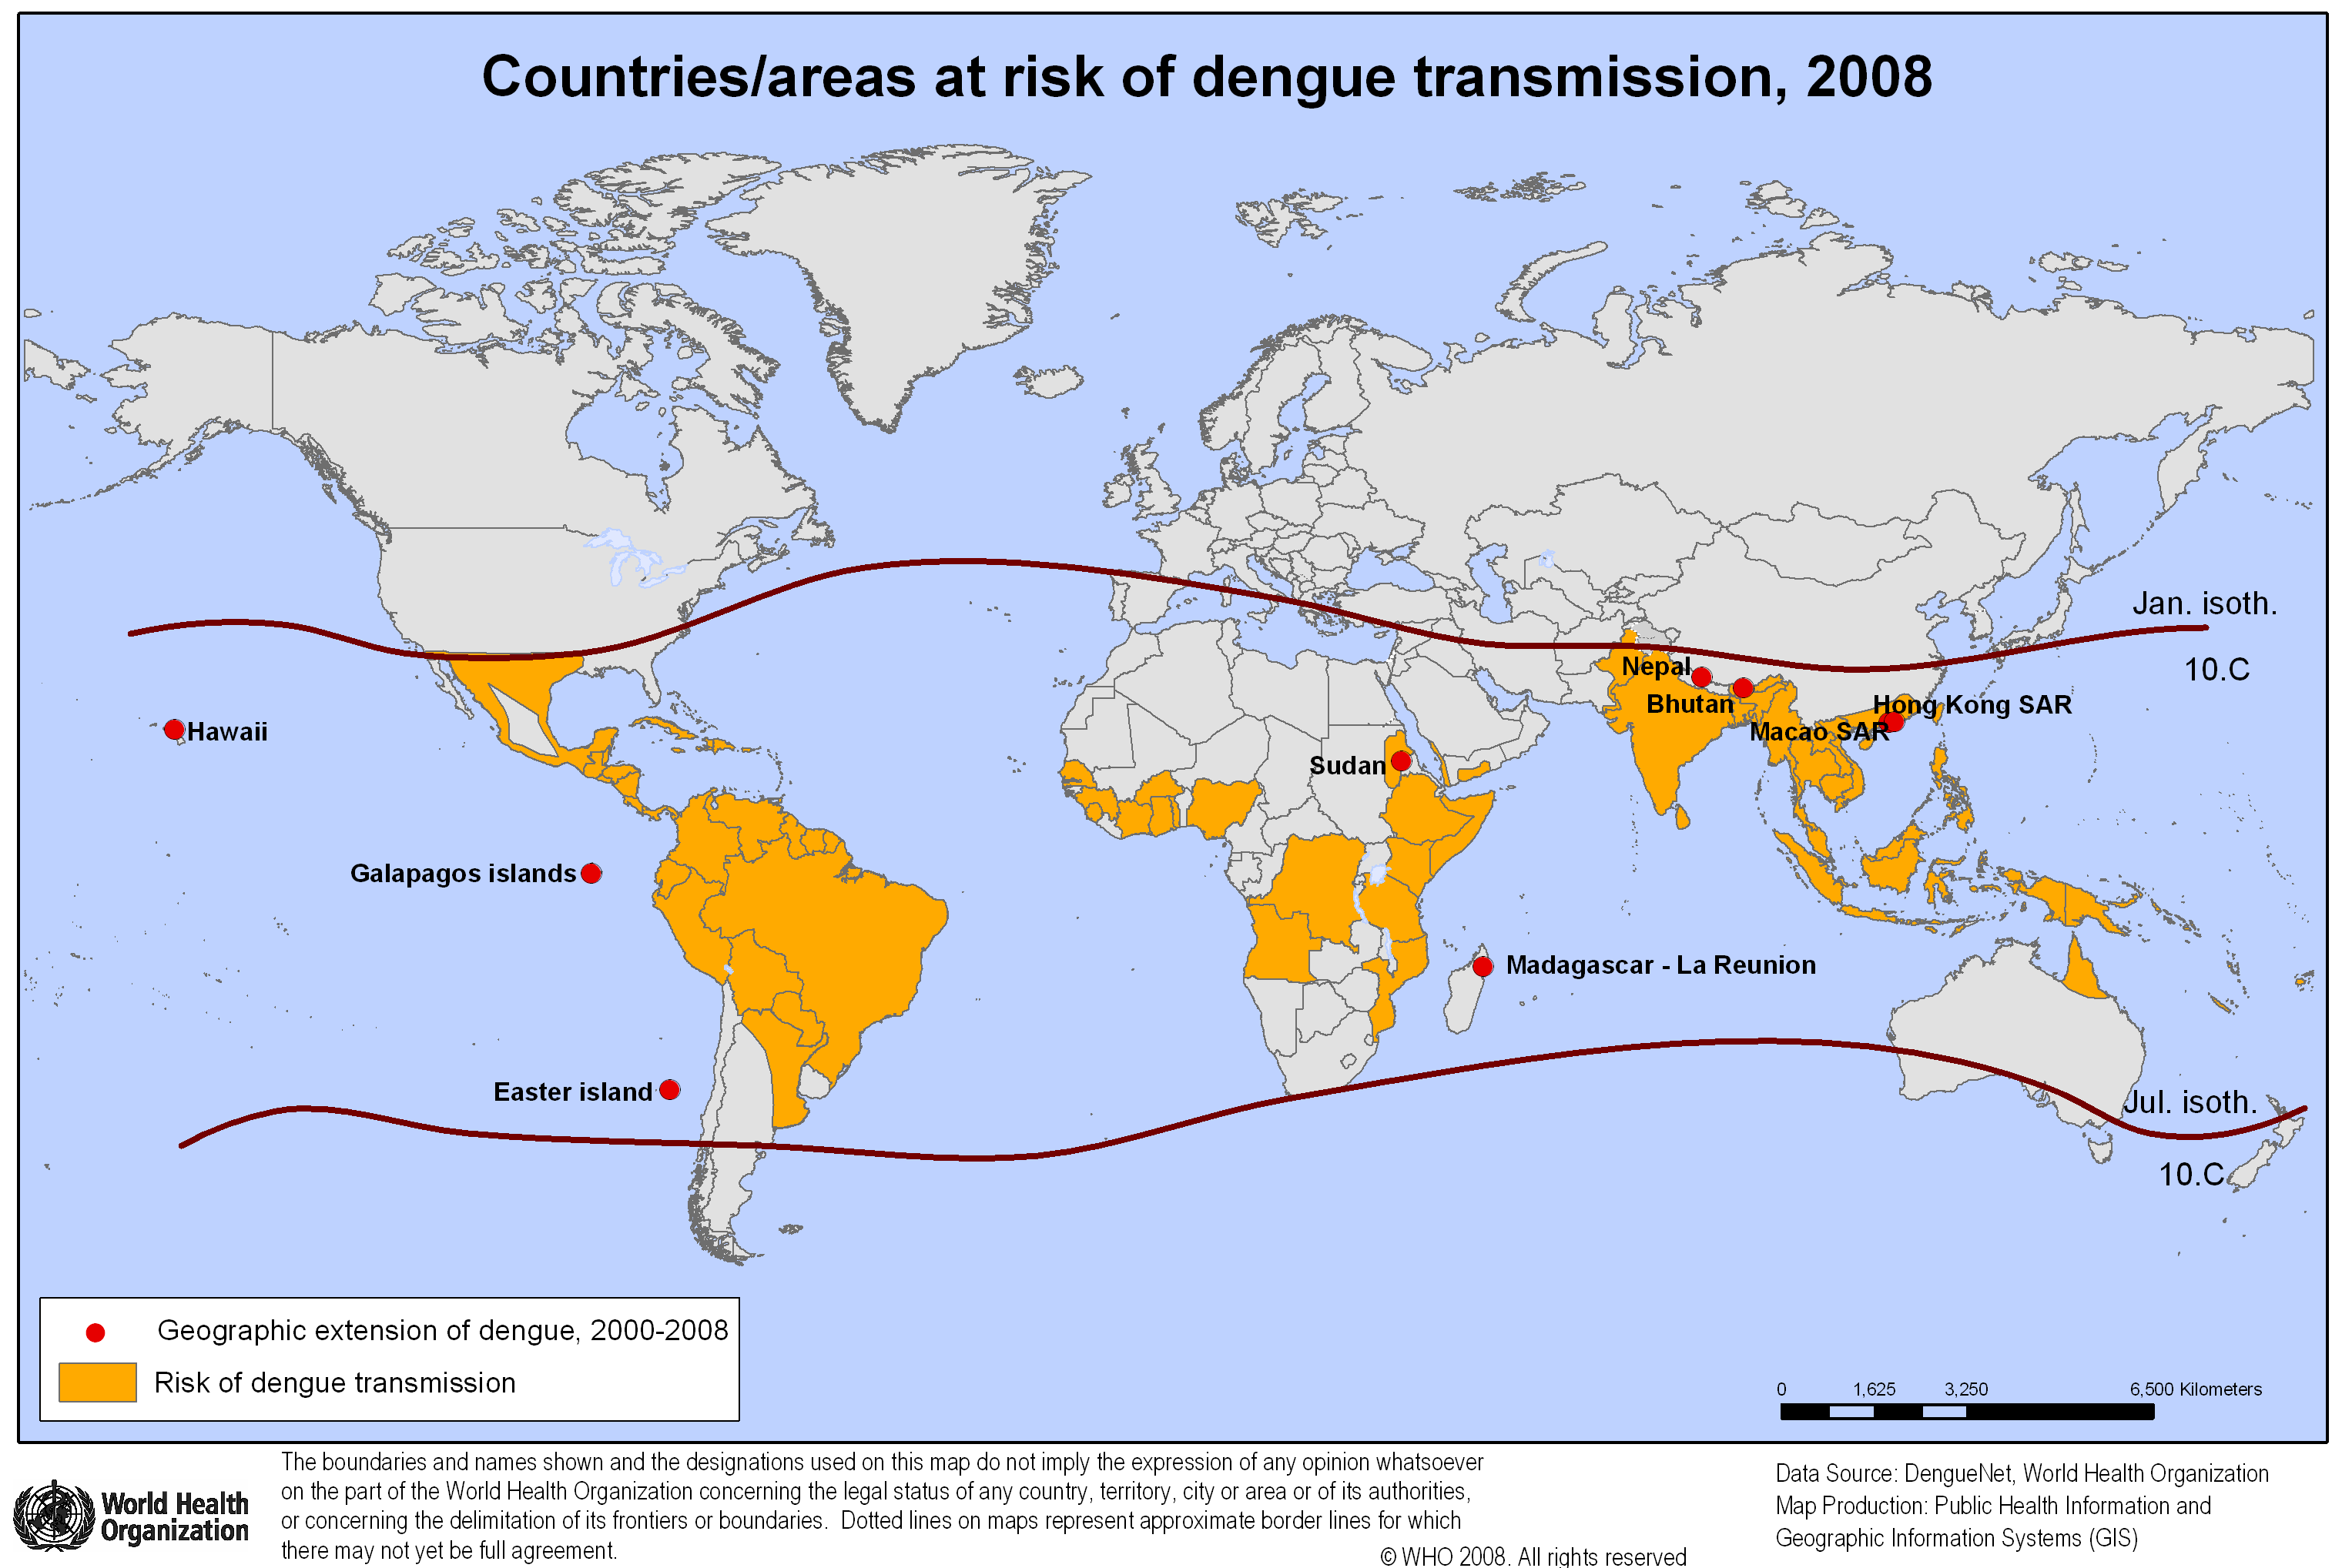

Slide 3
Chinese - Taipei

Slide 4
Visitors to “Chinese Taipei” 1956 - 2016
‘14-15 Outbreak
No. Visitors from China
‘87-88 Outbreak
‘60 ‘65 ‘70 ‘75 ‘80 ‘85 ‘90 ‘95 ‘00 ‘10 ’15
Year

Slide 6
Dengue Clinical Manifestations

Slide 7
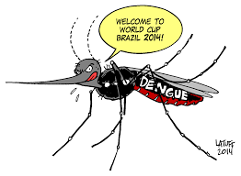
Major DRIVERS that are increasing the global spread of dengue
Driving Force

Slide 8
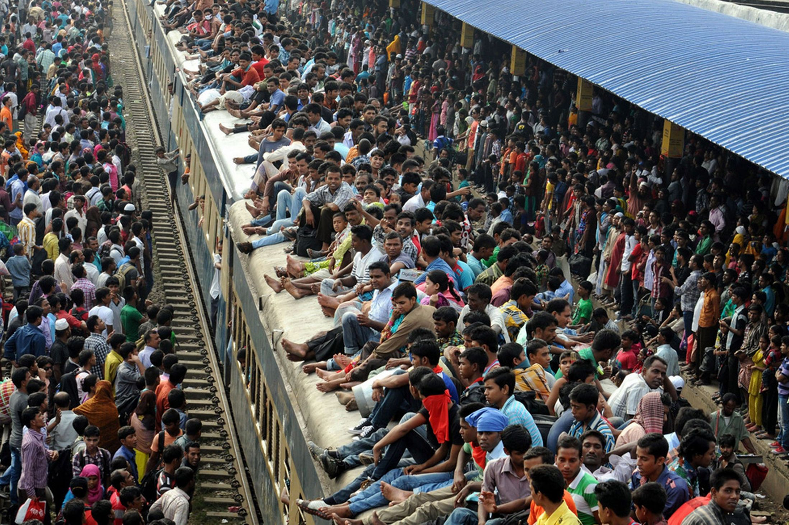
1. Urban Migration

Slide 10
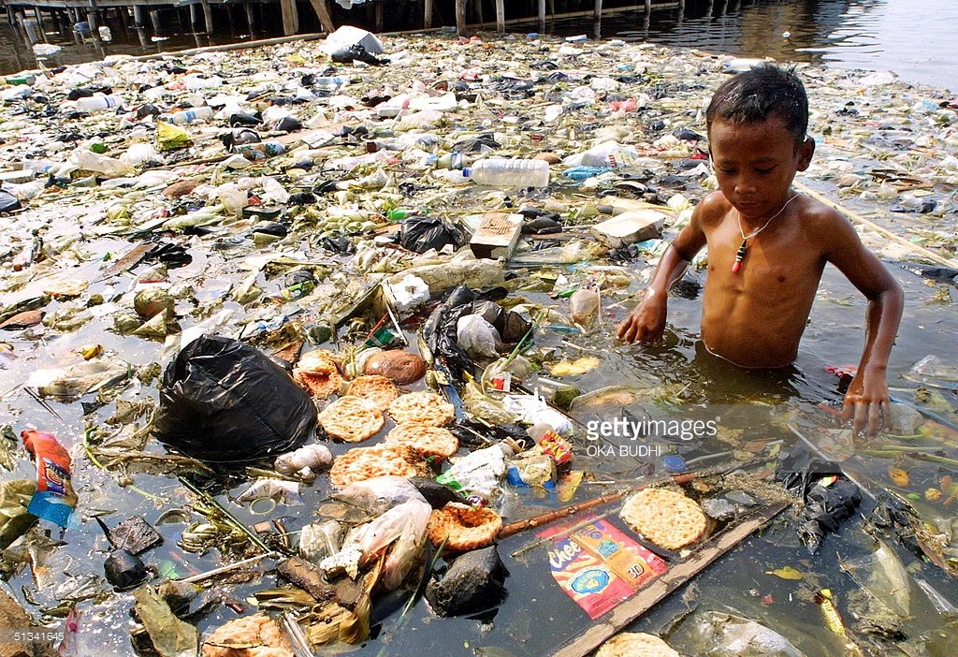
2. Solid Waste

Slide 11
Global Plastic Waste (in billions of tons)

Slide 12
3. Globalization of Trade and Travel

Slide 14
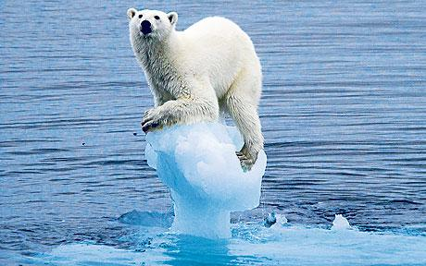
4. Global Warming

Slide 16
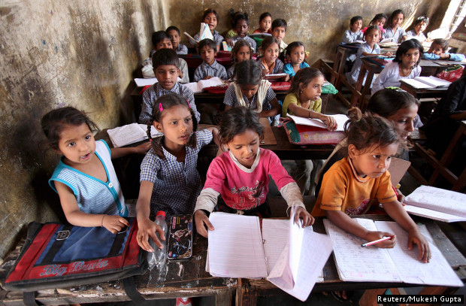
5. Lack of Education/Awareness

Slide 18
Biomedical vs. Social and Environmental Interventions to combat Dengue
Compared to strategies aimed at improving social and environmental determinants of health (poverty, pollution, education) –
Biomedical interventions are:
less costly
more expedient (easier to implement, more acceptable, and easier to evaluate)
more easily commercialized

Slide 19
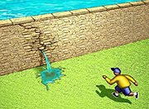
Fundamental solutions, or stop-gap measures?
Biomedical interventions, efficacy and effectiveness notwithstanding, don’t really address the root causes that are driving the global spread of dengue and other arboviruses

Slide 20
Goal – Increase measles vaccine coverage rate among 1-4 year-olds from 70% to 90%
Clinic hours too short
Cost of vaccine
Motivated staff
Political support
Weak cold chain
70%
Donor funds available

Slide 21
Goal: Reduce Dengue Morbidity and Mortality ====➔
Bio-medical Interventions
Social Determinants
Global Warming
Vector Control
Dengue Vaccine
Solid Waste
Surveillance/
diagnostics
Urban Migration
DENGUE
Morbidity &
Mortality
Coalitions/
Funds &
Awareness
Globalization

Slide 24
Polio in Afghanistan 1994 - 2015

Slide 25
Chinese – Taipei 1955-1983
Notes:
.

Slide 26
Summary of Key Points
Dengue’s global spread being driven by social and environmental factors that have no easy solutions
New biomedical interventions will help, but are not aimed at alleviating the underlying factors that are driving dengue’s global spread
We must remain vigilant, expect set-backs, and not over-promise
We must also strive to find strategies that address the social and economic determinants of global dengue’s spread and realize that in the case of dengue, biomedical interventions alone are treating the symptoms, but not the underlying cause of disease.

Slide 28
Medigen Vaccine Biologics

Slide 29
Chinese - Taipei
Taiwan was once known as Garbage Island. Now, it has an impressive recycling rate of 55%.
Chinese – Taipei

