Slide 1
APEC Conference on the Innovation, Achievement and Sustainable Development in Public Health Emergency Response Systems 10 years after SARS Epidemic July 5-6, 2013 Taipei

Slide 2
Conference Information
Date： July 5-6, 2013
Host：Taiwan Centers for Disease Control
Venue: gis MOTC Convention Center
Conference Topics
Innovation and Application in Health Information Technology
Public Health Human Resource and System Reform
Sustainable Development in Prevention and Control of Emerging Infectious Diseases

Slide 3
The conference gathered 31 delegates from 15 member economies, including Australia, Brunei Darussalam, Canada, Chile, China, Indonesia, Japan, Korea, Malaysia, Papua New Guinea, Peru, the Philippines, Thailand, the United States, and Vietnam, 1 delegate from the United Kingdom and about 90 domestic experts.
Three objectives of this conference
To demonstrate the latest health information technologies and innovation in public health emergency response system in order to enhance APEC developing economies’ capacity building in health emergency response.
To identify the major challenges and constraints in APEC developing economies’ public health emergency response system and mitigate the health and economic impacts of potential infectious disease pandemic.
To create an expert network to contribute to long-term and effective cooperation in the APEC developing economies' capacity building in public health emergency response system.

Slide 5
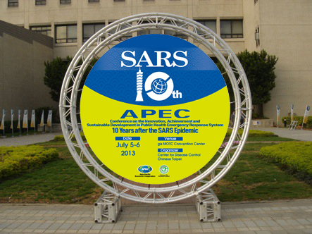

Slide 6
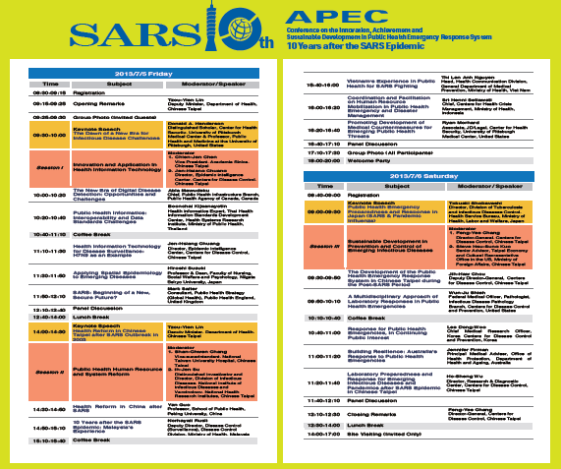

Slide 7
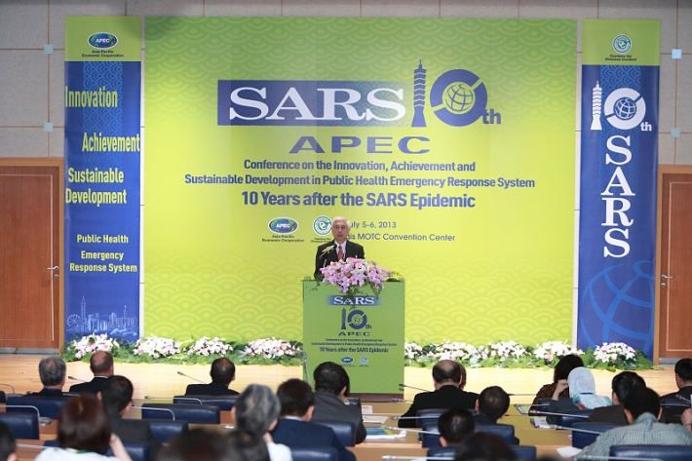
Opening Remarks

Slide 8
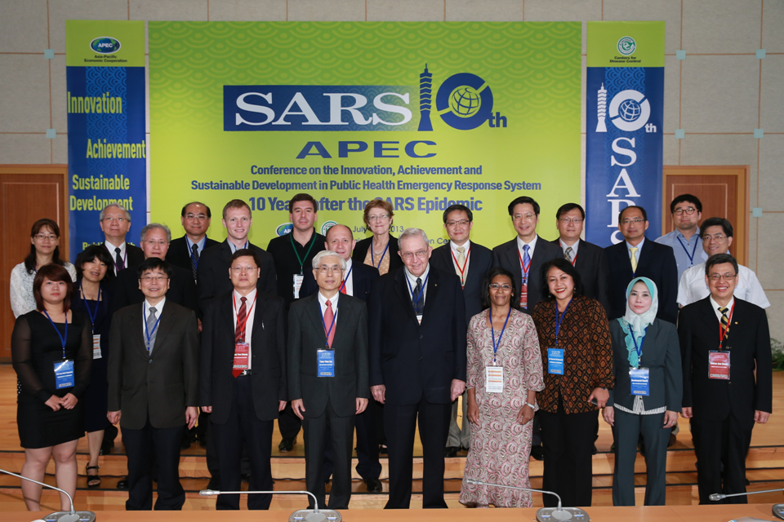
Moderators and Speakers

Slide 9
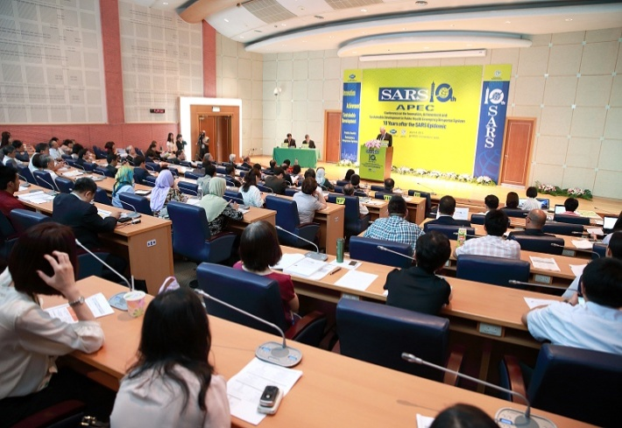
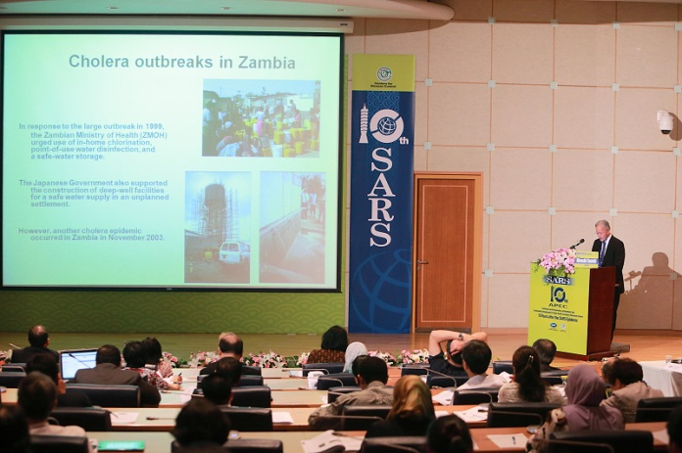
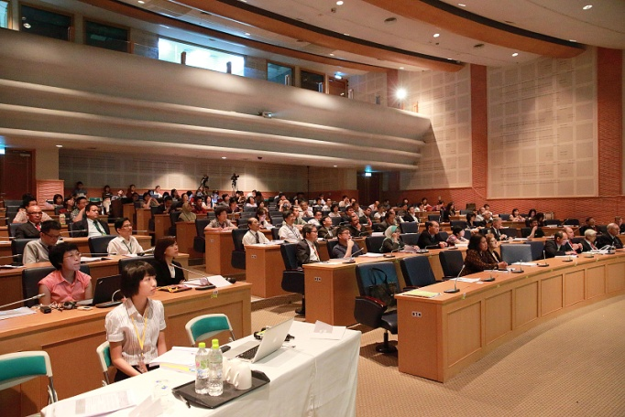
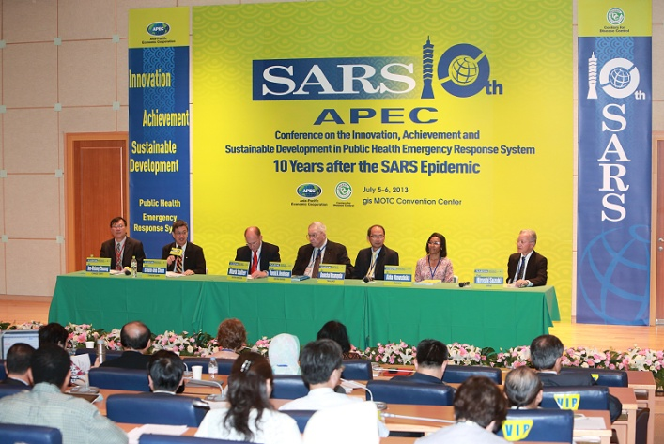

Slide 10
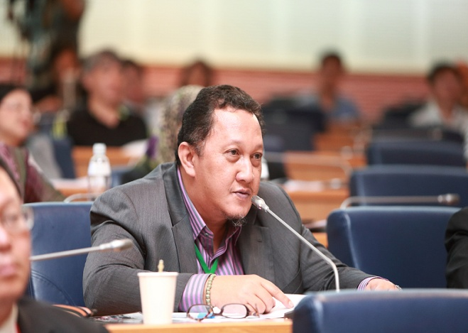

Slide 11
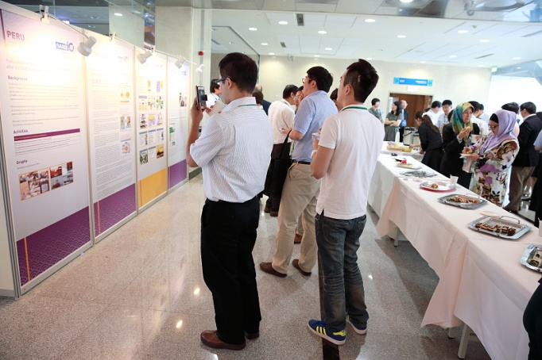
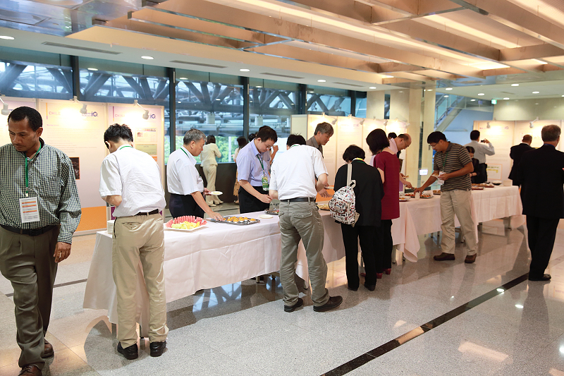
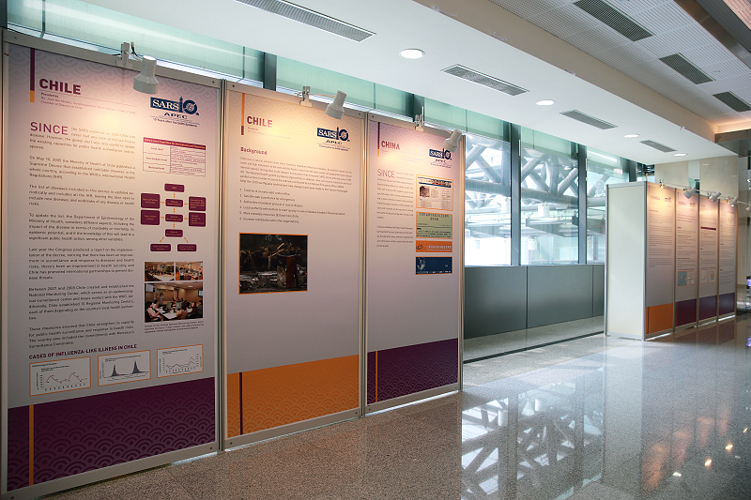
Coffee Break

Slide 12
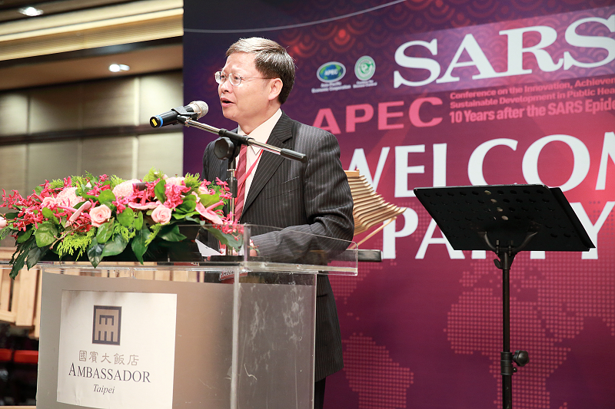
Welcome Banquet

Slide 13
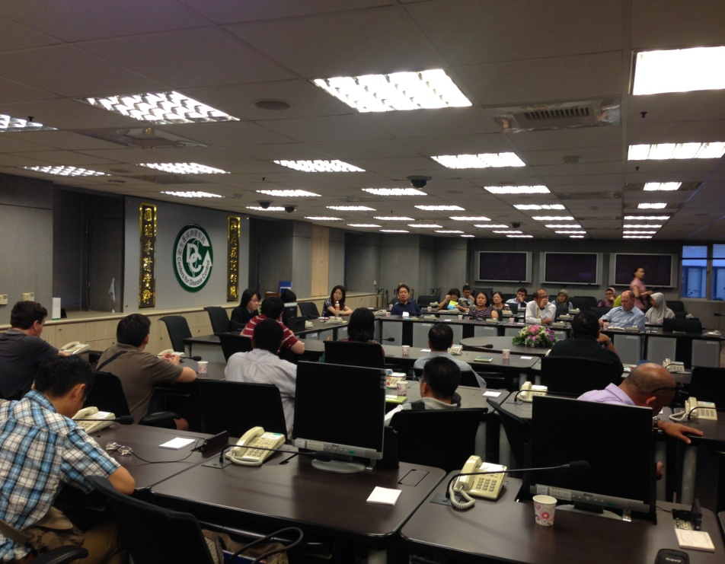
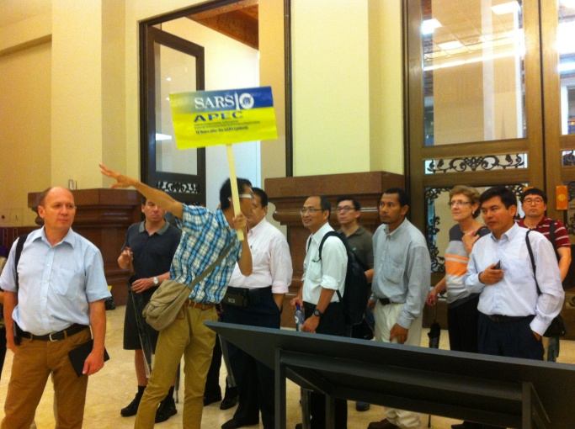
Site Visiting
Chiang Kai-shek Memorial Hall
Taiwan CDC

Slide 14
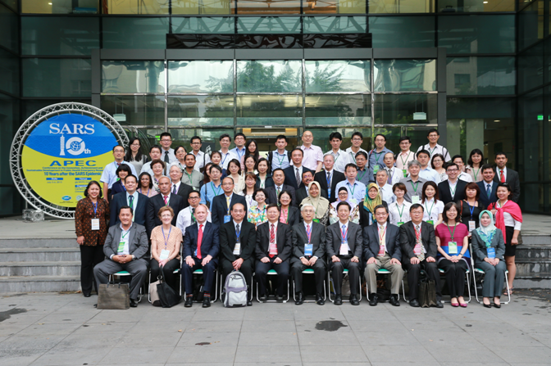
Group Photo

