Slide 1
Introduction to the NIAID
live attenuated tetravalent
dengue vaccine
Stephen Whitehead, 3 May 2018
APEC, Tainan

Slide 2
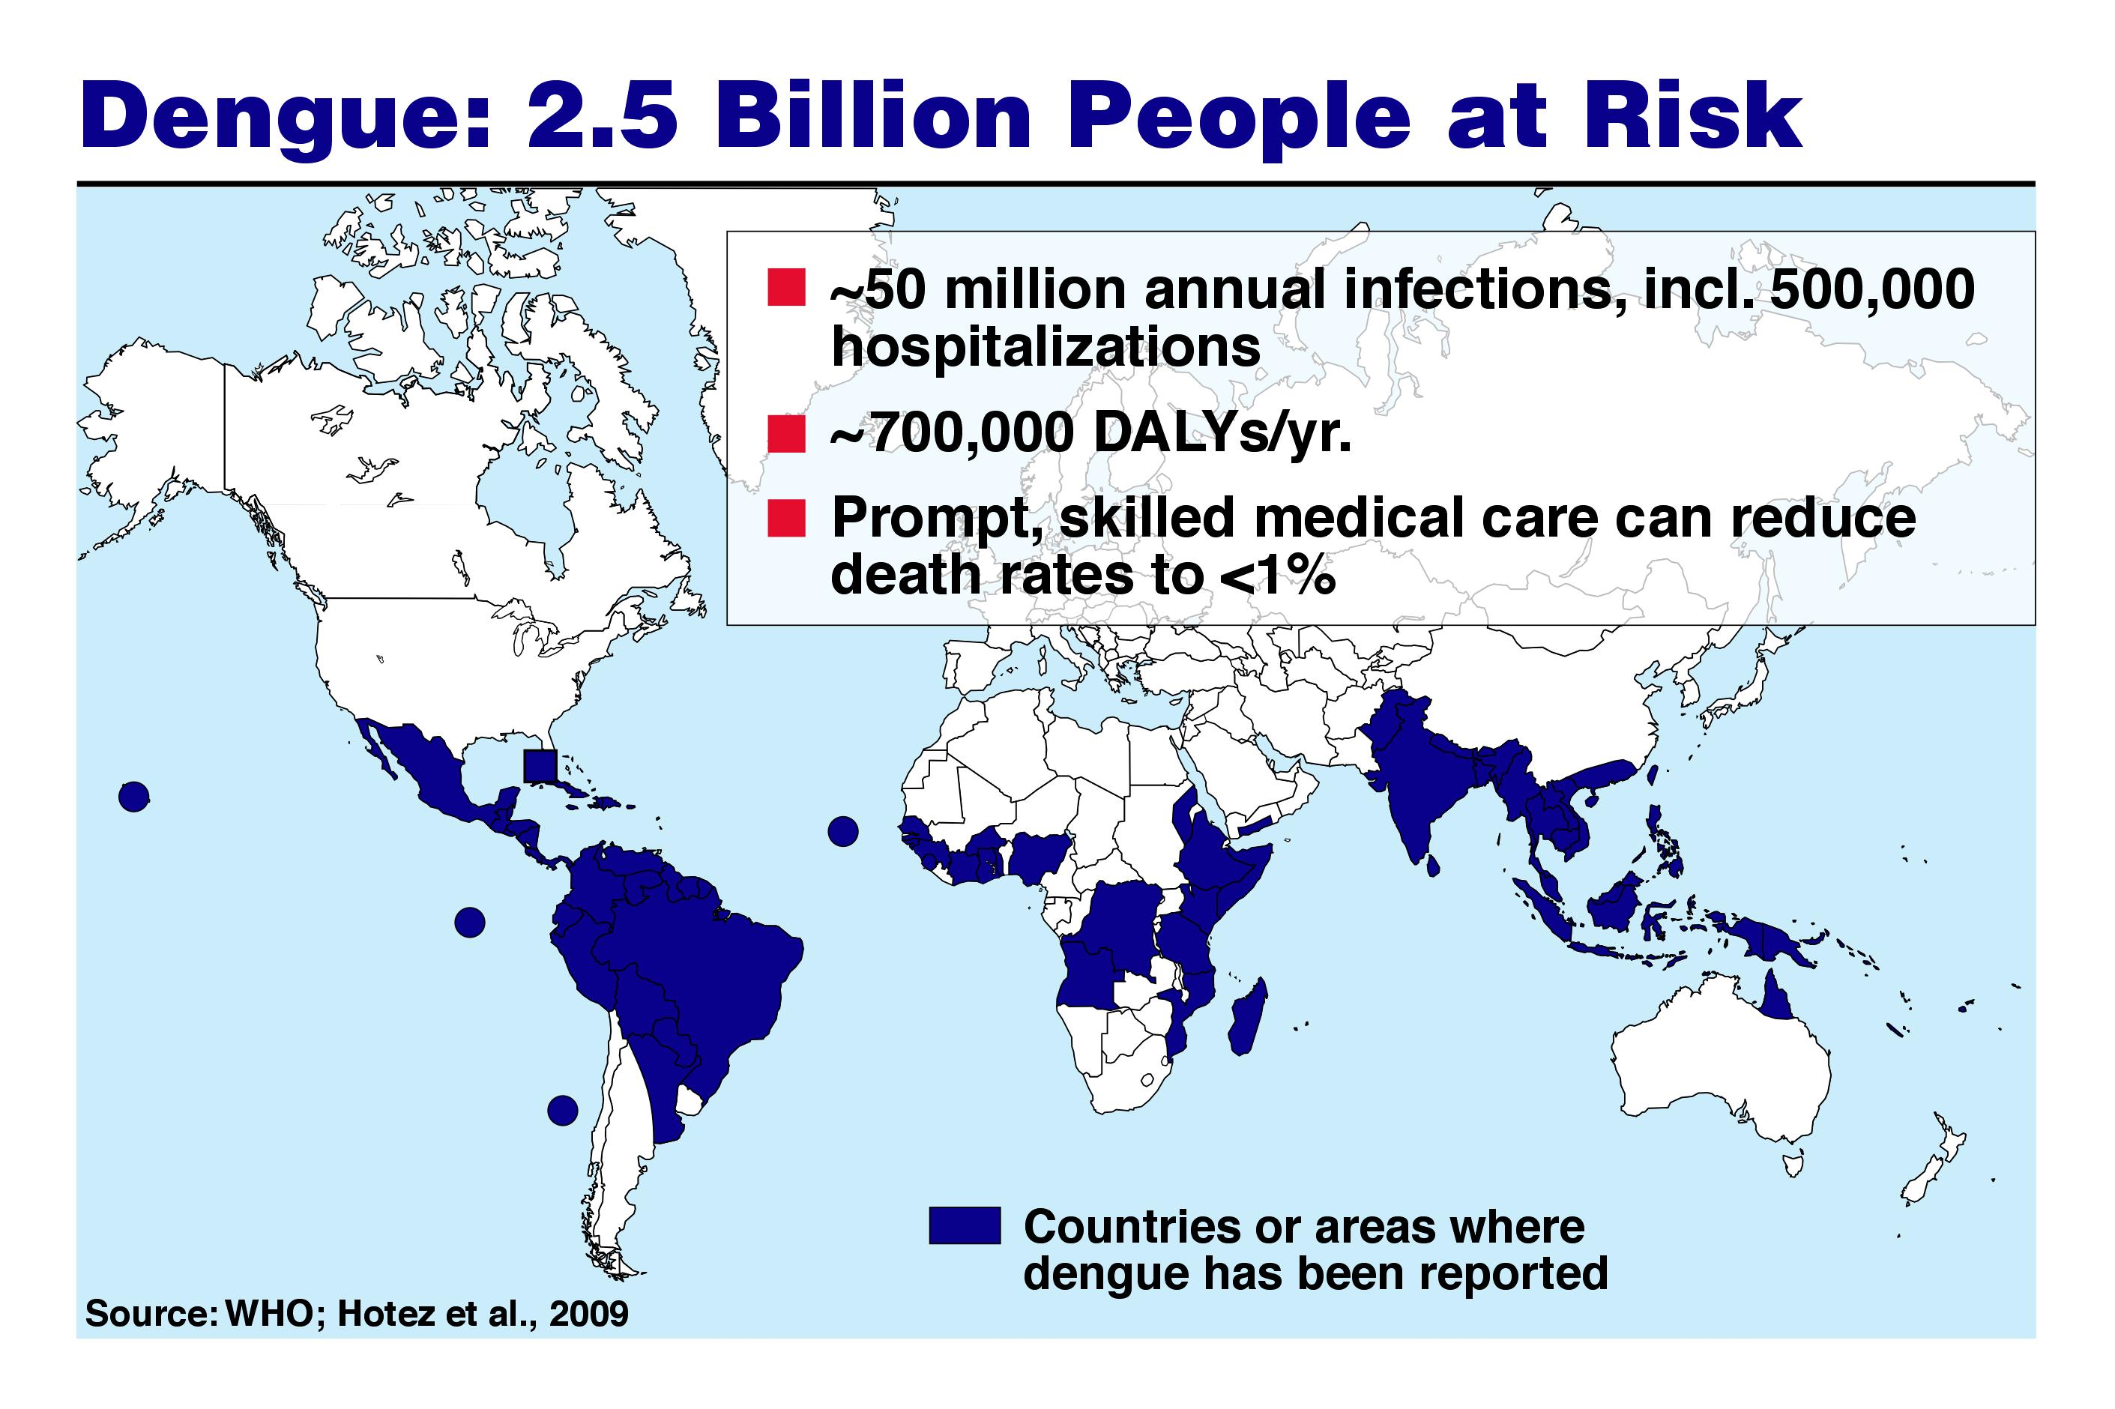
390 million annual infections
96 million infections are clinically apparent
Endemic in over 100 countries
Skilled medical care can reduce death rate <1%
Source: WHO and Bhatt et al., Nature 2013
Dengue is both an established disease and an emerging/re-emerging disease

Slide 3
Why develop a live attenuated DENV vaccine?
  Successful for other flaviviruses: YFV and JEV
  Induces both humoral and cellular immune responses
  Antigens and epitopes are in their native conformation
  Expected to induce lifelong immunity
  Can be very economical to produce
  Highly immunogenic, requiring only one dose

Slide 4
Dengue vaccine Target Product Profile
- T. Monath
Safe: Low reactogenicity, not transmissible by mosquitoes
Suitable for ages 1 yr to elderly adults
Single dose (or multiple doses with rapid primary schedule)
Durable immunity. Boosters? None or at intervals ≥3 years
Neutralizing antibodies to all 4 serotypes
>70% efficacy ideally against all dengue serotypes
No interference from other flaviviruses or prior dengue
No increase in severe dengue on subsequent exposure
Thermostable formulation (cold chain acceptable)
Large scale manufacturing (>100M doses/year)
Low cost, affordable pricing strategy for global access

Slide 5
18 years of DENV vaccine development at NIAID
1999 - 2012
2013 - 2018
Pre-clinical
candidates
(monkeys 180+)
Phase I
monovalent
(700+)
Phase I
tetravalent
(200+)
Phase II
tetravalent
(800+)
Phase III
tetravalent
(16,000+)
DEN1Δ30
DEN1/4
DEN1/4Δ30
DEN1/4Δ30(CME)
DEN1mutF
DEN2Δ30
DEN2Δ30-4995
DEN2/4
DEN2/4Δ30
DEN2/4Δ30(CME)
DEN2-3’D4Δ30
DEN3Δ30
DEN3/4
DEN3/4Δ30
DEN3/4Δ30(CME)
DEN3/4Δ30(Sri Lanka)
DEN3Δ86
DEN3Δ30/31
DEN3-3’D4Δ30
DEN4Δ30
DEN4Δ30-200,201
DEN4Δ30-436-437
DEN4Δ30-4995
★
DEN1Δ30
DEN2/4Δ30
DEN3Δ30/31
DEN4Δ30
DEN1Δ30
DEN2/4Δ30
DEN3Δ30/31
DEN4Δ30
DEN1Δ30
DEN2/4Δ30
DEN2Δ30
DEN3/4Δ30
DEN3Δ30/31
DEN3-3’D4Δ30
DEN4Δ30
DEN4Δ30-4995
DEN4Δ30-200,201
DEN1Δ30
DEN2/4Δ30
DEN3Δ30/31
DEN3-3’D4Δ30
DEN4Δ30
DEN4Δ30-200,201
100’s of virus constructs

Slide 6
18 years of DENV vaccine development at NIAID
1999 - 2012
2013 - 2018
Pre-clinical
candidates
(monkeys 180+)
Phase I
monovalent
(700+)
Phase I
tetravalent
(200+)
Phase II
tetravalent
(800+)
Phase III
tetravalent
(16,000+)
Tetravalent DENV:
DEN1
DEN2
DEN3
DEN4
Structural
Non-structural
Δ30
5´
C
prM
E
NS1
NS2A
NS2B
NS3
NS4A
NS4B
NS5
3´
rDEN1Δ30
∆30
5´
C
prM
E
NS1
NS2A
NS2B
NS3
NS4A
NS4B
NS5
3´
rDEN2/4Δ30
∆30/31
5´
C
prM
E
NS1
NS2A
NS2B
NS3
NS4A
NS4B
NS5
3´
rDEN3Δ30/31
Δ30
5´
C
prM
E
NS1
NS2A
NS2B
NS3
NS4A
NS4B
NS5
3´
rDEN4Δ30
The Δ30 mutation: Decreases expression of subgenomic RNA which we have shown to increase susceptibility to type I IFN

Slide 7
Live attenuated dengue vaccines
 | Dengvaxia (Sanofi Pasteur) | TDV (Takeda) | TV003/TV005 (NIH/Butantan)
Status | Licensed | Phase 3 | Phase 3
Doses | 3 doses (0, 6, 12 mos.) | 2 doses (0, 3 months) | 1 dose
Indicated age | 9 - 45 | Phase 3 age range 2 - 16 | Phase 3 age range 2 - 59
Other | Seroprevalence ≥ 70% | ? | ?
Construct
DENV-1
YFV
DENV-2
DENV-3
DENV-4

Slide 8
NIAID-Sponsored Clinical Trials
JHU – PI: Dr. Anna Durbin
★
Monovalent – Down Selection | 8
Monovalent – Infectivity, ID₅₀ | 10
Monovalent – 2 dose | 3
Tetravalent - Formulations | 5
Tetravalent – Expanded safety | 2
Tetravalent – 2 dose | 2
Tetravalent – Flavivirus-experienced | 1
Tetravalent – Older adults | 1
Tetravalent – Challenge with DEN2 or DEN3 | 3
Tetravalent – Thailand age de-escalation | 1
Tetravalent - Bangladesh age de-escalation | 1
Total: 37 Trials

Slide 9
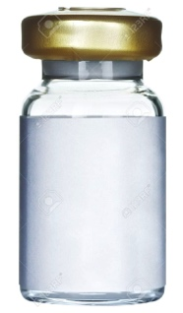


Vaccine formulation to create tetravalent admixtures
Frozen
monovalent
vials
DEN1
DEN2
DEN3
DEN4
Titer
(log₁₀pfu/mL)
7.6
7.8
7.7
7.4
1:20,000
1:3200
1:25,000
1:12,500
1X L-15
diluent
DEN1: 3 log₁₀pfu
DEN2: 4 log₁₀pfu
DEN3: 3 log₁₀pfu
DEN4: 3 log₁₀pfu
TV-005:

Slide 10
Technology licensing partners
Merck & Co.
Medigen
Vabiotech
Butantan Inst.
Serum Inst.
Panacea Bio.
Indian Immuno.

Slide 11
#1 Most common question:
How will the NIAID vaccine strategy address the shortcomings of the
Sanofi Pasteur CYD vaccine (Dengvaxia®)?

Slide 12
Stephen S. Whitehead and Anna P. Durbin
July 17, 2017

Slide 13
Efficacy and Long-term Safety of the
Sanofi CYD vaccine
YR
1
YR
2
YR
3
YR
4
YR
5
Vaccination
Efficacy
Hospitalization follow-up
Year 3 Safety
Severe hospitalized dengue:
Vaccine group | Vaccine efficacy % (CI) | Relative risk of hospitalization
Age > 9 yr (Sero-positive) | 91% (58 - 99) | 0.57
Age < 9 yr (Sero-negative) | 45% (-54 - 80) | 1.58
Age group | Relative risk of hospitalization
2 – 5 years | 7.45
6 – 11 years | 0.63
12 – 14 years | 0.25
CYD14, Hadinegoro et al., 2015, NEJM

Slide 14
Infection with live vaccines
For live vaccines – infection is required for immune stimulation
→ Antigen load is generally minimal and insufficient for immune response
Infection
Viremia
Immunity
Clinical
signs
Replicating virus in the blood
(Viral load):
Direct culture of serum
RT-PCR for viral genome
Neutralizing antibody
Seroconversion
Boosting
T-cell immunity
CD4
CD8
Clinical side effects
Adverse events
Clinical signals

Slide 15
TV003 & TV005 induce balanced viremia following first dose, CYD does not
 | Percentage of subjects with detectable viremia by culture post-vaccination (% by PCR¹)
 | DENV-1 | DENV-2 | DENV-3 | DENV-4
TV003 (n=84) | 25 | 7 | 38 | 30
TV005 (n-84) | 25 | 19 | 38 | 24
CYD, Day 7 (N-12)² | 0 (0) | 0 (0) | 0 (17) | 8 (50)
CYD, Day 7 (n=84)³ | 0 (0) | 1 (2) | 0 (11) | 2.1 (30)
CYD(n=25)⁴ | (0) | (4) | (0) | (52)
CYD (n=95)⁵ | (7.4) | (0) | (12.6) | (44.2)
★
★
PCR not done for TV003 and TV005 vaccines. Viremia measured through day 16
Qiao et al, ASTMH, 2011. Viremia measured on day 7
Poo, et al, 2001, viremia measured on day 7
Dayan, et al, 2014; CYD 5:5:5:5 formulation. Viremia measured by PCR only
Torresi, et al 2017; CYD lot-to-lot consistency trial. Viremia measured on days 6, 8, 10, 14, 20

Slide 16
Antibody responses after multiple doses
All studies in flavivirus-naïve subjects:
Fraction of
total response
 |  |  | Mean titer (GMT) (PRNT₅₀)
Vaccine | N | Dose | DEN1 | DEN2 | DEN3 | DEN4
CYD Adults US | 101 | 1 | 9 | 13 | 23 | 643
NIH | 135 | 1 | 58 | 83 | 130 | 224
4
1
4
2
3

Slide 17
Antibody responses after multiple doses
All studies in flavivirus-naïve subjects:
 |  |  | Mean titer (GMT) (PRNT₅₀)
Vaccine | N | Dose | DEN1 | DEN2 | DEN3 | DEN4
CYD Adults US | 101 | 1 | 9 | 13 | 23 | 643
 |  | 2 | 19 | 32 | 40 | 164
 |  | 3 | 24 | 47 | 43 | 134
Dayan. et al. 2013
Heterotypic antibodies
No DENV T cells
CYD is principally a DEN4 vaccine
DEN4 response is not boosted at second and third dose
DEN1, DEN2, DEN3 responses increase after subsequent doses

Slide 18
Dengvaxia® (Sanofi-Pasteur)
Dengvaxia® works as a “catch-up” vaccine:
  Must be dengue “experienced” prior to vaccination
  → Mother Nature provides the first dose
  Efficacy against serious dengue disease can be as high as 92%
Dengvaxia® is a safety concern in dengue naïve recipients:
  < 9 years old: Not recommended for use
  > 9 years old: Confirm dengue seropositivity prior to vaccination
  Principally a monovalent DENV-4 vaccine
  Vaccination may predispose to severe secondary dengue
Bottom line (what have we learned?):
Incomplete or partial immunity to DENV is dangerous
T cells may be an important contributor to protection

Slide 19
Dengvaxia® (Sanofi) vs. NIH vaccine
Dengvaxia® | NIAID
3 dose | 1 dose
Imbalanced response | More balanced response
Low efficacy against vaccine | High efficacy against vaccine
Unknown efficacy against challenge | High efficacy against challenge
Moderate efficacy against disease | Unknown efficacy against disease
Poorly infectious in sero-naïve’s | Infectious in sero-naïve’s
CD8 T-cell epitopes: YFV | CD8 T-cell epitopes: DEN 1, 3, 4
1
4
2
3

Slide 20
#2 Most common question:
TV003 or TV005?

