Slide 1
Clinical predictors and case management of severe dengue in Singapore
Prof Leo Yee-Sin
Clinical Director Communicable Disease Centre CDC
Executive Director National Centre for Infectious Diseases NCID
Singapore

Slide 2
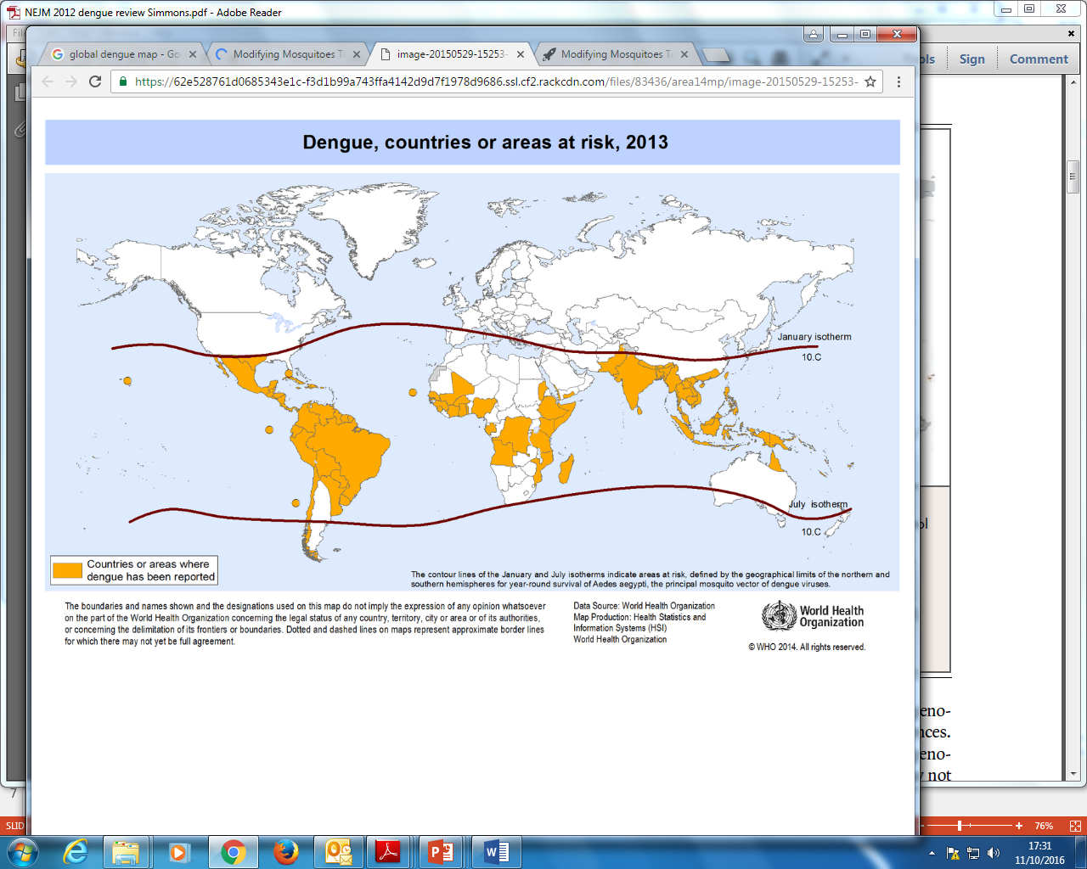
2.5 billion people -40% of world population – are at risk of dengue
100 million dengue virus infections worldwide every year
Half a million with severe dengue
Singapore

Slide 3
Despite vector control, low breeding index, Singapore faces successive waves of dengue epidemic
Predominantly adult dengue and increasingly more senior adults
Increasing recognition of atypical dengue
ZIKA outbreak 2016

Slide 4

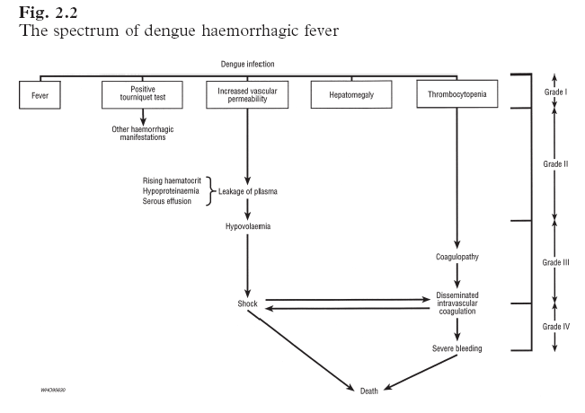
Dengue Fever
Dengue Hemorrhagic fever
Dengue Shock Syndrome
WHO 1997

Slide 5
Dengue haemorrhagic fever (DHF)
A case must meet all 4 criteria
  Fever lasting 2-7 days
  Haemorrhagic tendency shown by positive tourniquet test or spontaneous bleeding
  Thrombocytopenia (<100K/L)
  Evidence of plasma leakage shown by either hemoconcentration or development of pleural effusions/ascites, or both
  DHF is further classified into 4 severity grades based on presence/absence of shock
WHO 1997
Notes:
5

Slide 6

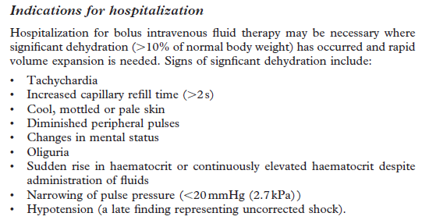
World Health Organisation 1997
Recognition of hypovolemia

Slide 7
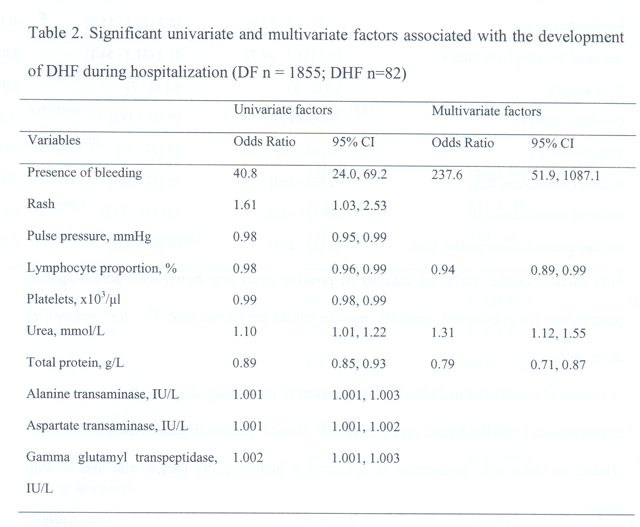
TTSH 2004 dengue cohort
Bleeding
Lymphocyte %
Urea
Total protein
LeeVJ et al Journal of Clinical Virology 42 (2008)34

Slide 8
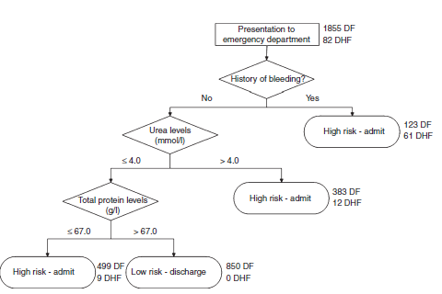
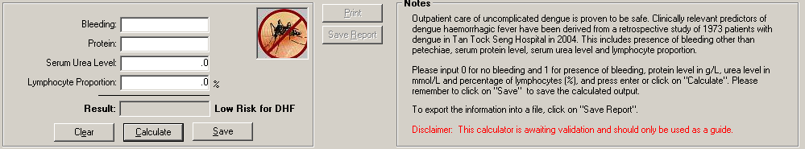
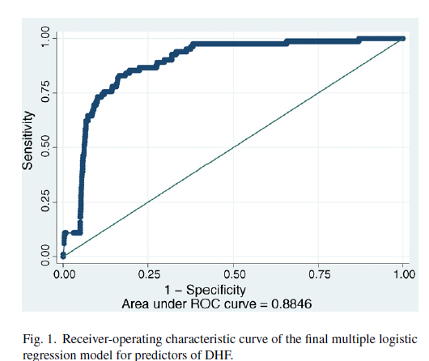
Research to support clinical management
Implemented March 2007
New criteria:
  Platelet ≤50,000/mm³
  Hematocrit ≥50%
  BP ≤90/60 mmHg
  Postural drop in BP >20mmHg
  Pulse ≥100/min
  Bleeding (except petechiae)
  Clinically unwell status
  Fulfill predictive model(s)
Lee, V.J. et al. Trop. Med. Int. Health 14, 1154-1159 (2009).

Slide 9
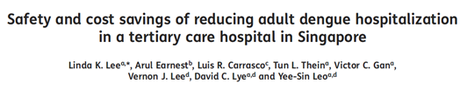
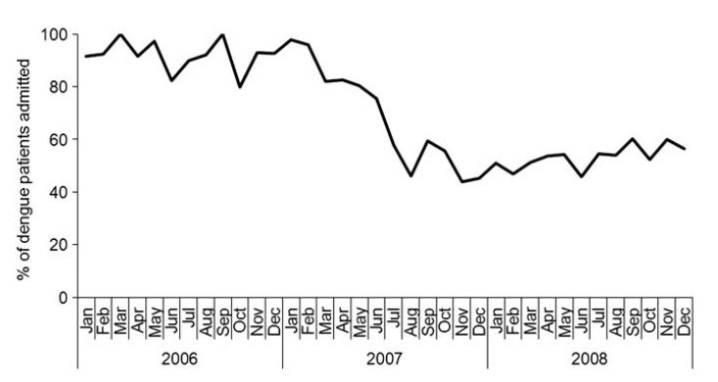
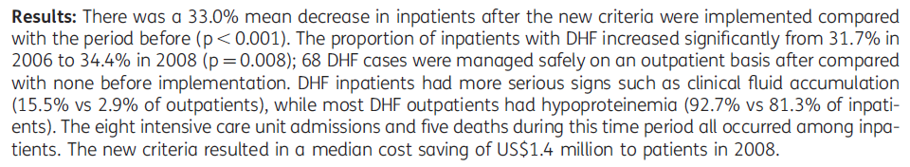
~30.5% hospitalised in the 2013 outbreak
(versus 78-83% in 2004-2005)
Trans R Soc Trop Med Hyg 2013;
107:37-42

Slide 10
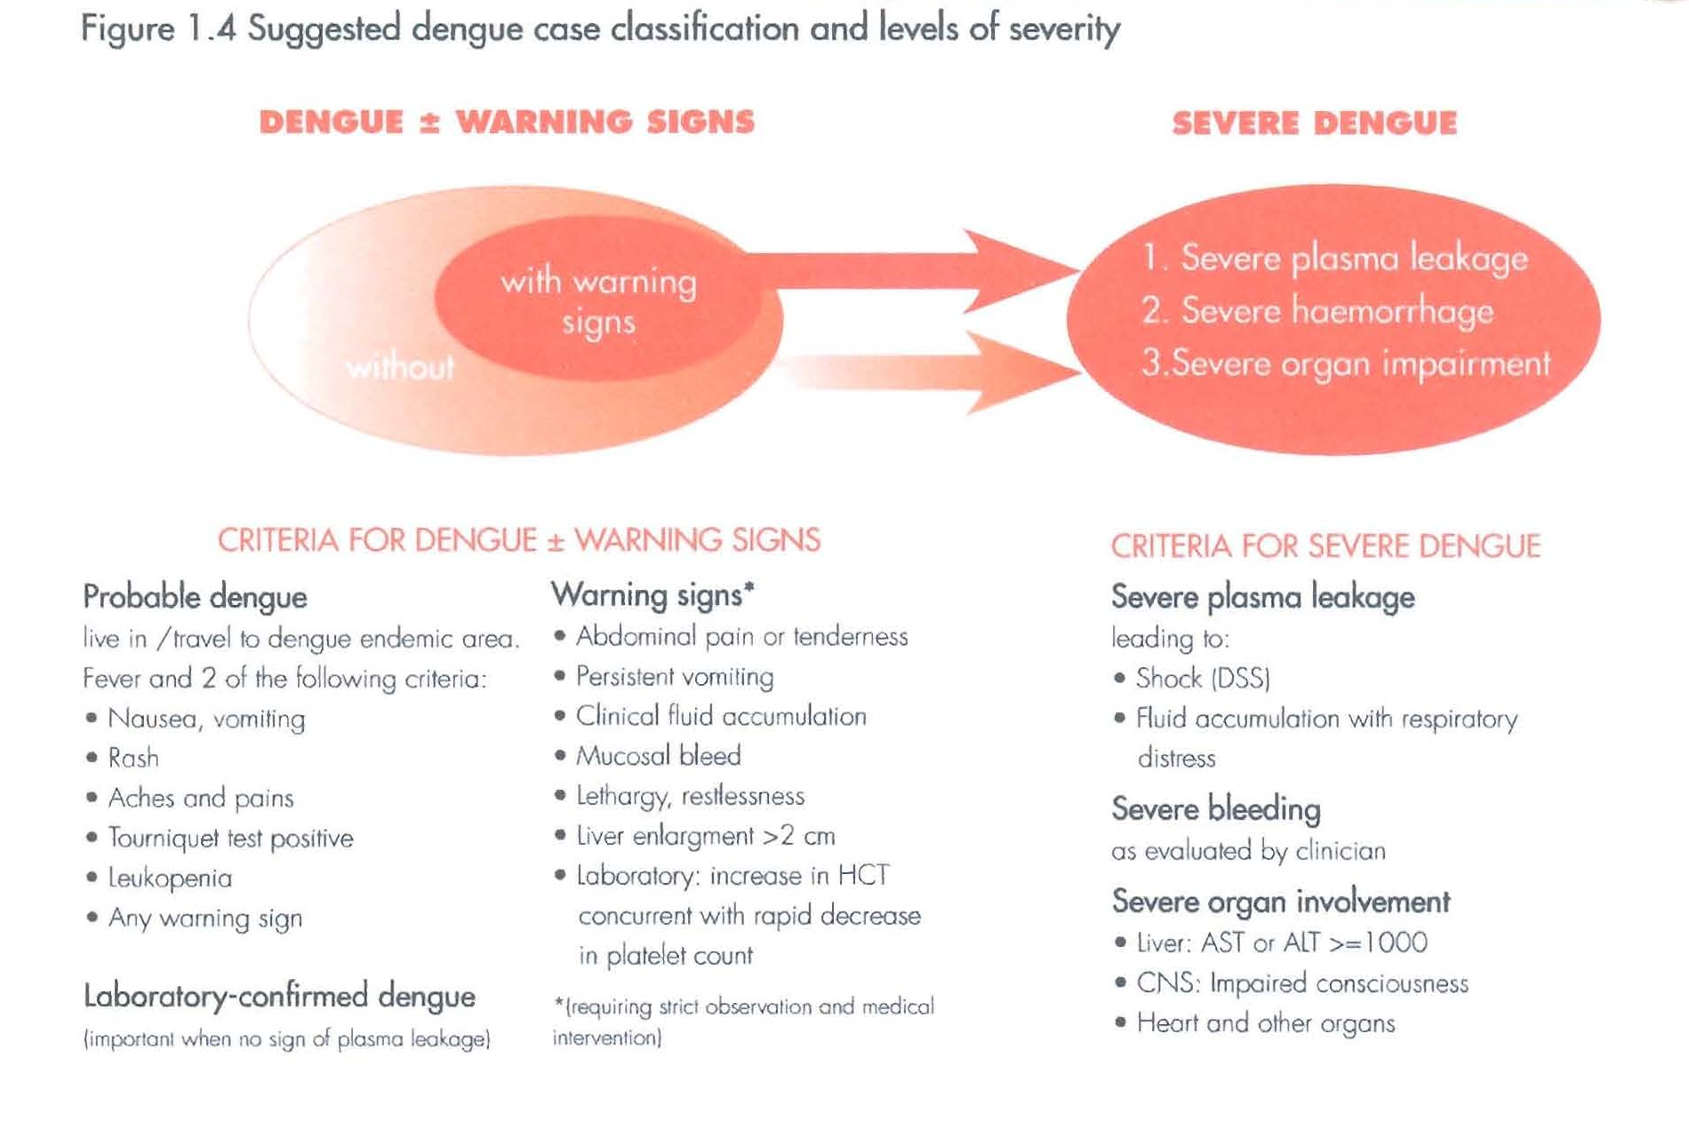
WHO 2009

Slide 11
WHO 2009

Slide 12
Expect the unexpected
“Atypical” presentations

Slide 13
WHO 2009

Slide 14
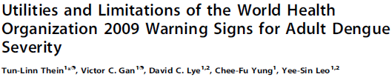
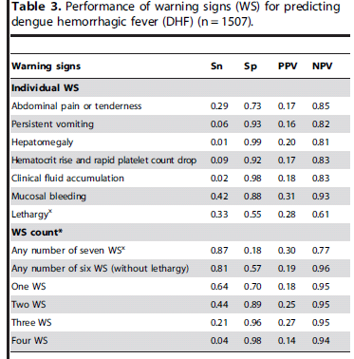
PLOS NTD 2013;7:e2023
Predicting DHF
NPV 0.96 in the absence of any WS
> 3 WS specific but not sensitive

Slide 15
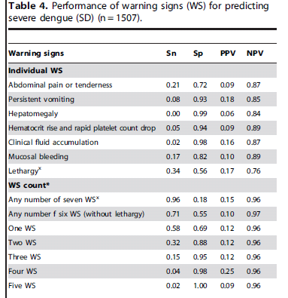
Predicting severe dengue
NPV 0.97 in the absence of any WS
PLOS NTD 2013;7:e2023

Slide 16

Prospective study
Enrolment site: Communicable Disease Centre, CDC
Jan 2010 to Sept 2012
Include outpatients and inpatients (2 cohorts: emergency dept ED and Outpatient cohort)
Febrile, > 18 years old
Confirmed dengue by PCR and NS1 (WHO standard)
Dengue research Clinic managed by 3 well-trained Medical officers

Slide 17
Mucosal bleeding the most common WS
NPV for severe disease in the absence of any WS was 100%

Slide 18
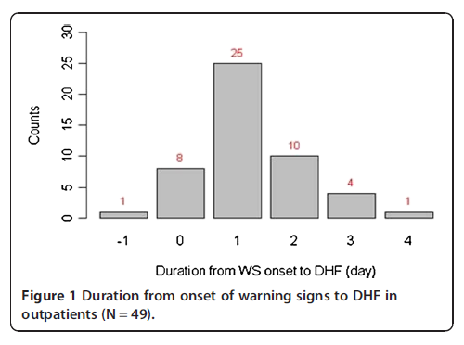
Majority had WS 1 day prior to onset of severe illness

Slide 19
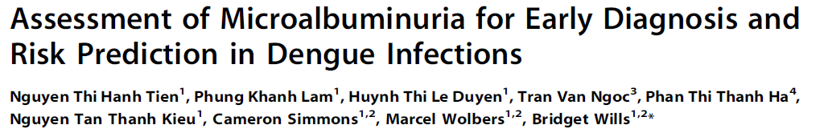
Considerable within-patient variation
Higher UACR values in dengue cases
Peak UACR values for dengue cases observed around day 5

Slide 20
PADS prospective study
168 dengue cases
34 DHF

Slide 21
WHO 2009

Slide 22
SEARO 2011

Slide 23
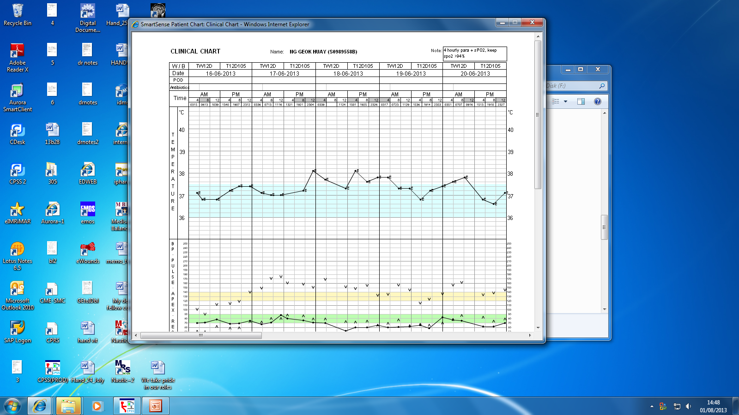
75 years old Chinese female, DM, HTN, HLD, dementia Premorbid ADL independent
non toxic
T 37.9, BP 147/76, HR 102, 98% RA
H S1S2, Lung clear, Abd Soft, no hepatomegaly
Calf supple, No pedal oedema
TWC 14,900/ul, Poly 96%
Hb 10.6g/dl, Hct 31.9%
Platelet 129,ooo/ul
Cr 129 umol/L, S Bil 160u/l
AST 52u/l ALT 69u/l ALP450u/l
Fever x 3/7, a/w jaundice x 2/7 with tea colour urine, a/w vomiting, chills and rigor and myalgia, No dysuria, No abdo pain, No Chest pain, No SOB
No travel, No ill contacts

Slide 24
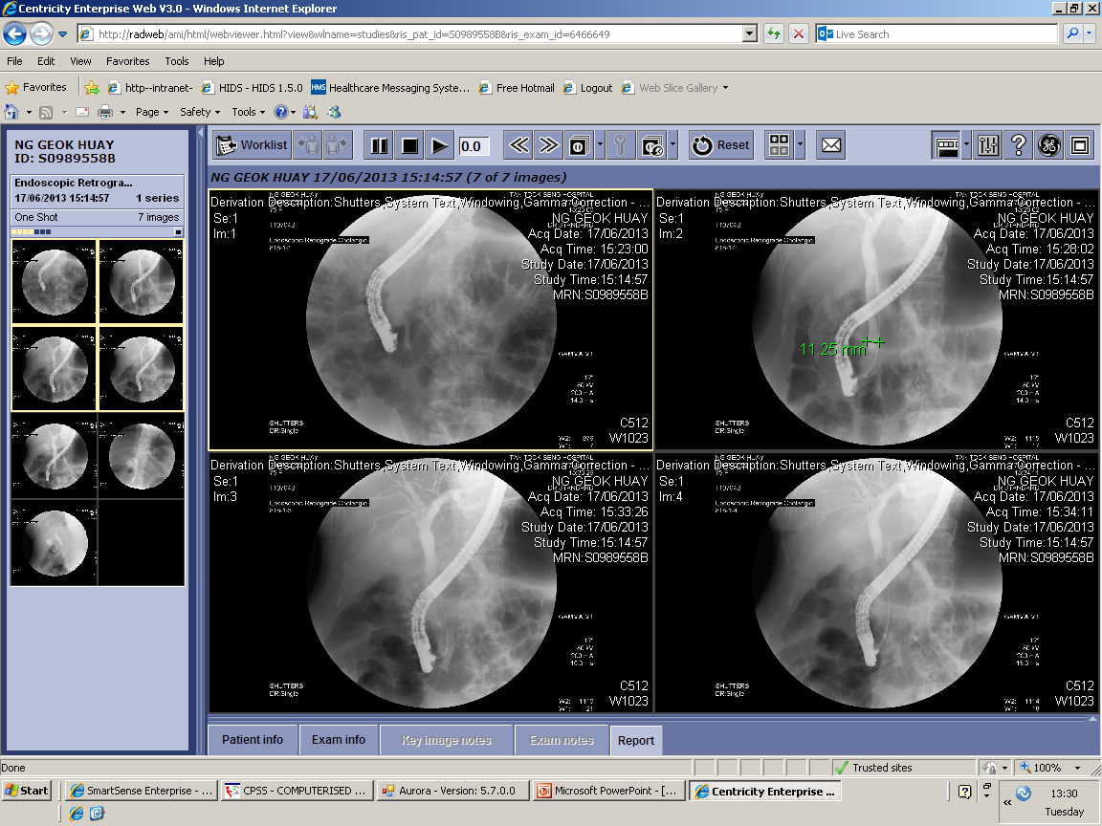
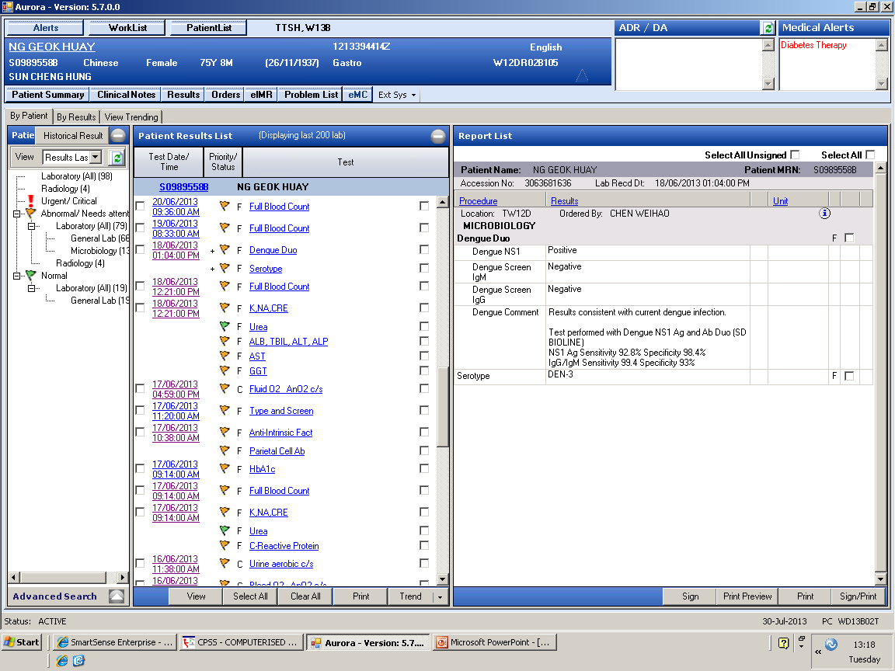
Day 2 hospital day:
Dilated common bile duct
Stone successfully removed
Day 3 hospital day
TWC 8500/ul, poly 91%
Hb 9.5 g/ul
Platelet 92,000/ul
Blood culture
E.Coli

Slide 25
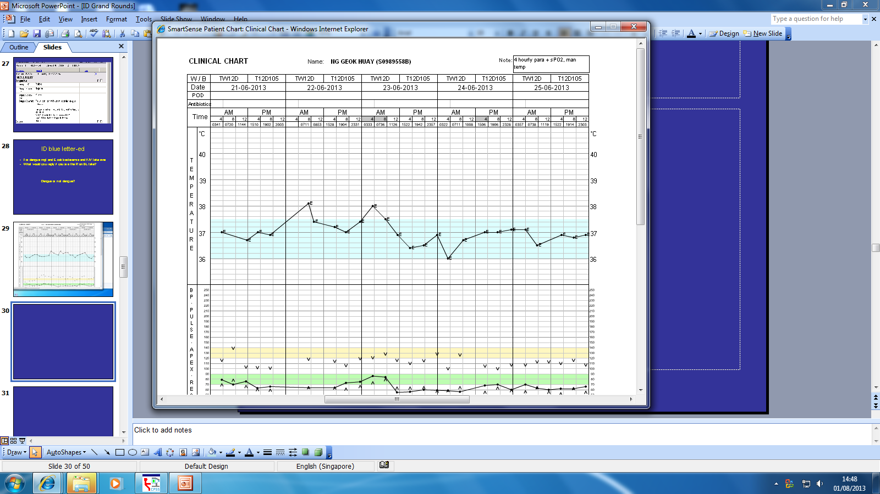
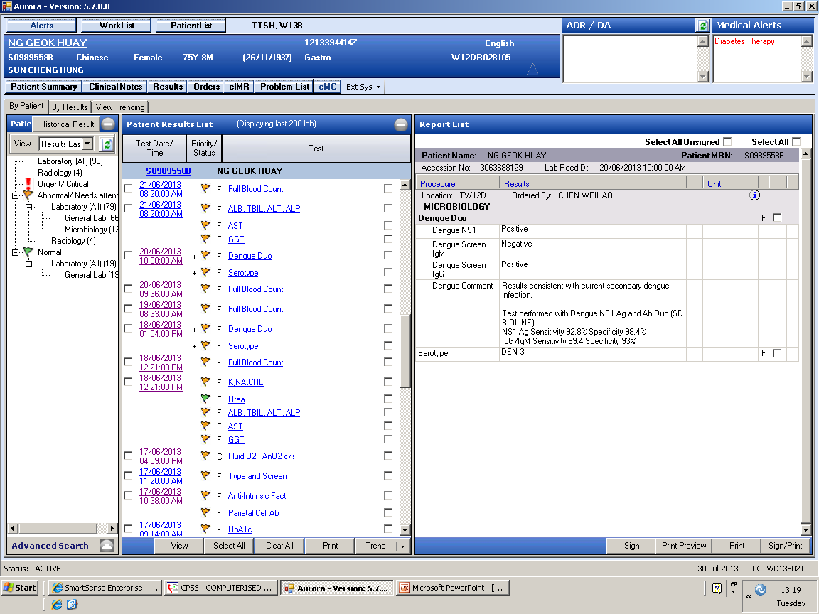
TWC 19.5K
Hct 31.1
Platelet 121K
3.9K
28.2
92K
6.4K
31.5
53K
5.7K
30.9
28K
5.5K
30.2
61K
7.8K
30.5
106K

Slide 26
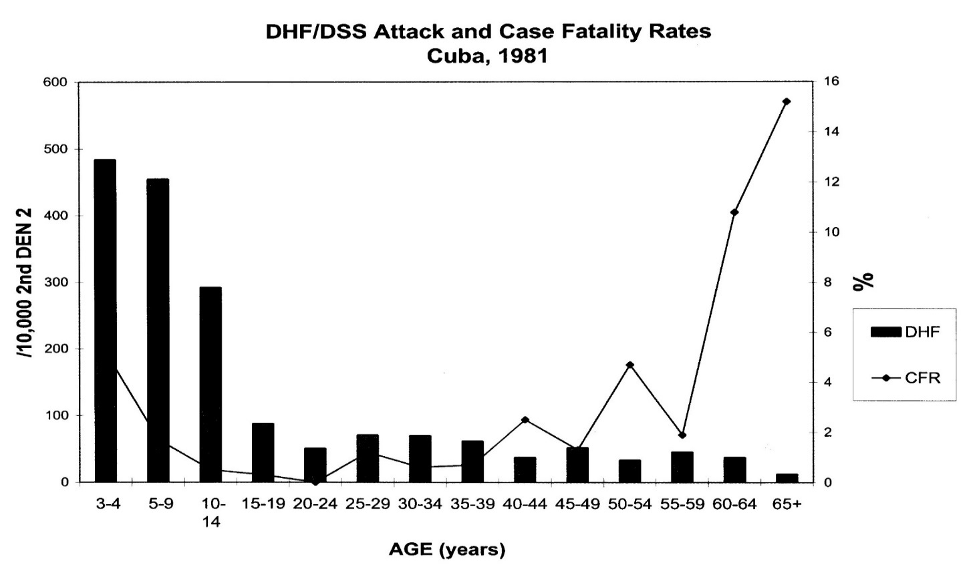

DHF – age in 2º Infection, 1981 Cuba Outbreak
Guzman IJID 2002;6:118
Older adults with dengue have more atypical presentations, more organ involvement, more pre-existing comorbidities, higher mortality, require higher index of suspicion to diagnose, closer monitoring and careful management

Slide 27
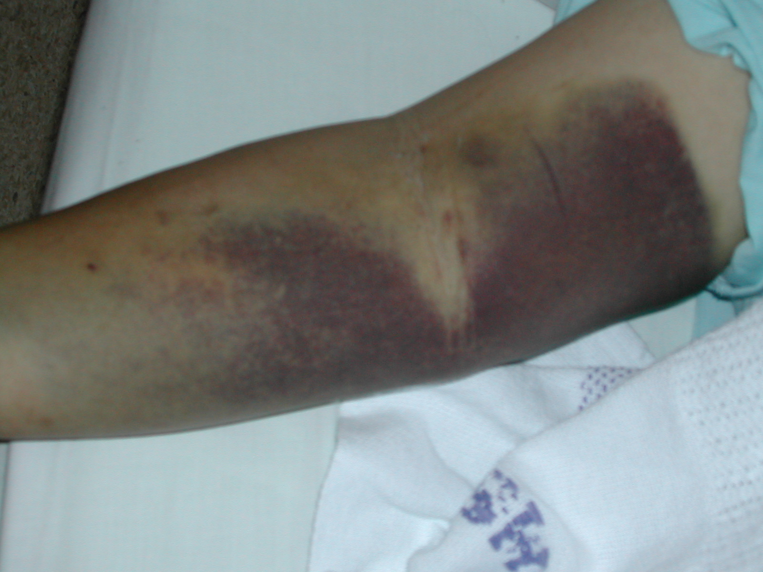
Bleeding in dengue fever

Slide 28
Higher AST/ALT in cases with more severe disease
However, AST/ALT alone was insufficient to differentiate severity of cases

Slide 30

63 female, multiple comorbidities and obese, seen on day 7 of illness with fever, fatigue, anorexia, headache, hematuria, hypotension, Sa02 92%.
Hospitalised on day 27 illness with persistent fever, fatigue, Sa02 90%, Hb 11.3g/dl, ANC 900, PLT 94K, S bil 6.5mg/dl, AST 662, LDH 717IU/L, S.ferritin >7500, PT 250sec, fibrinogen <60, BMAT done
Next 7 days developed bilateral pleural effusion, splenomegaly, hemoptysis, encephalopathy, given IFN for possible WNV infection, hemodialysis, 27 units of blood products. she died at day 38 of illness
Liver biopsy revealed fulminant hepatitis suggestive of a viral process with no overt hepatocyte necrosis
BM revealed 98% nucleotide identity with DENV-3, which was confirmed with DENV-type specific RT-PCR. Anti-DENV immunohistochemistry was negative in both the liver and bone marrow biopsies

Slide 31
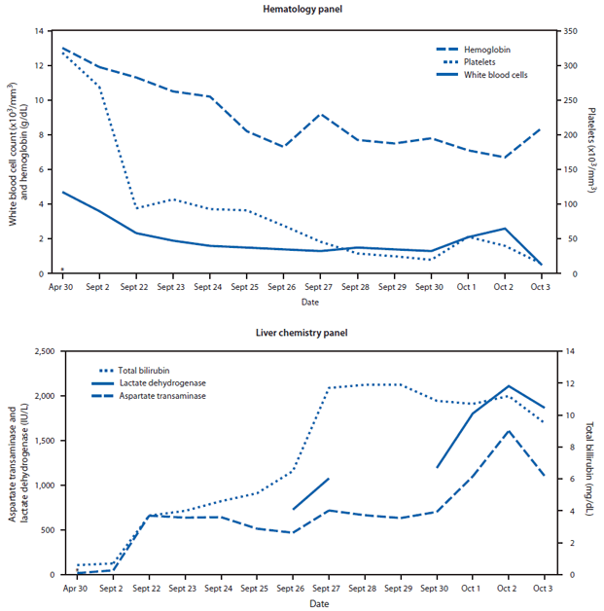
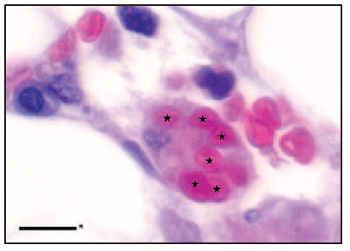
Persistently low PLT, low Hb
stars indicating erythrocytes phagocytized by a macrophage in a hematoxylin and eosin-stained section of bone marrow biopsy
Elevated S.bil, LDH, AST, ALT
MMWR January 24, 2014 / 63(03);49-54

Slide 32
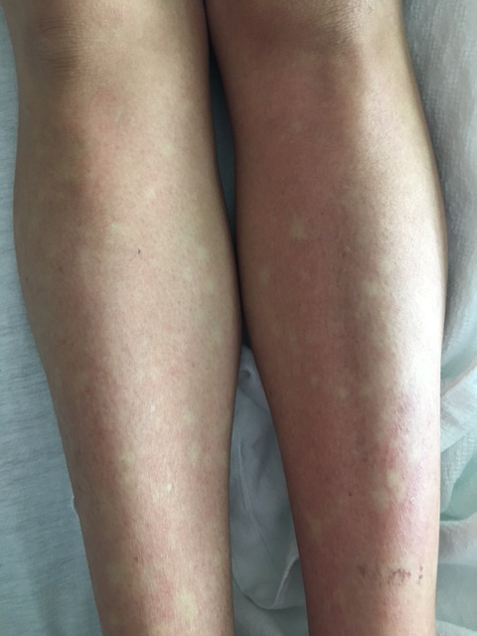
A recent case in Singapore – at day 14 of illness
T 39.5, comfortable, cheerful
Bp 105/58
Hr 85
98% RA, RR 18
No jaundice / anaemia / peripheral stigmata of CLD
Generalised rash with island sparing
Stony dull on percussion on right with decreased AE bilaterally R>L
HS1S2, no murmur
Hepatosplenomegaly with shifting dullness
Pitting oedema
37 years old, female

Slide 33
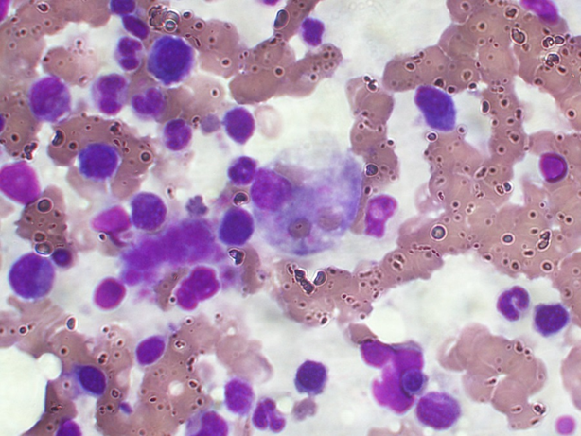
Admit TTSH
Ongoing fever
Hepato-splenomegaly
Rt pleural effusion
37/F
D7 illness
NS1+ve
Disch
A case from Singapore
Fever lyse
Macrophage ingested 2 rbc
Etoposide
D7
D9
D14
D17
D19
D24
D26
D28
D36
Hb 12.4
TWC 4.3
PLT 197k
ALT 220
AST 359
Alb 22
LDH >3800
B2 glob 5028
CT – hepato-splenomegaly
Oedema++
No LN
S.Ferritin 9523
Fibrinogen 1.1
TG 3.8
BMAT- occ hemophagocytosis, increase plasma cell/histocyte
Cr 113
AST 1428
ALT 495
S.Bil 49.3
Hb 12.6
TWC 3.5K
PLT 64k
Dexa
Liver bx
Home
AST 1181
ALT 408
S bil 53.3
Hb 13.1
TWC 9.0
PLT 113
HLH
Prolonged fever
Elevated TG
Elevated S.ferritin
Hemophagocytosis
Splenomegaly

Slide 34
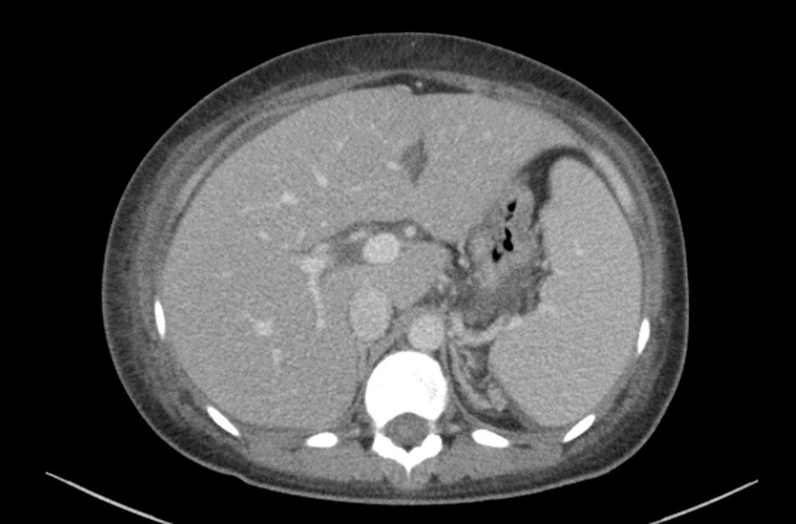
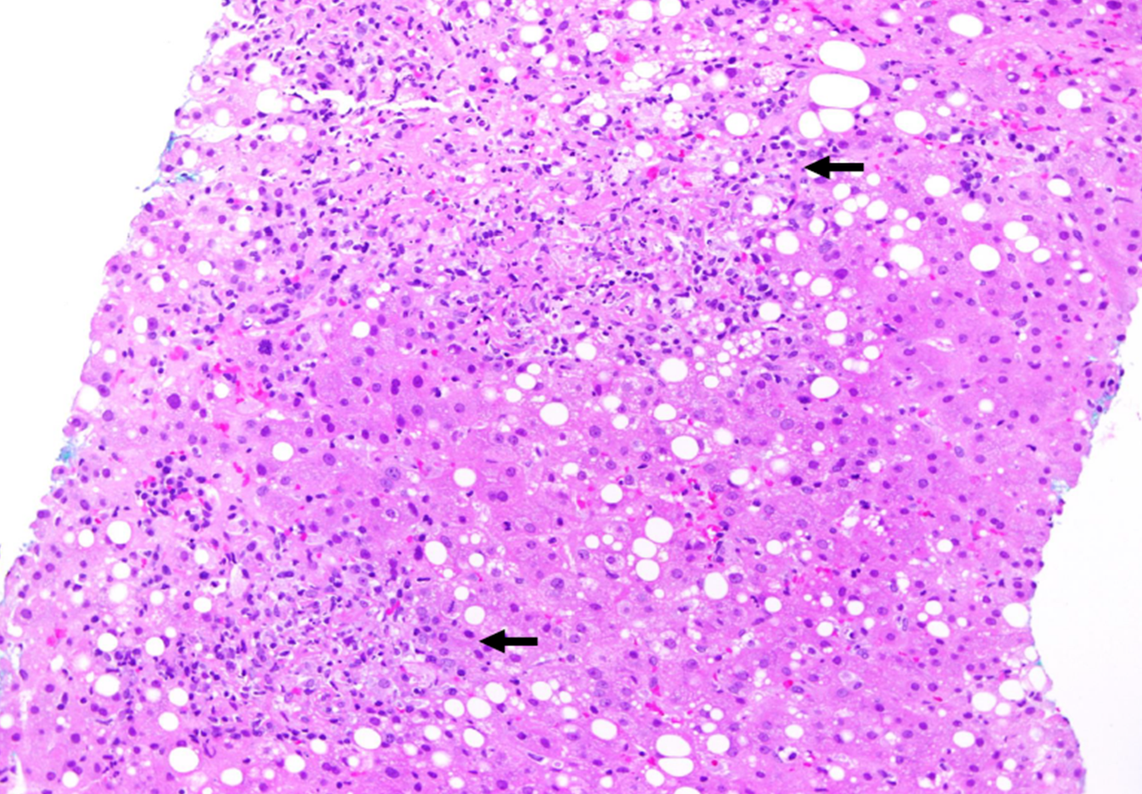
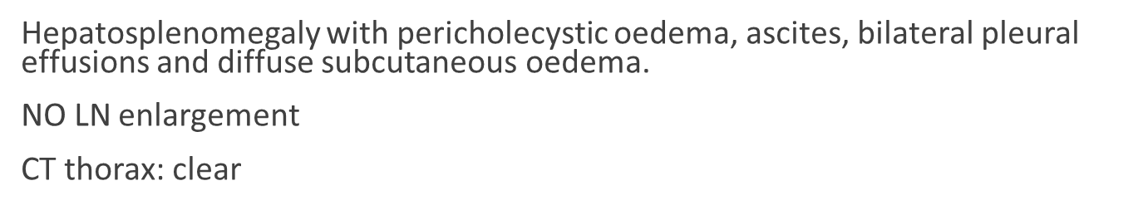

Mild lobular disarray, macrovesicular steatosis involving 10% hepatocytes, foci of necrotizing granulomatous inflammation,
IHC stain CD3+ T cells, co-expression CD2,CD5, CD7. Mixture of CD4, CD8 T cell. T cells are CD30-, CD56-, Ki67 proliferation index about 20-30%. B cells are CD20, PAX5. ISH no EBVpencoded RNA(EBAR)
Necrotising granulomatous inflammation

Slide 35
Fever and hypotension
39, Female designer, history of Thalassemia, Prolapsed intervertebral disc,
No recent travel for the past 2 weeks before illness onset
Consulted GP twice (D1 and D3 illness-> referred to ED)
1st ED presentation at D3 Illness 14:00: T 39.6 C, lowest BP recorded 86/50, HR 91/min
1.5 L NS given, advised admission but patient requested AMA (personal commitment) BP 94/58, HR 90/min upon ED discharge
2nd ED presentation D3 illness 21:26: returned for admission, BP 78/58, HR 99/min, total 2 L IV NS given, IV dopamine 5 → 10 mcg/kg/min

Slide 36
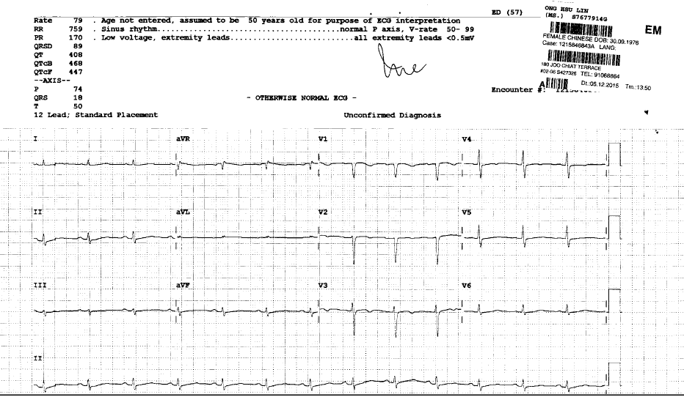
ECG: D3 4:20 PM

Slide 37
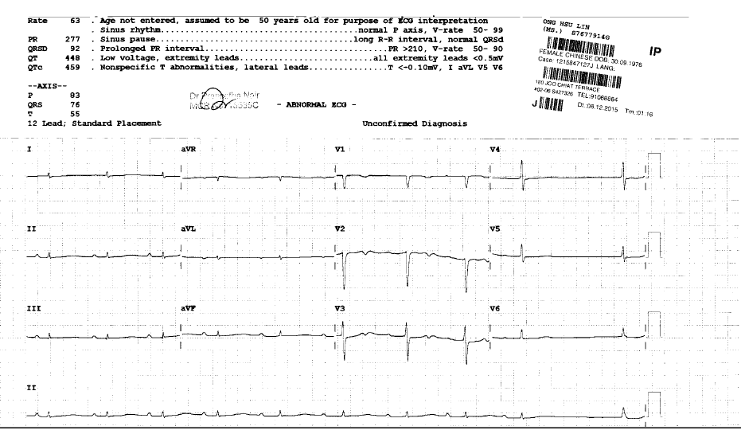
ECG D4 1:35 PM

Slide 38
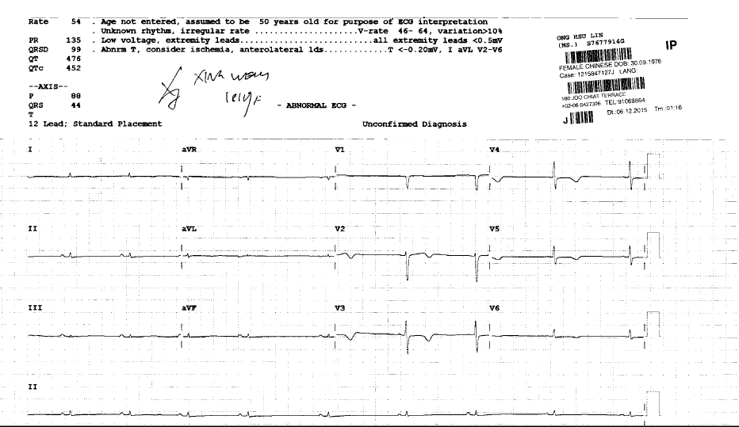
ECG D5 8:30 AM

Slide 39
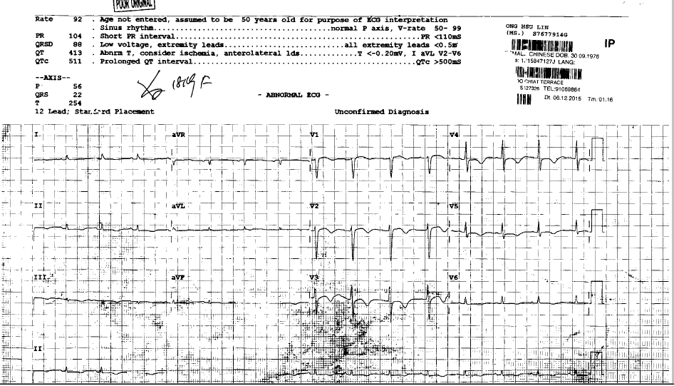
ECG D7 9:16 AM

Slide 40
Proposed Viral and Immune Mechanisms in the Cardiac Manifestations of Dengue

Slide 41
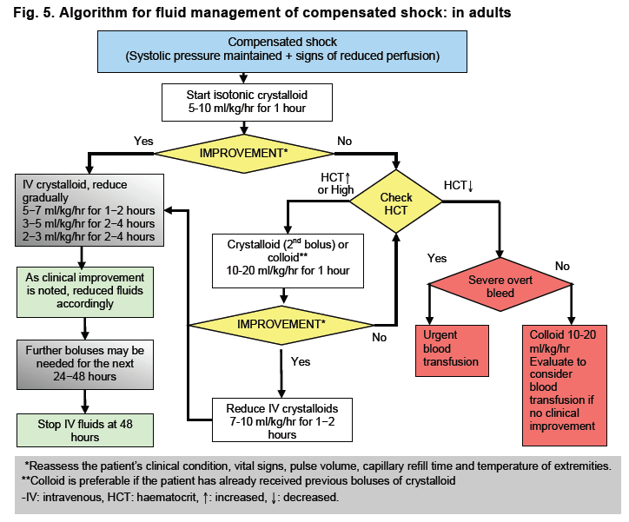

No all hypotension are due to hypovolemia
No one size fit all
Study on optimal fluid management
WHO 2012

Slide 42
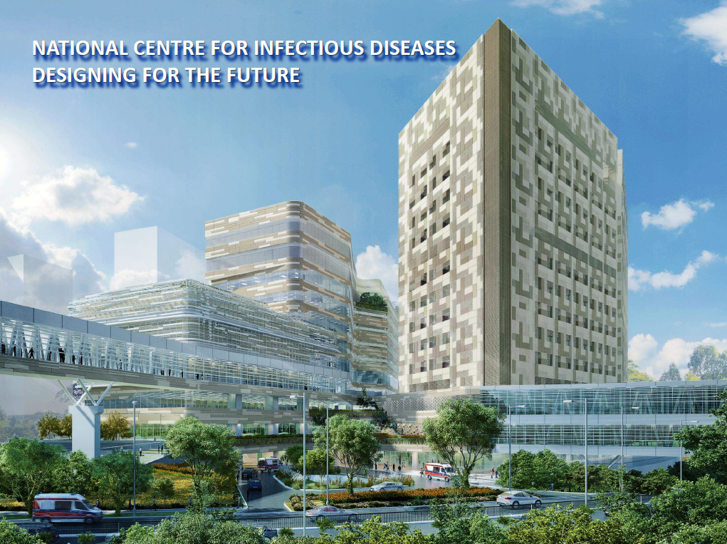
DEVELOPMENT DATA
NCID – functionally go-live in April 2018
Building ready in 2018-2019
Welcome to NCID
Singapore
CHI
9-storey educational and training building
NCID
14-storey clinical building
330 beds
4 basements with
850 car park lots
Food and retail outlets
Notes:
Quick Glance Of Project Fact Sheet
Key Milestones
DPAP Gateway 1 – 22 Aug 12
MOH obtained Cabinet Approval for Gateway 1 on 23 May 13
Sketch Design report submitted by CPG on 12 Dec
DPAP Gateway 2 review – 11 June 13
CP2M clearance of Gateway 2– 20 Sep 13
Detailed Design Development – almost complete pending ITD
Gateway 3 – pending funding approval by MOF since 18 Dec 13, MOH submitted DPC paper to MOF on 18 Dec 2013
Design Updates
NCID – Study of demountable wall and conversion of cohort ward to ISO room are in progress. Review of security concept provision studies in progress.
METB - Currently working with 4 SGs to review and finalize room data collection for preparation of tender specification.
Façade – Façade design options to be presented.
Car park Updates – In-consultation with LTA to explore the possibility to increase 850 to 900 car park lots including under category 4 road. Junction 4 study to follow.

Slide 43
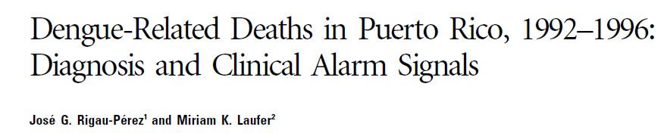
16/23 (75%) had co-morbidities
Signals usually noted on the day of deterioration.

Slide 44
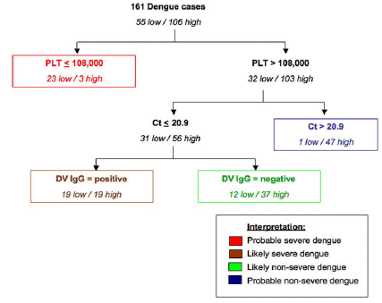
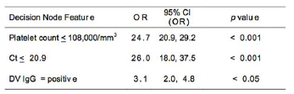
< 72 hours of illness onset
PLOS NTD 2008;2:e196
Severity
Platelet nadir <50,000/ul
hospitalized

Slide 45
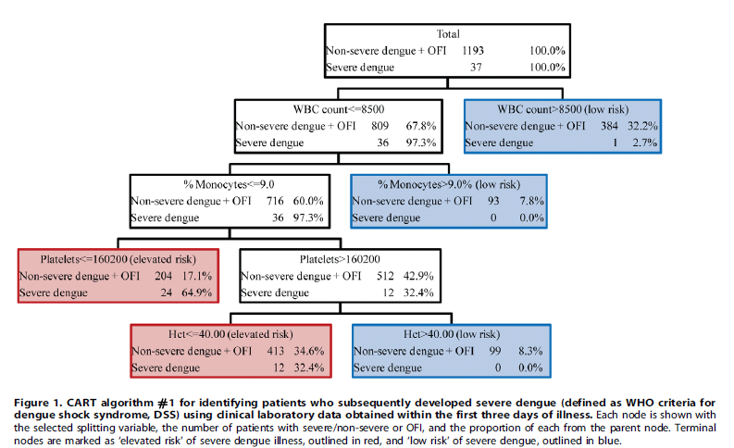
First 3 days of illness
Thai children
Potts, et al. PLOS NTD 2010;4:e769

Slide 46
DEN 2
NS1
PCR
DHF
DHF
DF
DF
Libraty DH et al. JID 2002;186:1165-8

Slide 47
Epidemiological risk factors
Secondary infection
Extremes of age
Pregnancy
Under-nutrition and over-nutrition
Presence of co-morbidities
Female

