Slide 1
Healthcare-associated Infections in Intensive Care Units in Asia: Recent Trends Based on Healthcare-associated Infections Surveillance Network over an 8-year period
Yee-Chun Chen, M.D., PhD.
Center for Infection Control, National Taiwan University Hospital; Department of Medicine, National Taiwan University College of Medicine; National Institute of Infectious Diseases and Vaccinology, National Health Research Institutes, Taiwan

Slide 2
National and Regional HAI surveillance
CNISP
Canada
HAI-net Europe
NHSN
USA
VICNISS
Australia
Notes:
Talking about national surveillance, the National Healthcare Safety Network established by the US CDC is the earliest of its kind, and laid the framework and foundations that are later used by other surveillance systems.
Most of the efforts in national and regional surveillance hails from the western world, and there was little surveillance efforts in Asia, until Taiwan, South Korea, and Japan established their national surveillance systems. And these 3 surveillance systems will be the focus of today’s presentation.
The Joint Commission. Preventing Central Line–Associated Bloodstream Infections: Useful Tools, An International Perspective. Nov 20, 2013

Slide 3
Healthcare-associated Infections in Asia
Rationale:
Sustainable systematic interventions are important for infection prevention and control (IPC).
Data from surveillance of healthcare-associated infections (HAI) provides feedback for implementation of IPC programs.
To address the paucity of such data in Asia, we searched for national HAI surveillance and IPC programs in this region.

Slide 4
Healthcare-associated Infections in Asia
Methods:
Google & PubMed search: “national nosocomial infection surveillance” or “national healthcare-associated infection surveillance” in combination with specific country names.
Inclusion criteria:
- English language,
open access data or PubMed publications,
annual data containing either point prevalence or yearly surveillance for 5 or more years.
Infection prevention and control programs implemented were identified.

Slide 5
Healthcare-associated Infections in Asia
Korean
National
Healthcare-associated
Infection
Surveillance System
(KONIS)
Since 2006
Japan
Nosocomial Infection Surveillance
(JANIS)
Since 2001
Taiwan
Nosocomial
Infection
Surveillance
(TNIS)
Since 2001

Slide 6
Healthcare-associated Infections in Asia
Population: 50M
Types: >900, 700-899, 600-699
Coverage: 18.0% (96/534)
Population: 127M
Types: not denoted
Coverage: 1.9% (143/7426)
Population: 23M
Types:
Medical center, regional hospital
Coverage: 21.2% (103/486)
Demographics and national surveillance systems

Slide 7
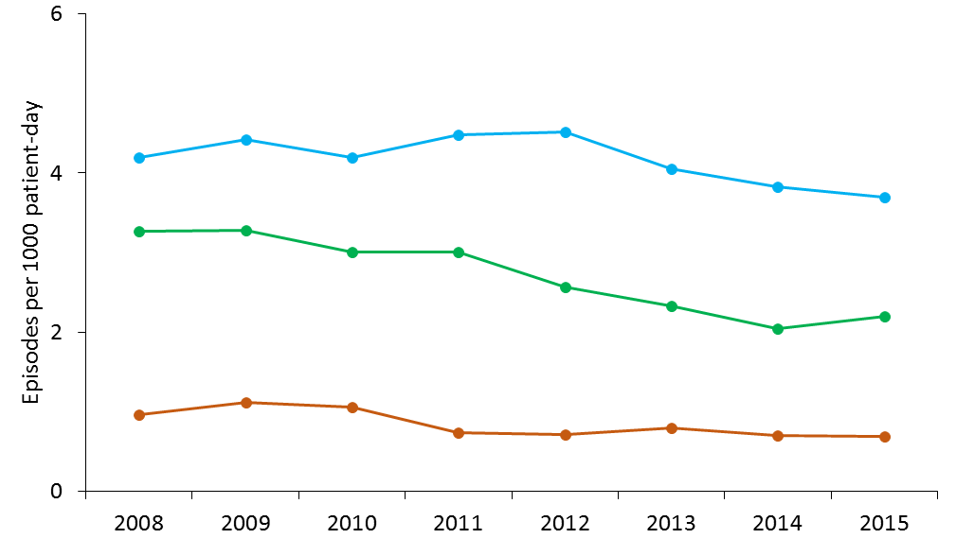
Overall healthcare-associated infection
There was a 53.0% reduction in overall HAI over the 8-year period.
P<0.05
For all
Notes:
There was a 53.0% reduction in overall HAI over the 8-year period. This consisted of a decrease from 9.34 to 5.03 infections per 1,000 patient-days in Taiwan, from 7.56 to 2.76 in Korea, and from 4.41 to 2.74 in Japan (Poisson regression, all p<0.05).

Slide 8
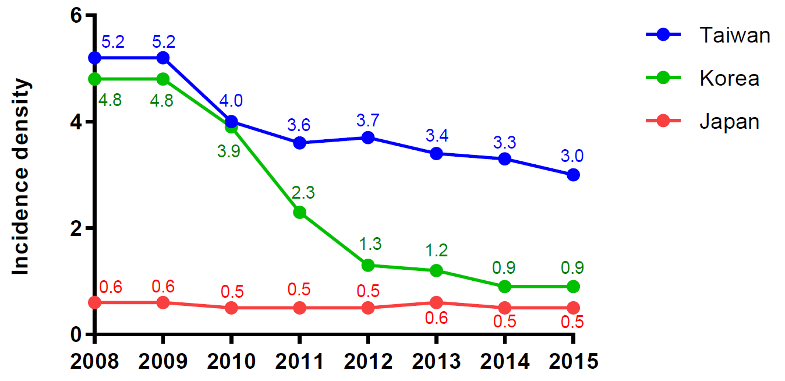
Catheter-associated urinary tract infection
TNIS
KONIS
JANIS
P<0.05
P<0.05
Notes:
For urinary tract infections, we see that both Taiwan and South Korea experienced a significant decrease in UTI incidence, while for Japan, the incidence remained at a constant low from 2008 to 2015.
Why south korea decreased more? Change in definition? USA definition??

Slide 9
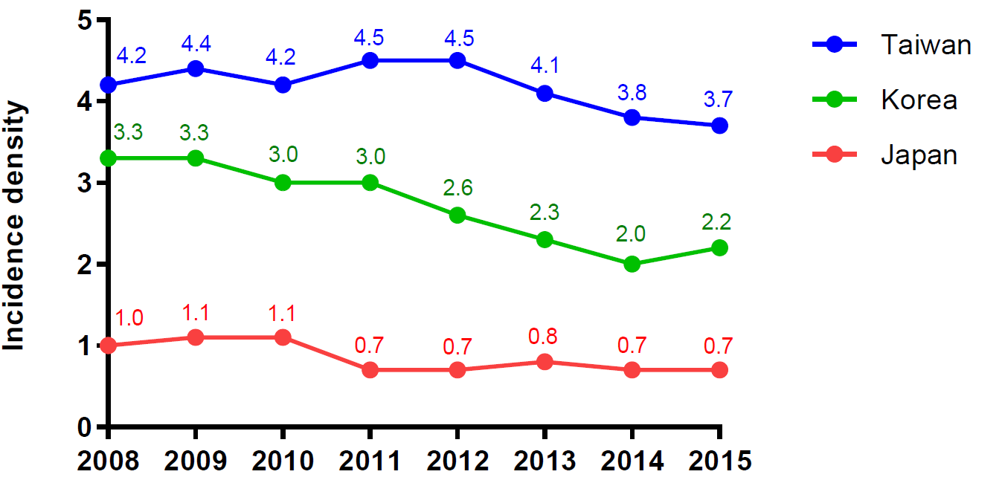
Central line-associated bloodstream infections
P<0.05
P<0.05
Notes:
For CLABSI, the trend is likewise similar. Taiwan and South Korea both experienced a decrease in incidence. Japan’s trend-line is dashed because calculation for CLABSI is by episodes per 1000 patient-day, and so there might be an underestimation.
Some bundle care reduces utilization rate, but has little on incidence density. Use of patient-day may see improvement.

Slide 10
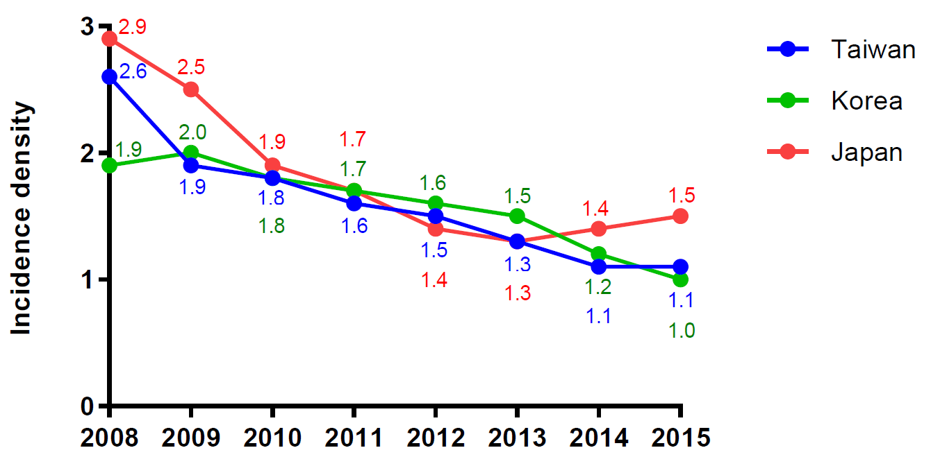
Ventilator-associated pneumonia
P<0.05
For all
Notes:
For VAP, the incidence decreased significantly across all three countries from 2008 to 2015. And again, Japan calculated its VAP incidence by episodes per patient-day, and may therefore underestimate its VAP incidence.

Slide 11
UTI causative pathogens
TNIS KONIS JANIS
E. coli and C. albicans are common across all three countries
Notes:
Next, common causative pathogens, first being urinary tract infections. E.coli and Candida are found to be the most common pathogens in causing UTIs across all three countries, consistent with studies from other regions.

Slide 12
BSI causative pathogens
TNIS KONIS JANIS
S. aureus is common across all three countries
Acinetobacter baumannii and Enterococcus faecium are important in TNIS and Korea
Notes:
In terms of bloodstream infections, a common pathogen across all three countries is staphylococcus aureus. Interestingly, Acinetobacter baumannii is only found in Taiwan and South Korea, while Japan reported little episodes of bloodstream infections caused by acinetobacter baumannii. Do note here however, that Japan’s data only include central-line BSI, and so this discrepancy might have been artificial.

Slide 13
Pneumonia causative pathogens
TNIS KONIS JANIS
A. baumanii is important in TNIS and Korea
P. aeruginosa, K. pneumonia, S. aureus are important across the three countries
Notes:
For pneumonia, acinetobacter baumannii is again a common pathogen for Taiwan and South Korea, and relatively unimportant for Japan. Consistent with previous studies in Asia, pseudomonas aeruginosa and klebsiella pneumoniae are common pathogens across the three countries.

Slide 14
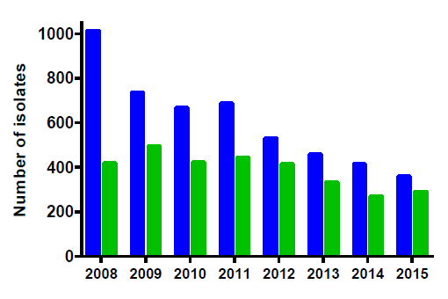
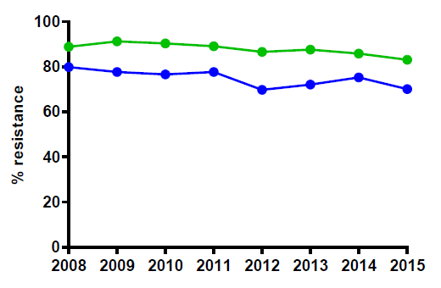
Methicillin-resistant Staphylococcus aureus
65% in the number of isolates of MRSA
Notes:
For antimicrobial resistance of important bacteria species. Percentage resistant MRSA remained high for all three countries from 2008 to 2015. However, the number of isolates have decreased throughout in the eight-year period.

Slide 15
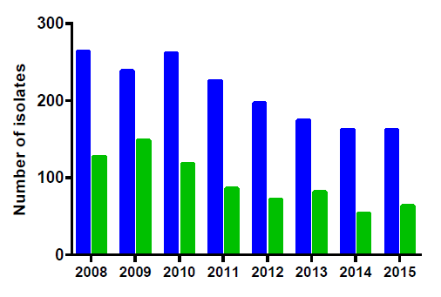
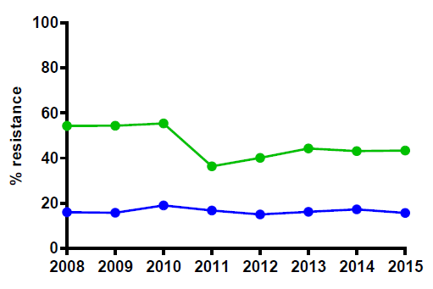
Carbapenem-resistant Pseudomonas aeruginosa
38% in the number of isolates of CRPA

Slide 16
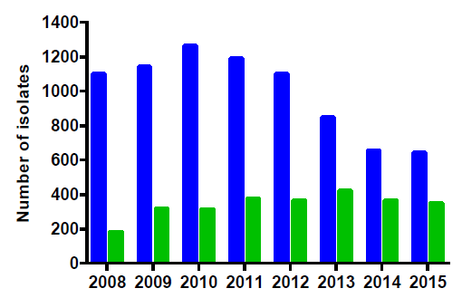
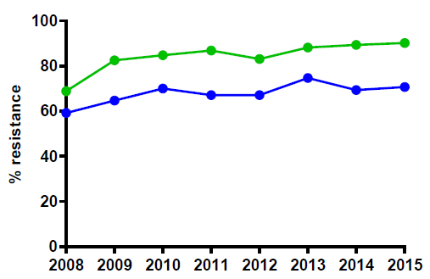
Carbapenem-resistant Acinetobacter baumannii complex
49% in the number of isolates of CRAB
Notes:
For carbapanem reistant AB, percentage resistance has also remained high. For Taiwan, the number of CRAB isolates have decreased significantly from 2008 to 2015. However, for South Korea, the levels of CRAB isolates have remained to be high throughout the eight-year period, suggesting the emerging importance of this bacteria, esp. in South Korea.

Slide 17
Overall HAI Incidence, 2015
Overall HAI Incidence, 2008
7.56
4.41
2.76
2.74
9.34
5.03

Slide 18
TNIS
Notes:
We also observed a general decrease in HAI trends for the 2008 to 2015 period. Taking Taiwan as an example, this decrease may be attributed to surveillance efforts, which was implemented in 2007, as well as infection control policies implemented nationally. For example hand hygiene and bundle care campaigns that effectively reduce contamination sources, as well as antimicrobial stewardships, which are built on the foundations and principles of hand hygiene and bundle care practices.
Decreased about 50% (halved).

Slide 19
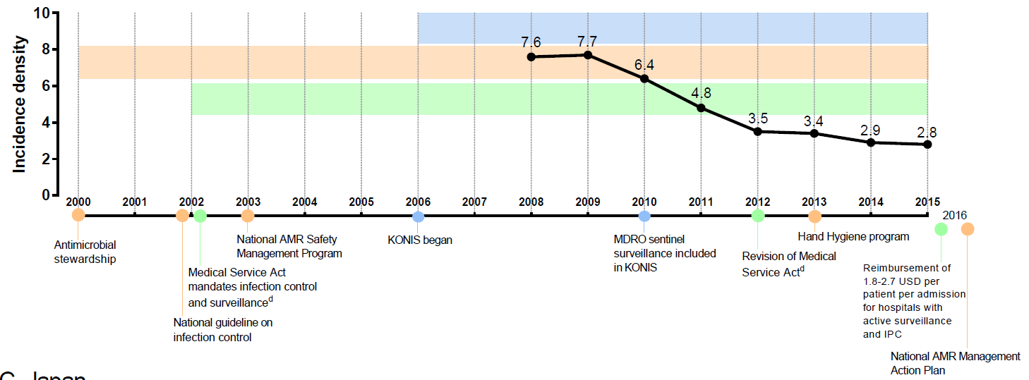
KONIS

Slide 20
JANIS

Slide 21
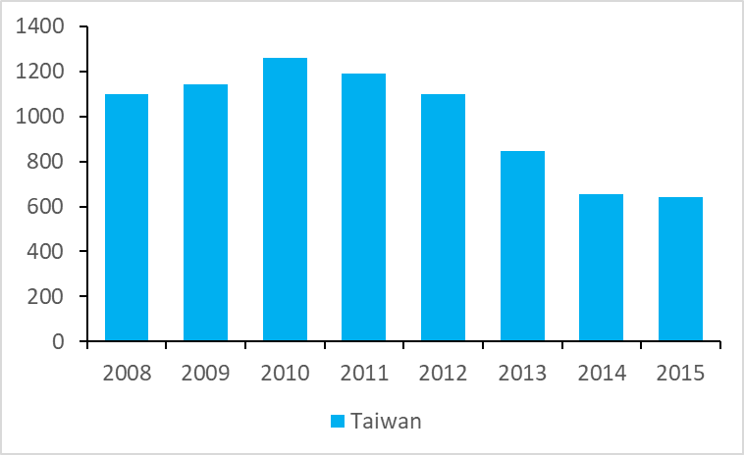
Integrated surveillance and intervention, TNIS
Carbapenem-resistant Acinetobacter baumannii complex
Hand Hygiene Program
Bundle Care Campaign
Antimicrobial stewardship
No. of isolates
Studies in South Korea found the reason for increased CRAB due to clonal outbreak, suggesting that infection control methods are important in reducing its incidence. J.Y. Choi et al., J Hosp Infect, 2015
Notes:
We also observed a general decrease in HAI trends for the 2008 to 2015 period. Taking Taiwan as an example, this decrease may be attributed to surveillance efforts, which was implemented in 2007, as well as infection control policies implemented nationally. For example hand hygiene and bundle care campaigns that effectively reduce contamination sources, as well as antimicrobial stewardships, which are built on the foundations and principles of hand hygiene and bundle care practices.
Decreased about 50% (halved).

Slide 22
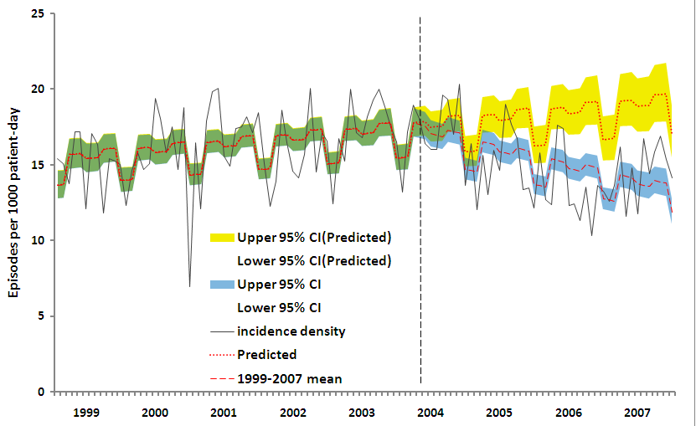
Impact of a hospital wide hand hygiene program The disease severity score (Charlson comorbidity index) increased (p=0.002) in the intervention period. Nevertheless there was an 8.9% decrease in HAIs.
Hospital-wide
MRSA
Predicted
Observed
levels, p=0.02
trends, p= 0.04
levels, p=0.03
trends, p= 0.04
Intensive care units
XDRAB
levels, p=0.78
trends, p=<.001
levels, p=0.26
trends, p=<.0001
YC Chen, et al PLoS ONE 6(11): e27163
Notes:
Figure 2. Time trends of monthly cumulative incidences of overall healthcare-associated infection before (January 1999 to March 2004) and during the hand hygiene program (April 2004 through December 2007). (A) hospital-wide (change in levels, p=0.02; change in trends, p= 0.04); (B) intensive care units (change in levels, p=0.26; change in trends, p<0.001); (C) hematology ward (p=0.21, p=0.38, respectively). Observed incidences, black solid line, －; mean, red dash line, －－－; green and blue shadow, 95% confidence interval of observed incidences; yellow shadow, 95% confidence interval (CI) of predicted incidences. The vertical dashed lines (- - -) separate the preintervention and intervention periods.
Figure 3. Time trends of monthly cumulative incidences by pathogen. (A) methicillin-resistant S. aureus (MRSA) (change in level, p=0.03; change in trend, p=0.04); (B) extensively drug-resistant Acinetobacter (XDRAB) (p=0.78; p<0.001, respectively); (C) Escherichia coli (p=0.89; p=0.33, respectively). Infection control measures for XDRAB were intensified during June 2001 to June 2002. These efforts resulted in only a transient reduction in the rates of infection for XDRAB and MRSA. Observed incidences, black solid line, －; mean, red dash line, －－－; green and blue shadow, 95% confidence interval of observed incidences; yellow shadow, 95% confidence interval (CI) of predicted incidences. The vert
Implementing a hospital-wide hand hygiene program is feasible and was associated with a reduction in the HAIs of most hospital units and HAIs caused by MRSA and XDRAB.
This effect was achieved and confirmed using a before and after study design combined with a prospective HAI surveillance program and hospital-wide annual promotion, which resulted in sustained effects and high-quality HH observation.
The impact may be even greater with full adherence to the five moments for hand hygiene.

Slide 23
Implementation of a HHP reduces preventable HAIs and is cost effective with a benefit cost ratio of 23.7
Parameter | Number
Episodes of healthcare-associated infections
Observed | 15,301
Predicted ª | 16,805
Total reduction (%) | 1,504 (8.9%)
Costs of the hand hygiene program in US dollars
Total alcohol handrub expense | 221,517
Campaign costs (posters, salaries, etc.) | 22,953
Total cost^{d} | 244,470
Average cost per 1000 patient-day | 90.60
Average cost to prevent one episode of HAI | 162.50
Extra costs per episode of HAI | 5,335±13,872
Mean cost reduction for HAIs | 8,023,840
Mean net cost savings from the hand hygiene program | 7,779,370 USD
Benefit cost ratio=benefit/cost
YC Chen, et al PLoS ONE. 2011;6(11):e27163

Slide 24
HAI Surveillance
Monitor HAI trends
Enhance safety and quality of care
Prioritize Infection prevention & Control Policies & Programs
Identify problems
Conclusion
We found a significant decrease of HAI across the three countries in association with sequential multifaceted interventions.
Further regional collaboration could be forged to develop joint strategies to prevent HAI which are sustainable and cost-effective.
Notes:
Our purpose is not to compare HAI rates across countries, but rather to identify problems and
highlight effective control measures

Slide 25
Acknowledgements
Cho-Han Chiang^{1*}, Sung-Ching Pan ^{2*}, Tyan-Shin Yang¹, Keisuke Matsuda³, Hong Bin Kim^{4,5}, Young Hwa Choi⁶, Satoshi Hori⁷, Jann-Tay Wang^{1,2,8}, Wang-Huei Sheng^{1,2,8}, Yee-Chun Chen^{1,2,8,9§}, Feng-Yee Chang¹⁰, Shan-Chwen Chang^{1,2}
¹College of Medicine, National Taiwan University, Taipei, Taiwan
²Department of Internal Medicine, National Taiwan University Hospital, Taipei, Taiwan
³Faculty of Medicine, Osaka University, Osaka, Japan
⁴Department of Internal Medicine, Seoul National University College of Medicine, Seoul, Republic of Korea
⁵Division of Infectious Diseases, Seoul National University Bundang Hospital, Seongnam, Republic of Korea
⁶Department of Infectious Diseases, Ajou University School of Medicine, Suwon, Republic of Korea
⁷Department of Infection Control Science, Juntendo University Faculty of Medicine, Tokyo, Japan
⁸Center for Infection Control, National Taiwan University Hospital, Taipei, Taiwan
⁹ National Institute of Infectious Diseases and Vaccinology, National Health Research Institutes, Miaoli County, Taiwan.
¹⁰ Division of Infectious Diseases and Tropical Medicine, Department of Internal Medicine, Tri-Service General Hospital, National Defense Medical Center, Taipei, Taiwan
NTUH, Taiwan
CDC, Taiwan: Ms. Lee-Jung Chien, Dr. Shu-Hui Tseng
Infection control personnel in Taiwan, South Korea, and Japan who contributed to infection control and the surveillance efforts
Healthcare-associated Infections in Intensive Care Units in Taiwan, South Korea, and Japan: Recent Trends Based on National Surveillance Reports.
Antimicrobial Resistance & Infection Control (revision)
Notes:
Before I end today’s presentation, I’d like to thank several people, my mentors from NTUH, Dr Yee-Chun Chen and Dr Sung-Chin Pan, and my research partner Ms Yang. From Taiwan CDC, Dr Chien and Dr Tseng who provided feedback and advice, as well as important data for our work. And also Mr Matsuda from Osaka University.
I would be happy to receive any questions that you might have.

