Slide 1

Longitudinal Multicenter Surveillance on AMR
2018 APEC CONFERENCE ON STRATEGIES AGAINST THE EVOLVING
THREATS FROM ANTIMICROBIAL RESISTANCE
Tsai-Ling Yang Lauderdale (楊采菱)
National Institute of Infectious Diseases and Vaccinology (NIIDV)
National Health Research Institutes (NHRI)

Slide 2
Why?
Antimicrobial resistance (AMR) is a global public health threat
“Determining the scope of the problem is essential for formulating and monitoring an effective response to AMR”
from WHO Antimicrobial Resistance: global report on surveillance 2014

Slide 3
Background
In 1998, Dr. Monto Ho established the “Microbial Infections Reference Laboratory (MIRL)” to carry out the mission of “Research and control of antimicrobial resistance”
Aims of MIRL: Surveillance, Research, Service, and Advocacy
To attain the first aim, Dr. Ho also instituted the Taiwan Surveillance of Antimicrobial Resistance (TSAR) program in 1998
Objective of TSAR: Systematically document, store, and track pathogenic microbes and their antimicrobial susceptibilities
Targets of TSAR study: Bacterial isolates recovered from clinical samples of inpatients and outpatients by hospitals

Slide 4

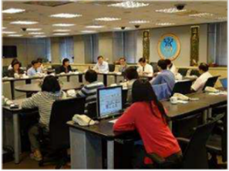
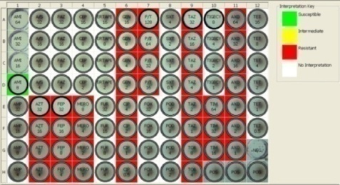

Stages of TSAR Related Work
Isolate Collection
Centralized AST
(Antimicrobial Susceptibility Testing)
at NHRI
Epidemiological Studies
Follow-up Activities
Hospitals
- Isolates
- Basic info.
NHRI
- Isolate bank
- Database
AST
- Confirm species
Determine MIC
Additional tests
Data analysis
- WHONET
Mechanisms of AMR
Strain typing
Clonality
Risk groups
Report to hosp.
Symposium
Advocacy

Slide 5

TSAR Progress
TSAR | Collection time | No. of Hospitals | No. of isolates
I | Oct-Dec 1998 | 44 | ~6000
II | Mar-May 2000 | 21 | ~3200
III | Jul-Sep 2002 | 26 | ~6000
IV | Jul-Sep 2004 | 26 | ~6500
V | Jul-Sep 2006 | 25 | ~6300
VI | Jul-Sep 2008 | 26 | ~7300
VII | Jul-Sep 2010 | 26 | ~7400
VIII | Jul-Sep 2012 | 27 | ~8000
IX | Jul-Sep 2014 | 26 | ~7600
X | Jul-Sep 2016 | 25 | ~7600
XI | Jul-Sep 2018 | 25 | Ongoing
N
E
C
S
* Population: 22.4 mil
*Area: 142 x 394 km
TSAR III – XI: Similar isolate collection protocol & participating hospitals
Medical center Regional Hosp.

Slide 6

First MIRL Symposium, July 1999
Report of excessive resistance to “first-line antibiotics” (TSAR I data)
- National Health Insurance Administration issued a policy to restrict antibiotic use for acute upper respiratory tract infections (URI) effective Feb 2001
Antimicrobial consumption for URI decreased by 55.8% from 2000 to 2001
(Ho M, Hsiung CA et al., Int J Antimicrob Agents. 2004)

Slide 7
Impact of Restriction on Antibiotic Use
  Erythromycin use in outpatients decreased by nearly 50% between 2000 and 2001 (*), from 2.19 to 1.15 DDD/1000 pop/day.
  Resistance to erythromycin in Group A Streptococcus (GAS) was >50% in 1998-2000, but has remained at around 20% since 2002.
*
*
DDD/1000 pop/day
ERY-R in GAS (%)
NHI data (Provided by Institute of Population Health Sciences/NHRI)
TSAR data (J Clin Microbiol 2014)

Slide 8
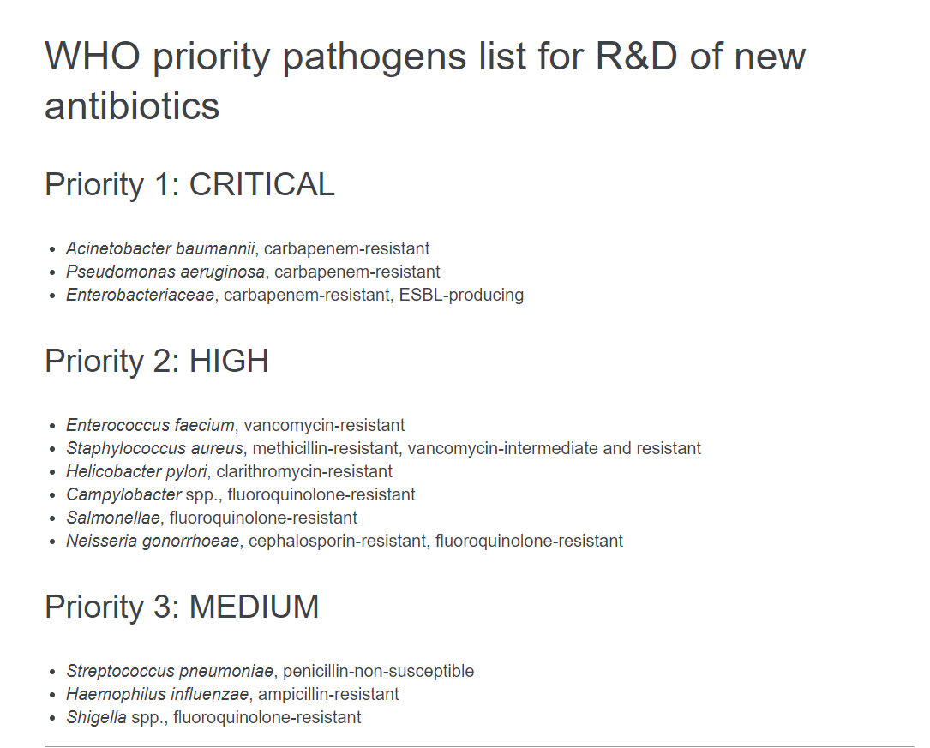
Data to be presented
Highlighted pathogens
Plus
- mcr-1 in human and retail meat E. coli
- Fluoroquinolone (FQ)-resistant GN and GP pathogens & FQ consumption
http://www.who.int/news-room/detail/27-02-2017-who-publishes-list-of-bacteria-for-which-new-antibiotics-are-urgently-needed

Slide 9
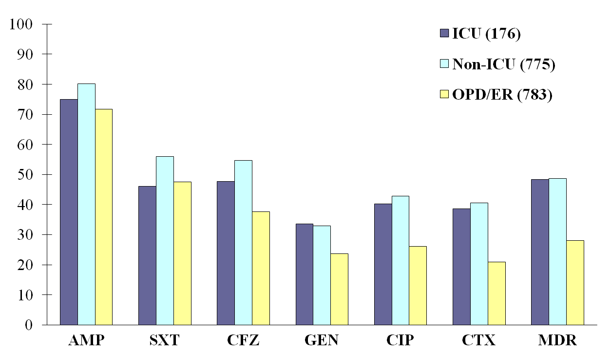
MDR is Prevalent in Hospitals & Community
2012 E. coli data
- E. coli comprised the largest proportion (~20%) of isolates in the TSAR collection
- Near 45% of E. coli are from outpatients/ER
% Resistant
MDR (Multidrug resistance), resistant to > 3 of the agents in this figure
AMP, ampicillin; SXT, trimeth/sulfa; CFZ, cefazolin; GEN, gentamicin; CIP, ciprofloxacin; CTX, cefotaxime.

Slide 10
Increased Extended-Spectrum ß-Lactam Resistance in E. coli from Outpatients
Due to increase of ESBL (mostly CTX-M) and AmpC ß-lactamase (mostly CMY-type) producers.
Modified from Wang JT et al., PLoS One 2015

Slide 11
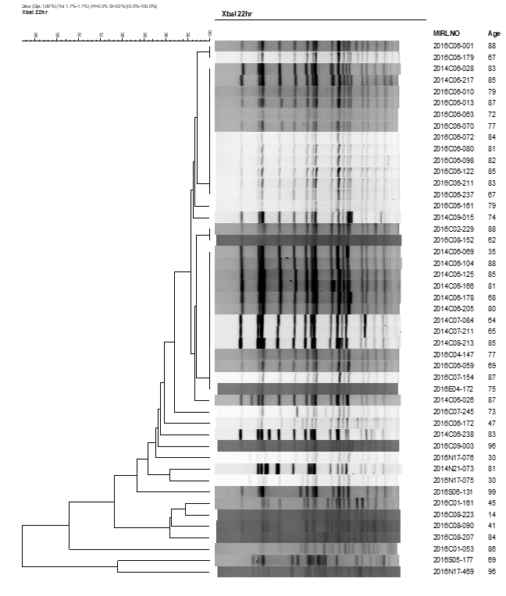
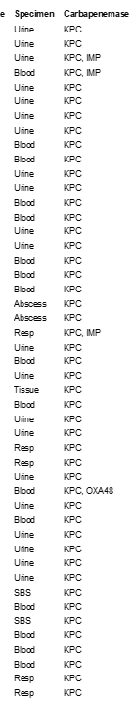
Dendrogram of KPC-Pos CRKP
Carbapenem-Resistant Klebsiella pneumoniae
(CRKP)
Increase of CRKP
≈30% of the CRKP are carbapenemase-positive
% Imipenem-resistant

Slide 12
Carbapenem-Resistant Acinetobacter baumannii*
- Secular Trend & Risk Factors
Age
% Imipenem-resistant
Ward
% Not-susceptible
Specimen
*Acinetobacter calcoaceticus-A. baumannii complex

Slide 13
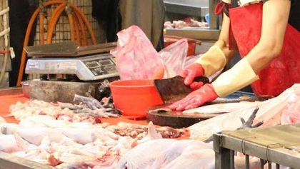
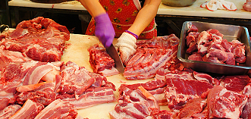
mcr-1 in E. coli isolates from Humans & Retail Meat
Colistin (& polymyxin B):
- Old agents from the 1960s shelved for decades because of toxicities.
- Increase of MDR GN bacteria in recent years lead to their renewed use.
mcr-1: The first plasmid-mediated colistin resistance gene, was reported from China in late 2015.
Since 2012, we have also been surveying AMR bacteria in retail meat in Taiwan.
mcr-1 prevalence
TSAR (human): 0.1%, 0.1%, and 0.6% of 2010, 2012, & 2014 collection, respectively.
Retail meat: 1.1%, 6.6%, and 8.7% of 2012, 2013, & 2015 isolates, respectively.
Similar rates found in 2016

Slide 14
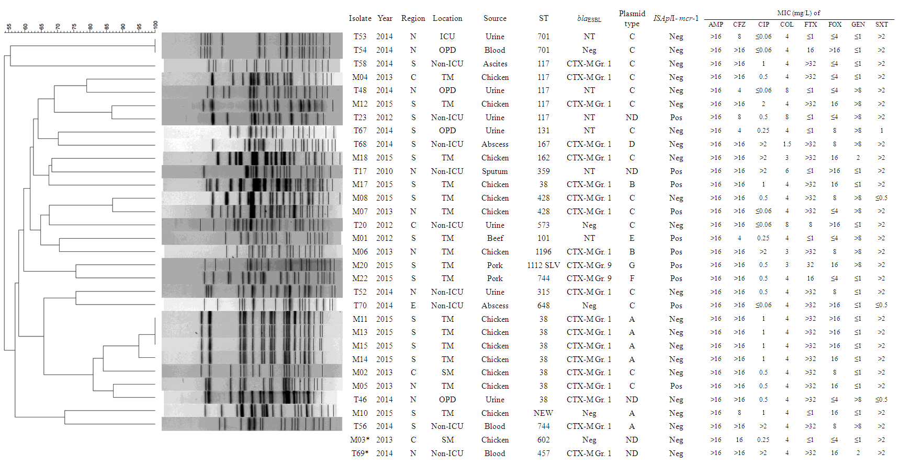
mcr-1 positive E. coli from Humans & Retail Meat
Plasmid profiles from
S1 nuclease assay
PFGE of XbaI digested genomic DNA.
Isolate: T=TSAR; M=Meat
Kuo SC et al., J Antimicrob Chemother 2016

Slide 15
VRE and MRSA Prevalence
%
%
VRE in Enterococcus faecalis & E. faecium
MRSA in ICU, non-ICU, and OPD/ER

Slide 16
Changing MRSA Resistance
Non-β-lactams | % Resistant (TSAR VIII – X combined)
 | MRSA | MSSA
Ciprofloxacin | 56.5 | 4.2
Clindamycin | 73.6 | 11.4
Erythromycin | 86.3 | 20.8
Gentamicin | 57.6 | 14.5
Tetracycline | 49.7 | 34.2
Trimeth./Sulfa (SXT) | 27.3 | 1.0
Vancomycin | 0.1 (I) | 0
% Resistant
Changing resistance to non-β-lactams in MRSA due to changes in major clones

Slide 17
Emergence and Increase of
Fluoroquinolone (FQ) Resistance

Slide 18
Secular Trend of Fluoroquinolone Resistance
CIP (ciprofloxacin), LEV (Levofloxacin)
%
%
Data modified and updated from:
- Kuo SC, et al., EID 2014 (Haemophilus influenzae)
- Lauderdale TL et al., ICAAC 2015 (Group A Streptococcus)
- Wang JT et al. PLoS One 2015 (E. coli from outpatients)
- Wu CJ et al., JAC 2017 (Group B Streptococcus)

Slide 19
Factors Associated with FQ-R Organisms
(2002 -2012 data)
H. influenzae | N (%) levofloxacin |  | Pª | OR^{b} | 95%CI^{b} | P^{b}
 | Susceptible | Resistant
Total | 1280 (87.5) | 182 (12.5)
Patient age > 65 y | 591 (80.8) | 140 (19.2) | <0.001 | 3.601 | 2.435-5.325 | <0.001
Resp. tract specimen | 1123 (86.5) | 175 (13.5) | <0.001 |  |  | NS
Regional hospital | 766 (85.0) | 135 (15.0) | <0.001 | 2.054 | 1.379-3.059 | <0.001
Geographic regions
Northern | 448 (95.5) | 21 (4.5) | <0.001 | Reference
Central | 585 (83.9) | 112 (16.1) | <0.001 | 3.656 | 2.214-6.038 | <0.001
Southern | 225 (82.4) | 48 (17.6) | 0.006 | 5.428 | 3.050-9.611 | <0.001
Eastern | 22 (95.7) | 1 (4.3) | 0.346
Group B Streptococcus
Investigation of FQ use in National Health Insurance (NHI) database

Slide 20
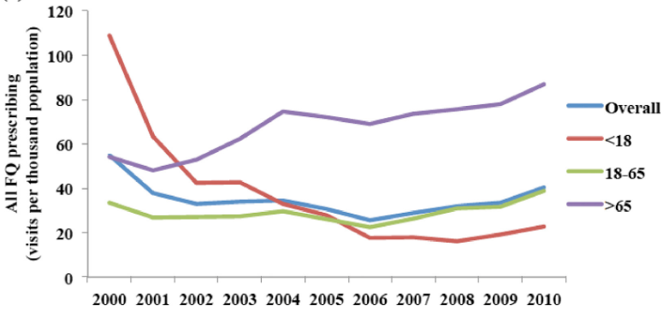
Estimated annual prescriptions of all FQs in NHI system
(Modified from J Microbiol Immunol Infect; In press)
Ciprofloxacin resistance in outpatient E. coli
(Modified from PLoS One 2015)
P < 0.001
P = 0.001
P = 0.913

Slide 21
Closing Remarks
Longitudinal multicenter AMR (phenotypic and genotypic) surveillance plays an important role in AMR control by helping to
- Monitor AMR trends in different patient groups
- Identify risk factors associated with AMR organisms
- Detect emerging resistance
- Pinpoint specific AMR problems that exist locally
- Increase understanding of changing epidemiology
Provide data for intervention measure & advocacy decisions
Assess the impact of intervention measures
However, AMR control requires a multifaceted approach, one of which is better understanding of antibiotic consumption and usage in human and non-human sectors

Slide 22
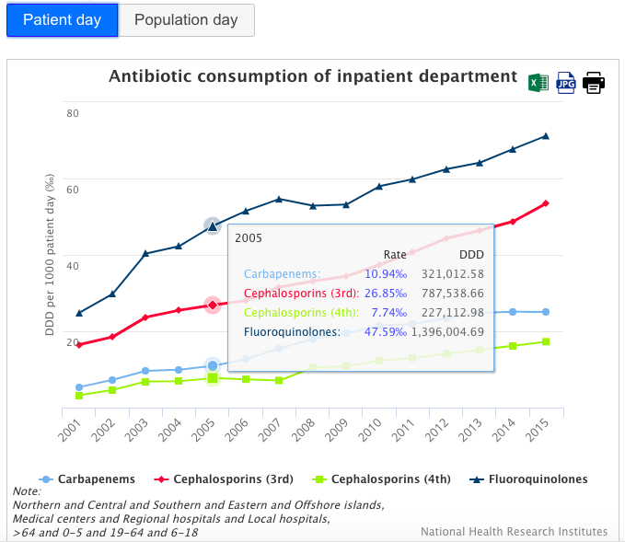
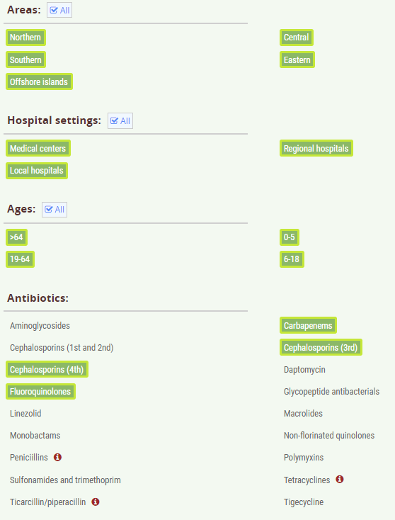
Upcoming:
Interactive Websites for Antibiotic Use and AMR Data
A collaborative project of CDC and NHRI
Modified from slide provided by Dr. Shu-Chen Kuo

Slide 23
Acknowledgements
TSAR Hospitals
Microbial Infections Reference Laboratory (MIRL) Steering Committee
- Dr. Shan-Chwen Chang (Chair); Dr. Feng-Yee Chang
- Dr. Ying-Ching Chuang; Dr. Chang-Phong Fung; Dr. Yao-Shen Chen
TSAR Studies:
- Dr. Jann-Tay Wang (Enterococci, OPD E. coli)
- Dr. Shu-Chen Kuo (Acinetobacter, H. influenzae, mcr-1)
- Dr. Chi-Jung Wu (Gr. B Streptococcus)
Antibiotic Consumption Studies:
- Dr. Chao A. Hsiung
- Dr. Yee-Chun Chen
- Dr. Shu-Chen Kuo

Slide 24

Thank You for Your Attention
NHRI Campus

