Slide 1
Dengue vaccines:
Current situation and public health impact
In-Kyu Yoon, M.D.
Director, GDAC
International Vaccine Institute
3 May 2018

Slide 2



Mission: To promote the development and implementation of innovative and synergistic approaches for prevention and control of dengue and other Aedes-transmitted diseases

Slide 3






GLOBAL DENGUE & AEDES-TRANSMITTED DISEASES CONSORTIUM
Chair: Duane Gubler
Director: In-Kyu Yoon
WHO
(close collaborator)
International Vaccine Institute
Vaccine introduction
Epidemiology
Laboratory testing
Modelling
Policy and access
Vaccine development
Regulatory support
Sabin Vaccine Institute
Communications and advocacy
International Vaccine Access Center
(at Johns Hopkins Univ)
Health economics
Vaccine development
Regulatory support
Partnership for Dengue Control
Integrated vaccine/vector control
Diagnostics
Surveillance
Clinical management
Pathogenesis
Therapeutics

Slide 4
Outline
Dengue burden
Dengvaxia® experience
  Potential public health impact of moderately effective vaccines
  Revised WHO SAGE recommendations on Dengvaxia®
  Lessons learned for 2nd generation vaccines
Dengue vaccine pipeline
  Takeda and US NIH/Butantan dengue vaccines
Conclusions

Slide 5
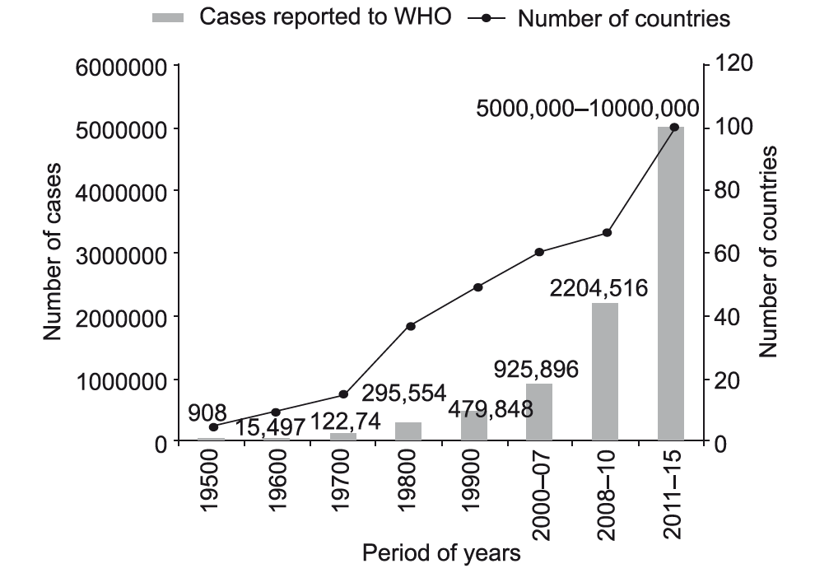
Global dengue burden continues to rise
Adapted from SEARO; J Vector Borne Dis. 2016 Oct-Dec;53(4):293-304.

Slide 6
Global burden of disease study 2013 & 2015
Modelled incidence from officially reported cases
  Adjusted for under-reporting based on published expansion factors (14 countries)
Modelled mortality from vital registration, verbal autopsy, and surveillance data
Estimated 58.4 million symptomatic cases (23.6-121.9 million) in 2013 [Stanaway JD et al. Lancet Infect Dis. 2016 Jun;16(6):712-23]
  21.1 million in Southeast Asia alone
From 2005 to 2015, dengue deaths increased by 48.7% (15.1-90.9), resulting in 18,400 deaths (11,800-22,700) in 2015 [Lancet. 2016 Oct 8;388(10053):1459-1544]
One of few infectious diseases with increasing mortality trend

Slide 7
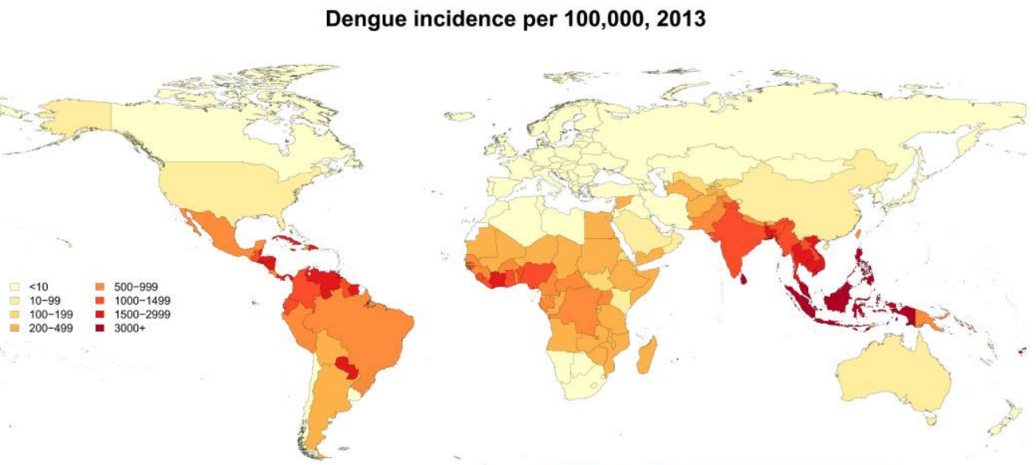
Highest incidence rates are in Asia
Stanaway JD et al. Lancet Infect Dis. 2016 Jun;16(6):712-23

Slide 8
Promising new tools being developed
Vaccines
Mosquito control
Surveillance and mapping
Diagnostic assays
Biomarkers for disease severity
Antiviral drugs
Therapeutic antibodies

Slide 9
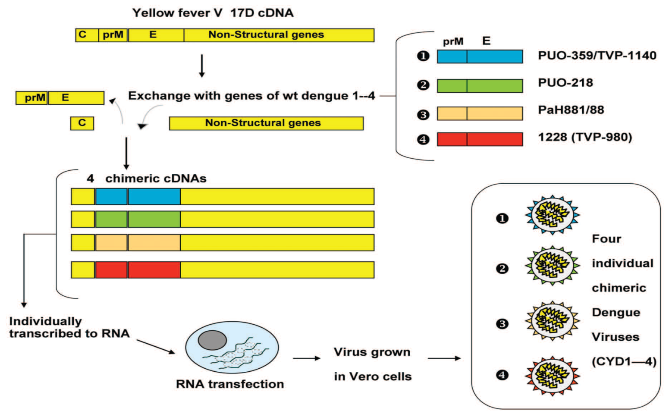
Sanofi Pasteur’s Dengvaxia® (CYD-TDV)

Slide 10
Dengvaxia® and seroprevalence
Seroprevalence in target age group (9 years +) | Vaccination recommended?
>70% | Yes
50-70% | Impact may be lower
<50% | No
CYD-TDV performs differently in seropositive vs. seronegative individuals
Lower impact in populations <50% seroprevalence
Possible harm in very low transmission settings (~10%)
Safety signal of increased hospitalization observed in 2-5 year olds in phase III trial

Slide 11
WHO position paper in July 2016
Countries should consider introduction of CYD-TDV only in geographic settings (national or subnational) where epidemiological data indicate a high burden of disease
  Indicated by seroprevalence of approximately 70% or greater
  50-70% is acceptable but impact may be lower
Important research and implementation questions remain
  Efficacy of shorter dosing intervals
  Safety in pregnant women
  Validation of age-stratified surveillance data to infer seroprevalence
  Duration of protection
  Risk of severe dengue especially in vaccinated seronegative persons of any age [included indicated age ≥ 9 years]

Slide 12
Public health outcome measures
Vaccine preventable disease incidence (VPDI)
  Same as vaccine attributable risk or incidence rate reduction
  Incidence [unvaccinated] – Incidence [vaccinated]
  Incidence [unvaccinated] x VE
  Number of cases averted per unit of vaccinated people per year
Number needed to vaccinate (NNV)
  Number of people who must be vaccinated to prevent one outcome
  Not a rate so incorporates length of trial (or duration of immunity)
  If VPDI is reported as cases prevented per 100,000 vaccinated persons per year, NNV = 100,000/VPDI/length of study

Slide 13
Dengvaxia® VPDI over 2-year period compared to other vaccines
Rotavirus
Caveat: What happens after 2 years?
Dengue
HiB
Rotavirus, Bangladesh and Vietnam ¹
Zaman, Lancet 2010
Hib, Indonesia ²
Gessner, Lancet 2005
Dengue ³
Villar, NEJM 2015
1: Data for children followed from infant immunization to age 2 years; VDPI = cases / 100,000 persons years of observation
2: Data for children followed from infant immunization to age 2 years; VDPI reported as PYO
3: Data calculated for persons 9-16 years of age and 2 year follow up period

Slide 14
Public health benefits beyond direct and indirect protection
Traditional measures:
  [non-severe + severe + sequelae] X [direct + indirect] X [duration of protection] X [total age groups possible to protect]
Nontraditional effects:
  Outbreak reduction
  Political stabilization
  Health system stabilization
  Equity
  Ancillary issues (e.g., antibiotic use reduction, chronic disease, other etiologies)

Slide 15
Impact of moderately effective vaccines
Vaccines with moderate efficacy may have high public health impact for diseases that:
  Have high burden
  Have high severity
  Have high economic costs
  Cause frequent outbreaks
  Cause political instability
  Disrupt health care systems

Slide 16
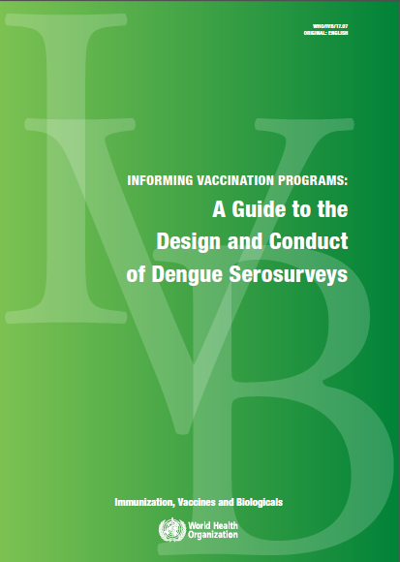
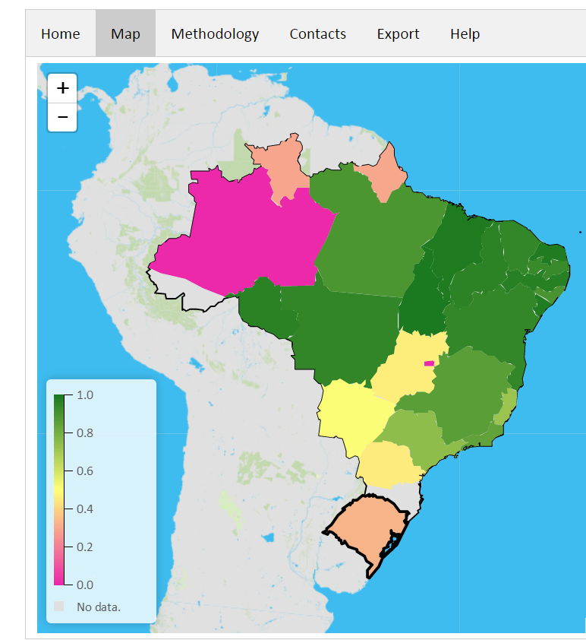
WHO support for country decision-making on Dengvaxia®
Serosurvey guide to inform vaccination
Global dengue transmission map
http://www.who.int/immunization/research/development/dengue_vaccines/en/
Difficult to implement

Slide 17
Dengvaxia® safety summary (up to 2017)
CYD-TDV is well-tolerated
SAEs similar across CYD/Placebo in Phase III trials
No non-dengue safety signals identified
An elevated risk of hospitalized dengue in CYD group was seen in 2-5 year-olds in Year 3 (RR=7.5)
  Risk diminishes in Years 4 and 5
  During entire study follow up (up to 5 years), there was an excess of hospitalized dengue cases in this group, but it was not statistically significant
  Not seen consistently in older age groups
  Understanding potential factors associated with increased relative risk of hospitalized and severe dengue among some trial participants is a priority

Slide 18
SP announcement on Dengvaxia® (29 Nov 2017)
“Based on up to six years of clinical data, new analysis [using dengue NS1 Ab test on post-vaccination serum] evaluated long-term safety and efficacy of Dengvaxia® in people who had been infected with dengue prior to vaccination and those who had not. The analysis confirmed that Dengvaxia® provides persistent protective benefit against dengue fever in those who had prior infection. For those not previously infected by dengue virus, however, the analysis found that in the longer term, more cases of severe disease could occur following vaccination upon a subsequent dengue infection.”
“Based on the new analysis, Sanofi will propose that national regulatory agencies update the prescribing information, known as the label in many countries, requesting that healthcare professionals assess the likelihood of prior dengue infection in an individual before vaccinating. Vaccination should only be recommended when the potential benefits outweigh the potential risks (in countries with high burden of dengue disease). For individuals who have not been previously infected by dengue virus, vaccination should not be recommended.”

Slide 19
Revised WHO SAGE recommendation in Apr 2018
New information
Vaccine efficacy (VE) against virologically-confirmed symptomatic dengue in first 25 months after first dose (i.e., 13 months after 3rd/final dose)
  High among inferred baseline seropositive participants ≥9 years of age: 76.0% (95%CI: 63.9, to 84.0)
  Much lower among inferred baseline seronegative participants ≥9 years of age: 38.8% (95%CI: –0.9 to 62.9%)
Increased risk of hospitalized and severe dengue in seronegative individuals [including ≥9 years of age] starting about 30 months after first dose

Slide 20
Revised WHO SAGE recommendation in Apr 2018
Recommendation
For countries considering vaccination as part of their dengue control program, a “pre-vaccination screening strategy” would be the preferred option, in which only dengue-seropositive persons are vaccinated
Given that no assay will be 100% specific, some truly seronegative individuals may be vaccinated due to a false positive test result

Slide 21
Revised WHO SAGE recommendation in Apr 2018
Still
Overall population level benefit of vaccination remains favorable in high transmission populations
In areas with 70% dengue seroprevalence, over a 5-year period:
  For every 4 severe cases prevented in seropositive vaccinees, there would be 1 excess severe case in seronegative vaccinees per 1,000
  For every 13 hospitalizations prevented in seropositive vaccinees, there would be 1 excess hospitalization in seronegative vaccinees per 1,000

Slide 22
Revised WHO SAGE recommendation in Apr 2018
SAGE also considered when determining recommendation
Feasibility of population seroprevalence studies and individual pre-vaccination screening
Heterogeneity of seroprevalence between and within countries
Potential vaccine coverage rates
Public confidence in national vaccination programs
Perceptions of ethical considerations with regard to population level benefit versus individual level risk
Communication issues

Slide 23
Lessons learned for 2nd generation vaccines
Will 2nd generation vaccines have similar issues as Dengvaxia®? Unclear, but developers will need to evaluate rigorously and communicate clearly.
  Dengue serostatus at baseline is an important variable, and safety and efficacy by serostatus should be presented in a stratified analysis…Need for pre-vaccination blood samples
  Safety and efficacy may be affected by transient heterotypic immunity that could wane over time…Need for prolonged active surveillance for safety and efficacy
  For licensure, vaccine efficacy will need to be demonstrated based on clinical outcomes (no immune correlate yet)

Slide 24
Lessons learned for 2nd generation vaccines
  Neutralization tests still represent our best assay of immunogenicity; however, they do not distinguish between type-specific antibodies, transient heterotypic antibody, and long-lasting heterotypic antibody…Complementary research assays are needed
  Early clinical studies are valuable to evaluate infectivity of vaccine viruses, which relates to development of type-specific immunity versus heterotypic immunity
  Co-circulating flaviviruses require close scrutiny
  Controlled human infection model Phase I trials can provide initial proof-of-concept for clinical benefit

Slide 25
Dengue vaccine pipeline (in human trials)
Sponsor/ Developer | Design (ALL tetravalent) | Name
Sanofi Pasteur | Live recombinant (chimera with YF17D backbone) | Dengvaxia® (CYD-TDV)
Takeda | Live recombinant (chimera with DENV-2 backbone) | TDV
US NIH Brazil (Butantan) Vietnam (Vabiotech) India (Panacea, Serum Institute, Indian Immunologicals) Taiwan (Medigen Biotech) Merck (Excl: US, Can, EU, Chi, Jpn) | Live recombinant (full length or DENV-2 chimera with DENV-4 backbone) | TV003/TV005
GSK/ Fiocruz/ US Army | Inactivated whole virus | TDENV-PIV DPIV
Merck | Recombinant protein subunit (80% E protein) | V180
US Navy | DNA (plasmid) | TVDV
US Army | Heterologous prime-boost (inact whole + live atten) | TDENV-PIV + TDENV-LAV

Slide 26
Dengue vaccine pipeline status
Phase I
Phase II
Phase III
Registration
TDENV-PIV +
TDENV-LAV
by WRAIR
(Heterologous prime boost)
TDENV-PIV
by WRAIR, GSK & Fiocruz
(Inactivated)
Butantan-DV (TV003)
by Butantan Institute*
(Live attenuated)
CYD-TDV
by Sanofi Pasteur
(Live attenuated)
TVDV
by NMRC
(DNA)
TV003/TV005
by NIAID
(Live attenuated)
TDV
by Takeda
(Live attenuated)
V180
by Merck
(Subunit)
Stalled

Slide 27
Two live atten. candidates in phase III trials
Structural
Non-structural
Sanofi Pasteur:
Unique DENV
proteins
DENV-1
Chimeric
DENV-2
Chimeric
DENV-3
Chimeric
8
Chimeric
DENV-4
YFV
Takeda:
Chimeric
Full-length
16
Chimeric
Chimeric
NIH/Butantan:
Full-length
Chimeric
32
Full-length
Full-length

Slide 28
TDV (Takeda)
DENV/DENV chimeric live tetravalent vaccine based on attenuated DENV-2 backbone
Has been evaluated in multiple trials in dengue-naïve and exposed subjects, addressing:
  Delivery routes (SQ, IM, ID)
  Vaccine formulations (high, low dose)
  Scheduling (one vs two doses)
Phase II trial in 1800 children 2-17 y.o. in 3 dengue endemic countries
  18-month interim results encouraging
In Phase III multi-center evaluation (NCT02747927)
  DB-RCT trial in children 4-16 years, placebo controlled
  0.5 ml TDV SQ day 1 and day 90
  Countries: Brazil, Colombia, Dom. Republic, Nicaragua, Panama, Philippines, Sri Lanka, Thailand
  Preliminary efficacy results in Q1 2019

Slide 29
TV003/TV005 (US NIH)
DENV attenuated by deletions in 3’UTR or DENV/DENV chimerization (DENV-2 component)
TV003 contains 3log10 PFU/component, TV005 contains 10x fold dose of rDENV2/4∆30
Extensively studied in Phase I trials, including human challenge studies
Elicits transient viremia in most subjects (≈75%)
For all 4 components, no boost observed with 2nd dose

Slide 30
Butantan-DV (Butantan)
Butantan-DV (equivalent to TV003)
Phase III trial (NCT02406729)
  DB-RCT multi-site in Brazil
  2:1 ratio of vaccine:placebo
  Single dose, lyophilized product
  Age groups: 18-59 years, 7-17 years, 2-6 years
  Study population N=16,944
  Primary efficacy outcome is incidence density of symptomatic virologically confirmed dengue
  Preliminary efficacy results in late 2018?

Slide 31
Paradigm for using new tools: Integration and synergy
Clinical management/therapeutics
Community
engagement
Improved surveillance
& diagnostics
Targeted prevention & control program
Vector
control
Vaccines
International mobilization of resources
Build public health capacity
Fund program implementation
Fund research

Slide 32
Conclusions
Dengue burden is increasing globally with highest burden still in Asia
Dengvaxia® has moderate efficacy
  Even moderately effective dengue vaccine can have potentially large public health impact
  However, concern due to increased risk of hospitalized and severe dengue in dengue naïve vaccine recipients
Key lessons have been learned from Dengvaxia® experience
Two other dengue vaccines, TDV (Takeda) and Butantan-DV (Butantan), are in phase III trials with preliminary results becoming available in near future

Slide 33
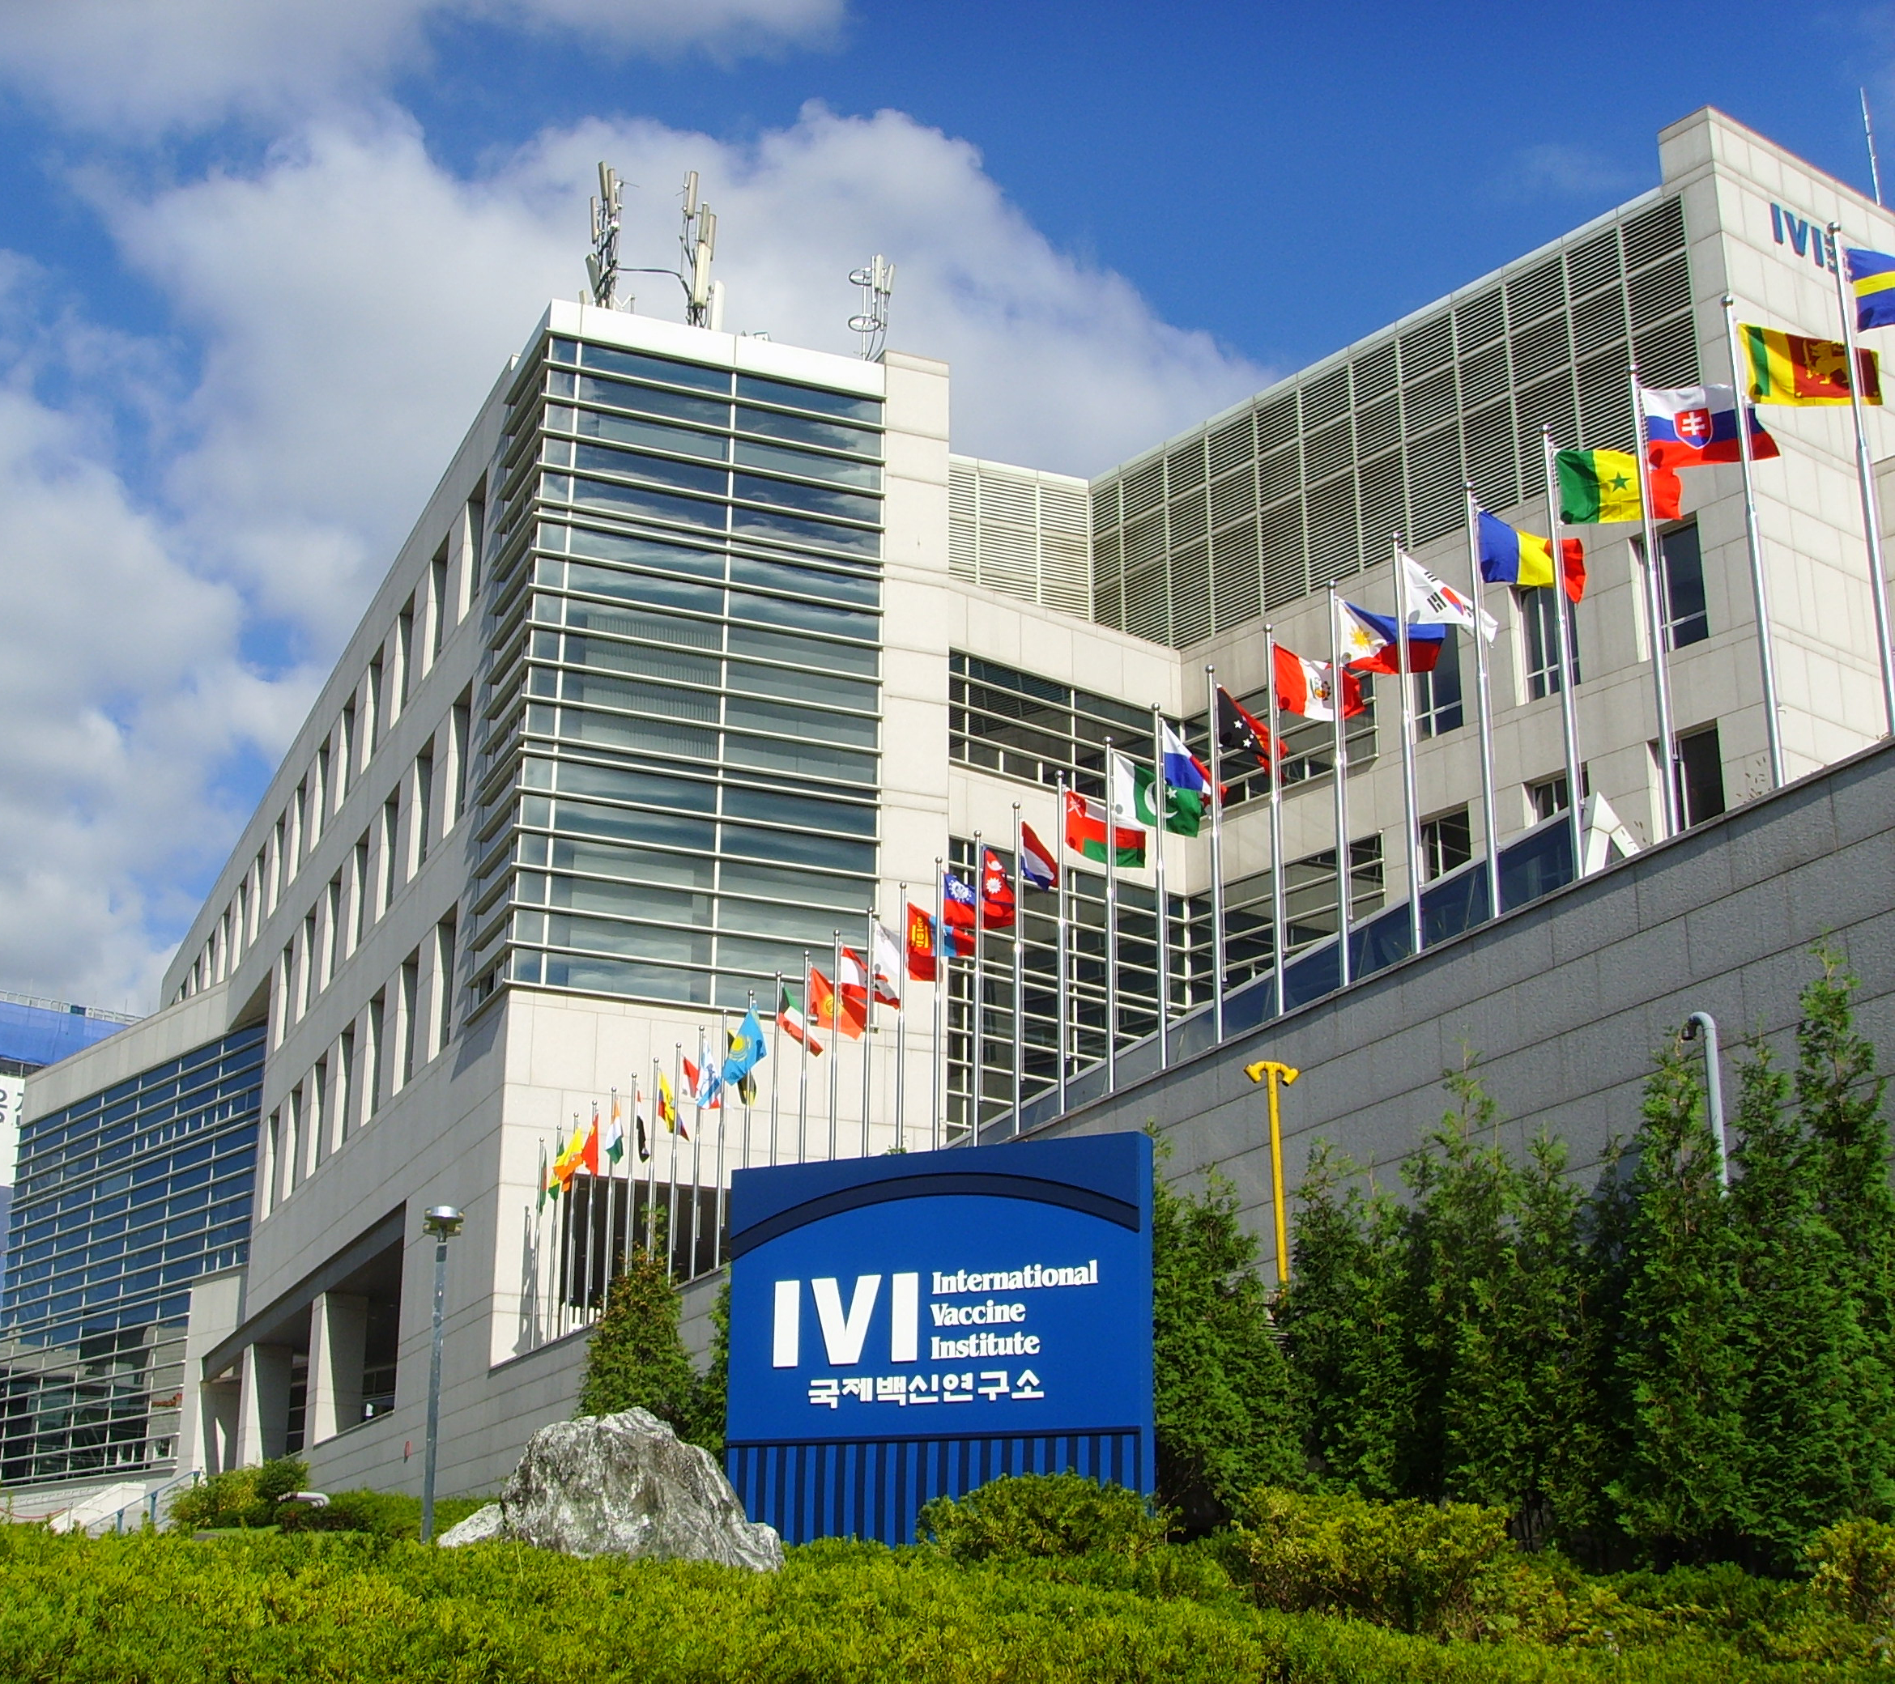
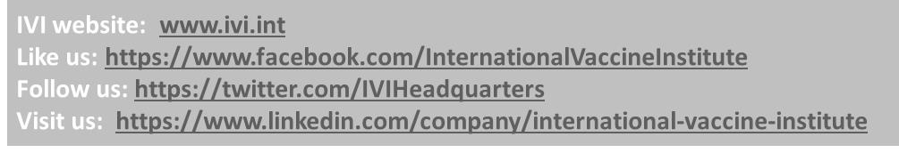
Thank you

