Slide 1

Dengue Epidemiology in Thailand
Darin Areechokchai M.D., M.C.T.M.
Deputy director, Bureau of Vector Borne Diseases
Department of Disease Control, MOPH Thailand

Slide 2

Contents
Background
Dengue surveillance and epidemiology
Characteristics of dengue deaths
Dengue control
APEC Conference on Severe Dengue Prevention and Strategies for Reducing Disease Burden, Tainan, 3rd May 2018

Slide 3
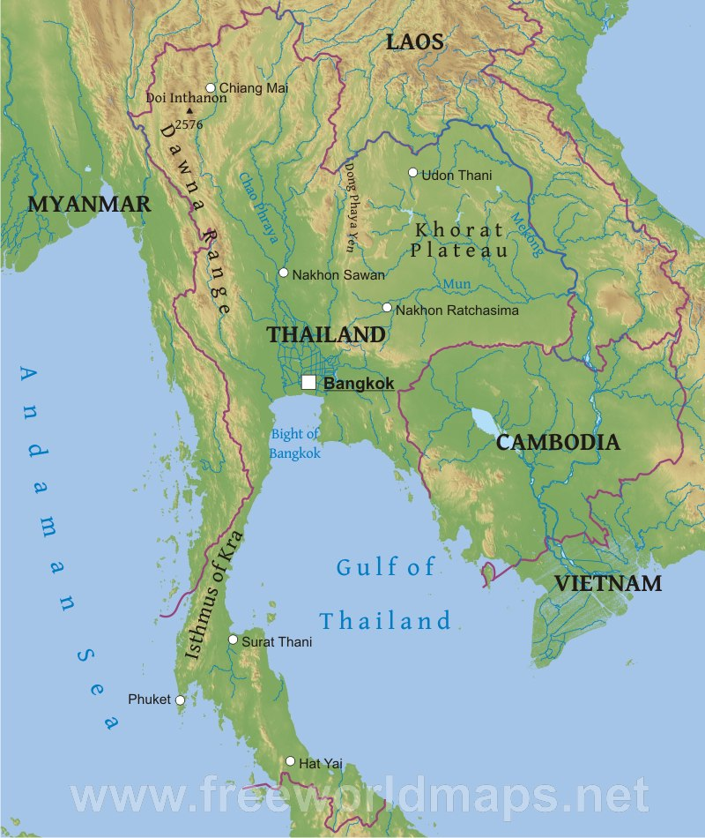
Background
Climate of Thailand
Three seasons
Cool season (Nov-Jan)
Hot season (Feb-May)
Rainy season (Jun-Oct)
Average annual Temp.
high of 38 °C (100.4 °F)
low of 19 °C (66.2 °F)
APEC Conference on Severe Dengue Prevention and Strategies for Reducing Disease Burden, Tainan, 3rd May 2018
Notes:
https://www.tmd.go.th/en/archive/thailand_climate.pdf

Slide 4
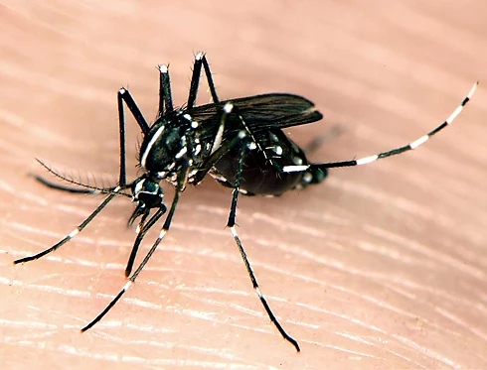
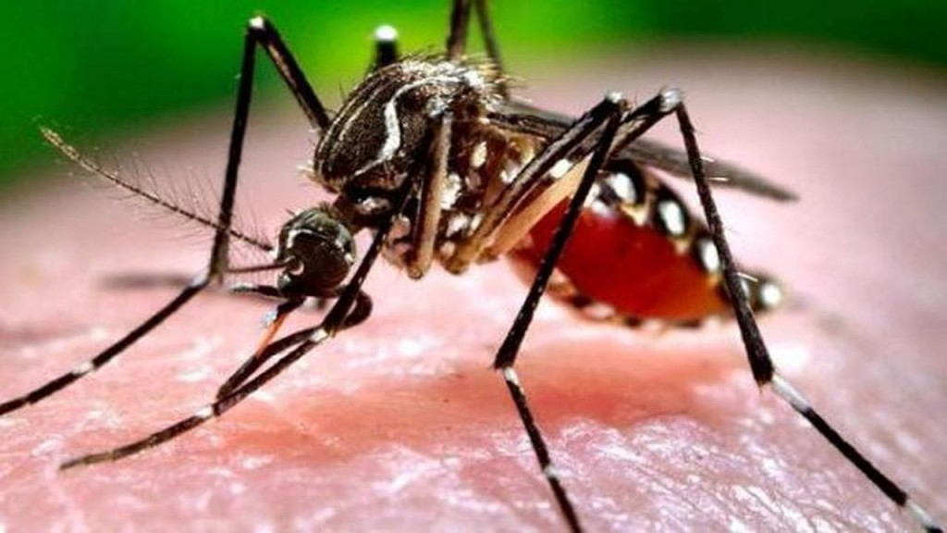
Background
Aedes aegypti and Aedes albopictus are the main vectors of mosquito-borne viruses
  Epidemics of dengue for >50 years
  Zika outbreaks since 2016
  Sporadic cases of chikungunya with occasional outbreaks
APEC Conference on Severe Dengue Prevention and Strategies for Reducing Disease Burden, Tainan, 3rd May 2018

Slide 5
Surveillance and Epidemiology

Slide 6
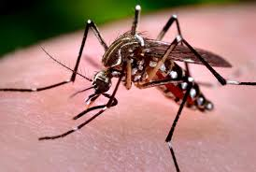
Aedes-borne disease surveillance
Community risk factors
- HI, CI, BI
- key containers
Other factors
- temperature, rainfall
- Density of population
Environment
Viruses
Infective vector
Trans-ovarian
Agent
Host factors
- Age, underlying conditions, delayed diagnosis and treatment, etc.
Host
Cases
Deaths
APEC Conference on Severe Dengue Prevention and Strategies for Reducing Disease Burden, Tainan, 3rd May 2018

Slide 7
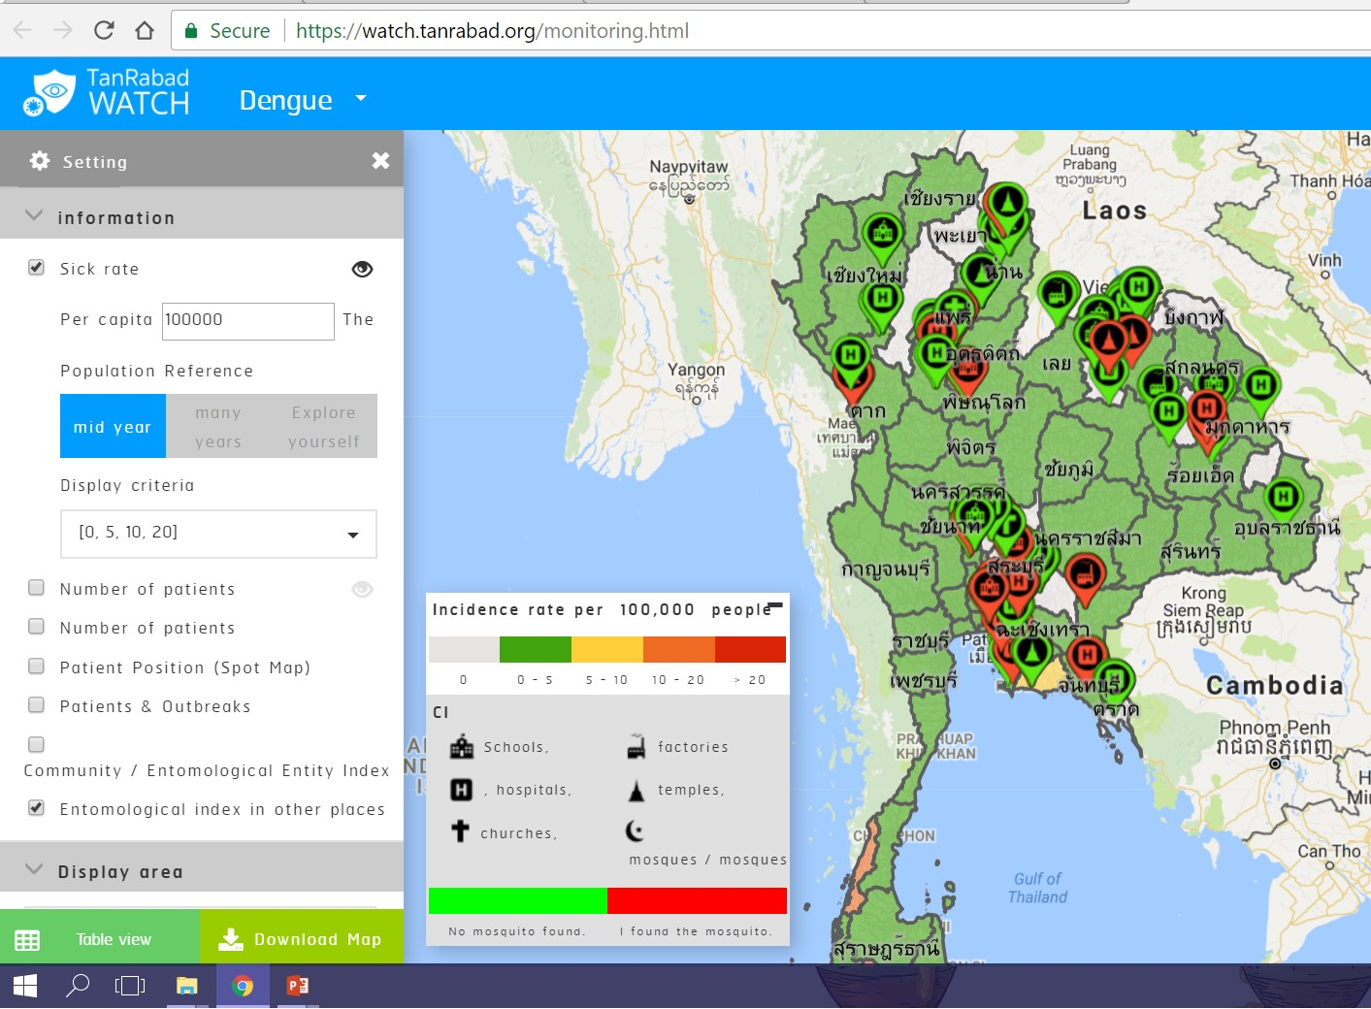
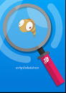

Dengue Surveillance System in Thailand
Ministry of Public Health
Department of Disease Control
Larva survey
Regional Disease Control Center
Bureau of Epidemiology
Provincial Epidemiological Unit
Report
District Surveillance information center
Feedback
Larva survey
Hospitals
under MOPH and universal coverage schemes
Hospitals and clinic under universal coverage scheme
Private hospitals and clinics
Ref: Bureau of Epidemiology, DDC, MOPH, Thailand

Slide 8
Monthly dengue cases, Thailand, 2008 - 2017
Epidemic every other years or once every 2 – 3 years
Strong seasonal pattern
  1000 – 3000 cases / month in non-rainy season
  Can be >20,000 cases in rainy season
APEC Conference on Severe Dengue Prevention and Strategies for Reducing Disease Burden, Tainan, 3rd May 2018

Slide 9
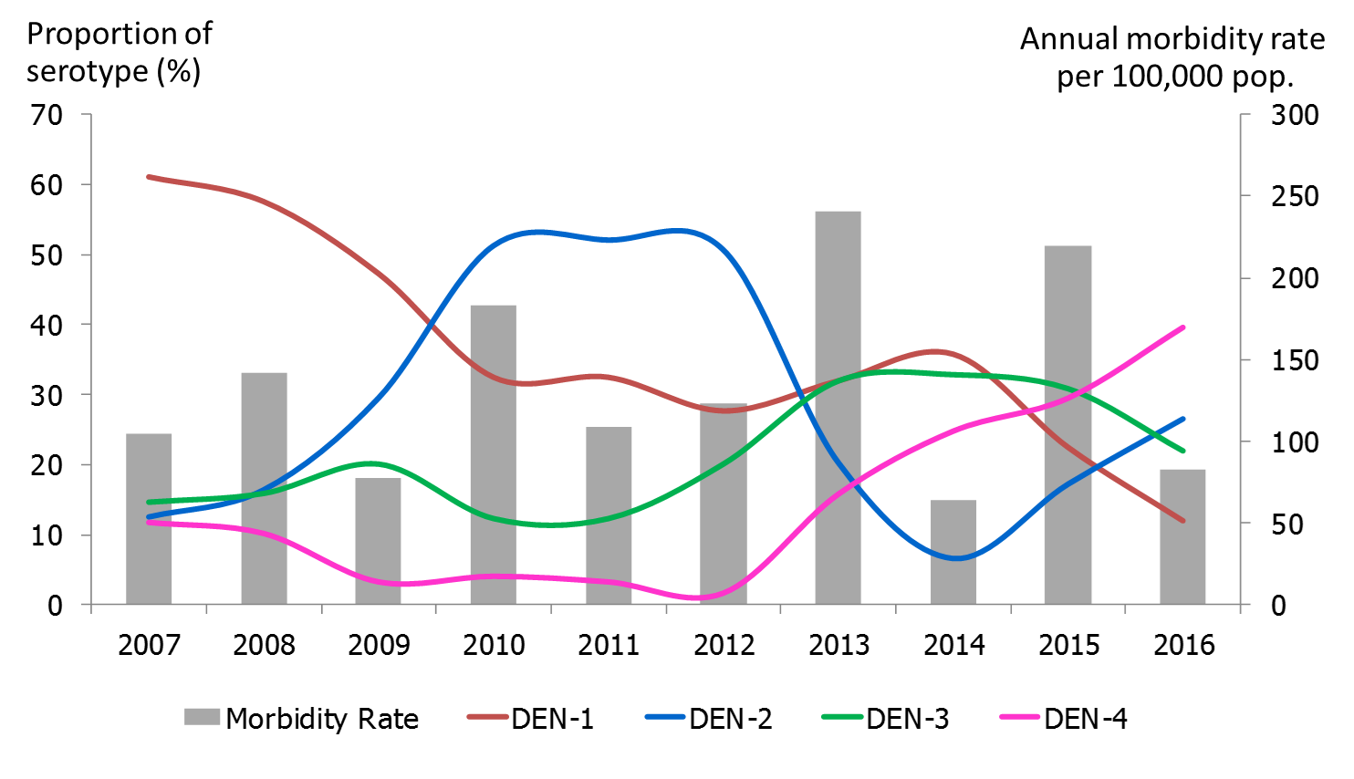
Proportion of dengue serotypes and morbidity rate, 2007 – 2016, Thailand
APEC Conference on Severe Dengue Prevention and Strategies for Reducing Disease Burden, Tainan, 3rd May 2018

Slide 10
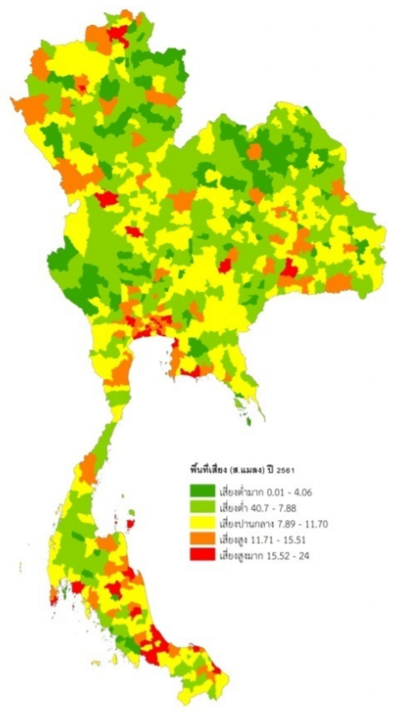
Risk of dengue transmission by district,
2013 - 2017
Geographical Distribution of dengue, in Thailand
Dengue spreads throughout Thailand
237 of 983 districts are high risk
High dengue transmission presents in urban areas
Bangkok and perimeter, and municipalities in the south are hyperendemic
Risk of dengue transmission
very low
low
medium
high
very high
APEC Conference on Severe Dengue Prevention and Strategies for Reducing Disease Burden, Tainan, 3rd May 2018
Notes:
This map show geographical distribution of dengue in Thailand. Dengue cases spread throughout Thailand and high risk of dengue transmission presents in urban area

Slide 11
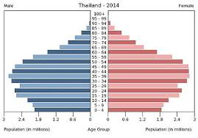
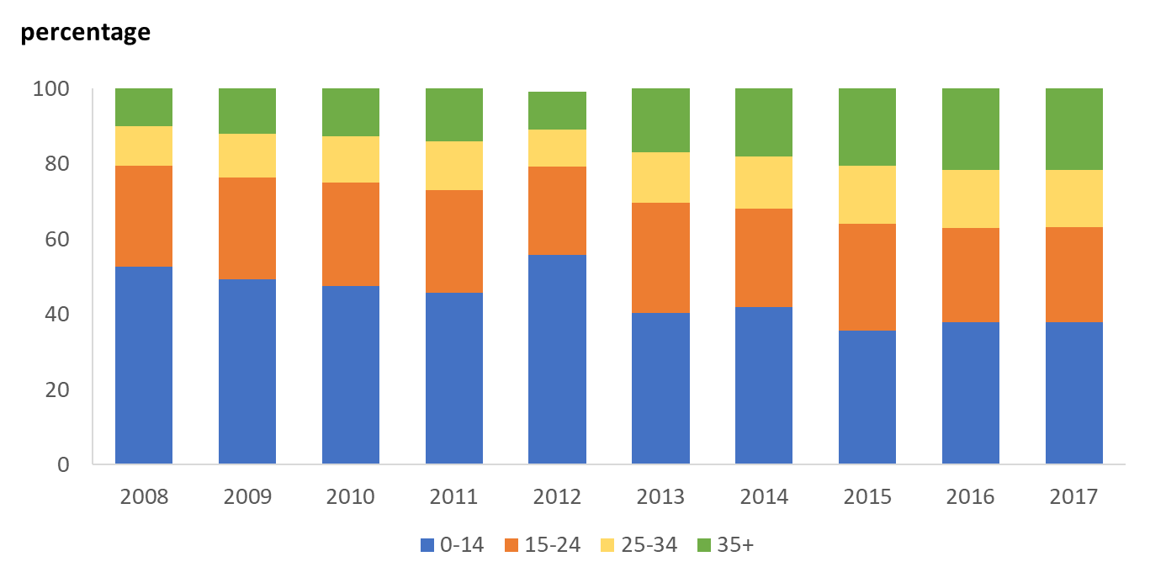
Age distribution of dengue cases, 2008-2017
Age group
APEC Conference on Severe Dengue Prevention and Strategies for Reducing Disease Burden, Tainan, 3rd May 2018

Slide 12
Dengue morbidity and mortality by age group, 2017
Age group (yrs) | Cases | Morbidity rate / 100,000 pop | Deaths | CFR (%)
0 – 14 | 20332 | 170.6 | 19 | 0.09
15 – 24 | 13140 | 137.5 | 12 | 0.09
25 – 34 | 6332 | 65.1 | 7 | 0.11
35 – 54 | 11449 | 54.6 | 27 | 0.24
55+ | 2708 | 18.6 | 6 | 0.22
รวม | 53961 | 97.7 | 64 | 0.13
APEC Conference on Severe Dengue Prevention and Strategies for Reducing Disease Burden, Tainan, 3rd May 2018

Slide 13
Characteristics of
Dengue deaths in 2018

Slide 14
Dengue deaths in Thailand, 2018
Total 18 deaths during January – April 2018
  Serotype 1 (3 deaths)
  Serotype 2 (3 deaths)
  Serotype 4 (2 deaths)
  Other 10 deaths had dengue IgM – positive or NS1 Antigen – positive without dengue PCR
14 deaths (78%) had underlying diseases or risky conditions
  4 Obesity
  3 DM, HT, cardiovascular diseases
  2 Thalassemia
  2 Epilepsy
  1 Alcoholism
  1 baby (5 months old)
  1 having menstruation
Data from dead case investigation
APEC Conference on Severe Dengue Prevention and Strategies for Reducing Disease Burden, Tainan, 3rd May 2018

Slide 15
Dengue deaths in Thailand, 2018
Admission diagnosis
  11 deaths were diagnosed dengue infection
  7 deaths had other disease diagnoses
    Gastrointestinal bleeding, gastroenteritis, pneumonia, sepsis, anemia
Causes of death
  10 Prolong shock and multiple organ failure
  6 massive bleeding with shock
  2 pulmonary edema
Data from dead case investigation
APEC Conference on Severe Dengue Prevention and Strategies for Reducing Disease Burden, Tainan, 3rd May 2018

Slide 16
Dengue control

Slide 17
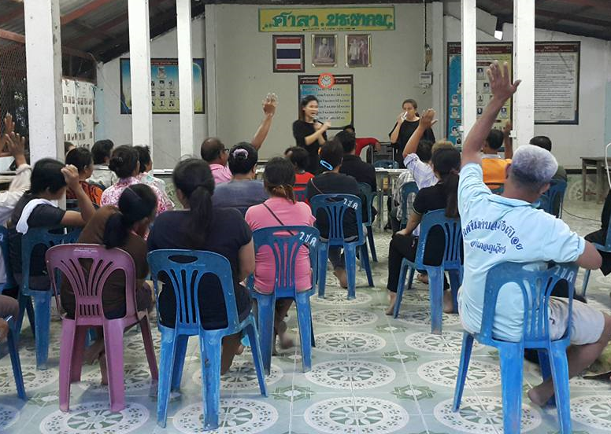
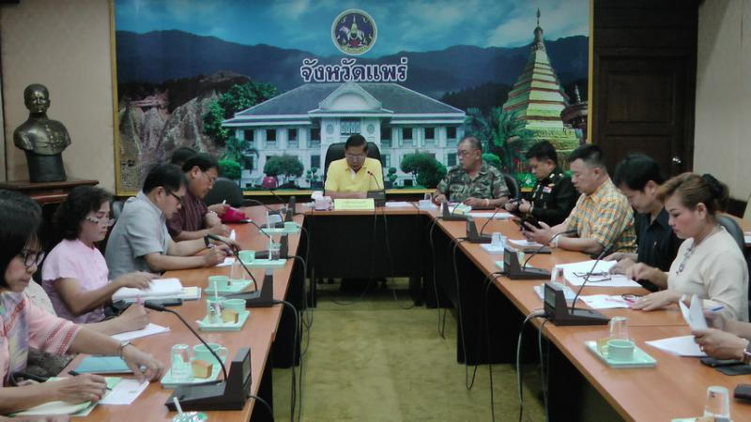
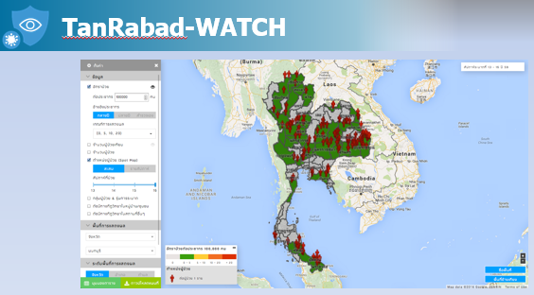
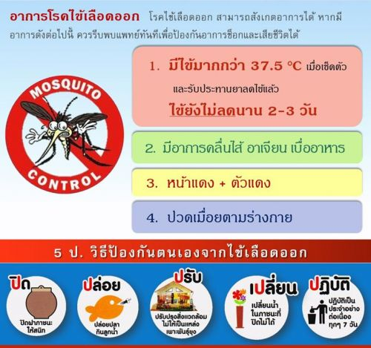
Surveillance data for disease control
Feedback to communities to raise awareness and community participation
Inform local government to accelerate outbreak response and resource mobilization
Report to executives for decision making
Alert the disease control network
Inform public about disease situations and personal protection
APEC Conference on Severe Dengue Prevention and Strategies for Reducing Disease Burden, Tainan, 3rd May 2018

Slide 18
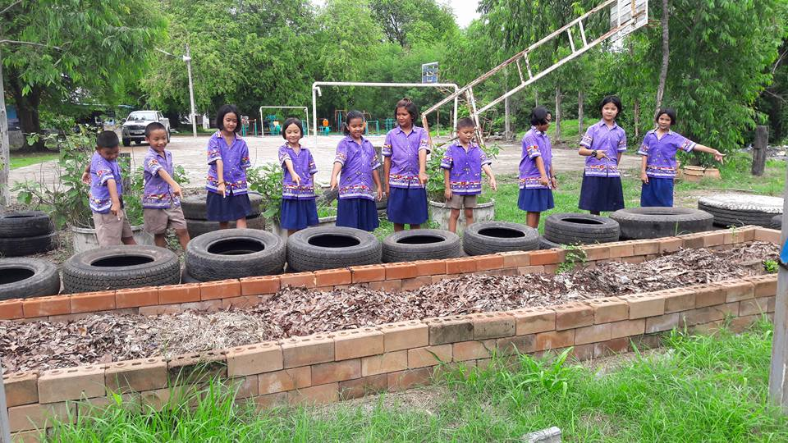
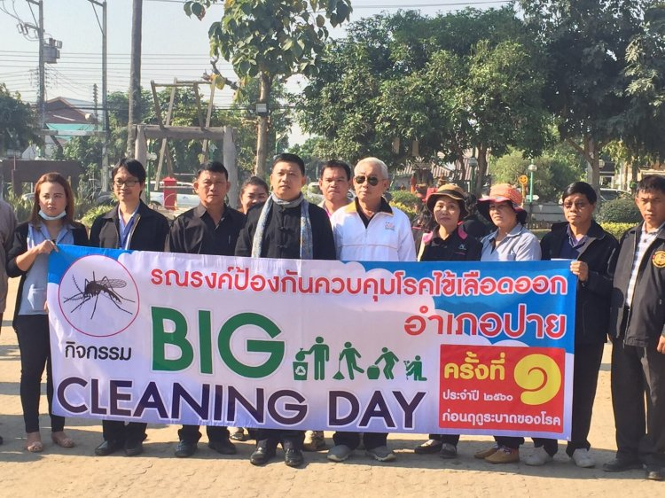
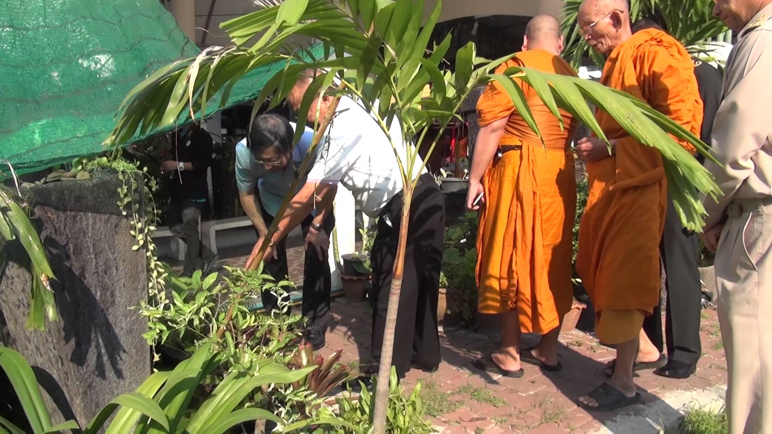

Community engagement
Schools: opening term
Tourist areas: resorts & hotels
Temples: Songkran & Buddhist lent day
Work places

Slide 19
Vector control:
Larva Index in public settings, 2017
Container index (CI) (%)
Jan
Feb
Mar
Apr
May
Jun
Jul
Aug
Sep
Oct
Nov
Dec
Temple
School
Hospital
Factory
Hotel / resort
APEC Conference on Severe Dengue Prevention and Strategies for Reducing Disease Burden, Tainan, 3rd May 2018

Slide 20
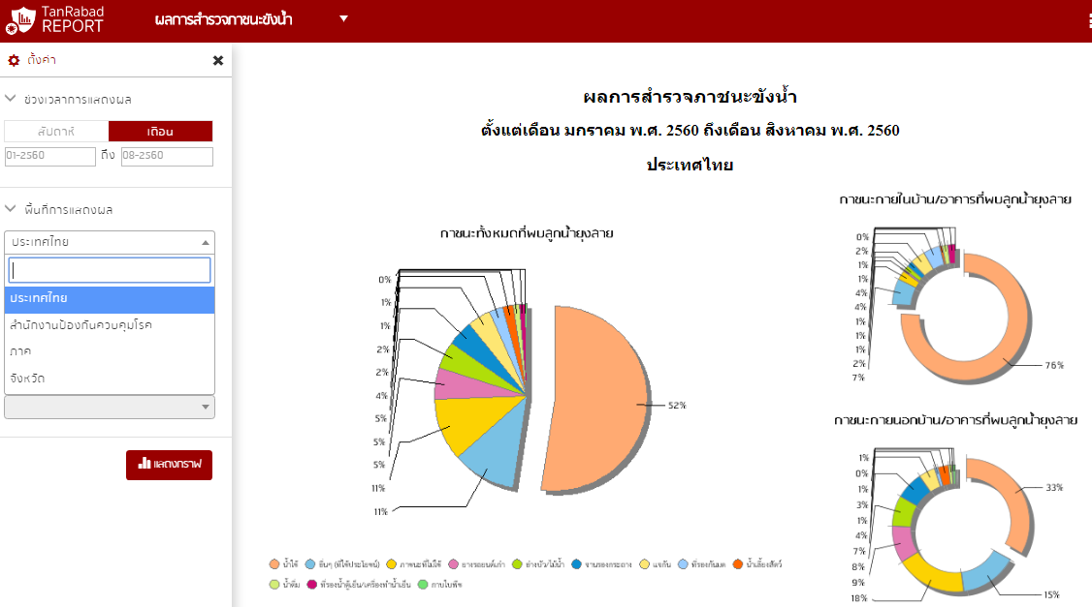
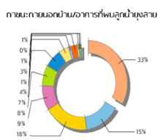
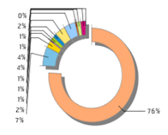
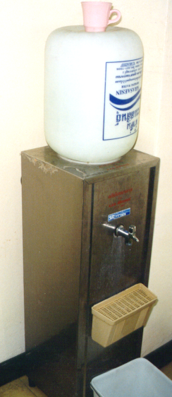
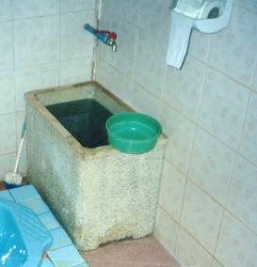
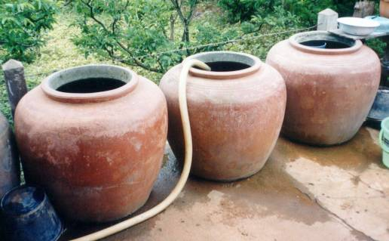
Key containers of Aedes breeding sites
www.tanrabad.org
Level of data analysis
Type of containers found Aedes larvae
2017, Thailand
Outdoor containers (39.8%)
Indoor containers (60.2%)

Slide 21
Conclusion and Challenges
Dengue is an endemic disease in Thailand
All serotypes have been circulating
More adult dengue cases and deaths
Vector control is ineffective in urban areas due to limitation of community engagement
Several regulations have been developed but not seriously enforced
APEC Conference on Severe Dengue Prevention and Strategies for Reducing Disease Burden, Tainan, 3rd May 2018

Slide 22
Thank you very much

